Slide 1
Appendix A
Osteology
Jason M. Organ, Ph.D.
Jessica N. Byram, Ph.D.
CC BY-NC

Slide 2
Learning Objectives
Identify anatomical position and anatomical planes
Use directional terms
Describe skeletal form and functions
Identify cells used in bone formation and remodeling
Identify all bones of the human skeleton
Identify features relevant to estimating age
Compare human and chimpanzee skeletal anatomy

Slide 3
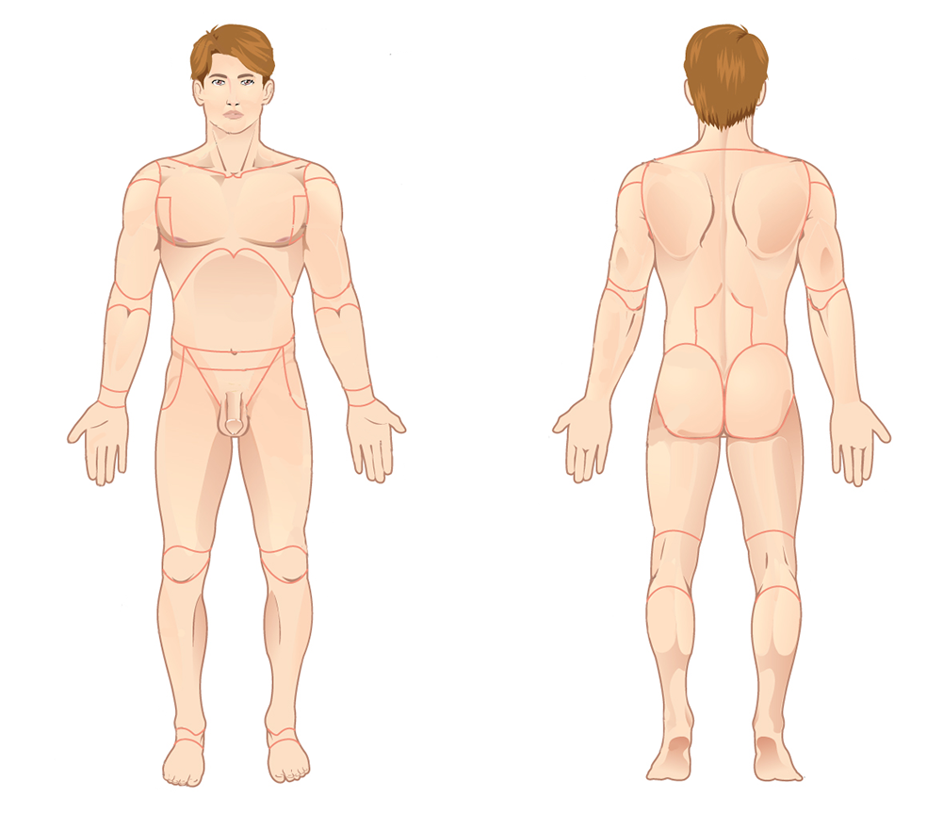
Anatomical Terminology
Anatomical position

Slide 4
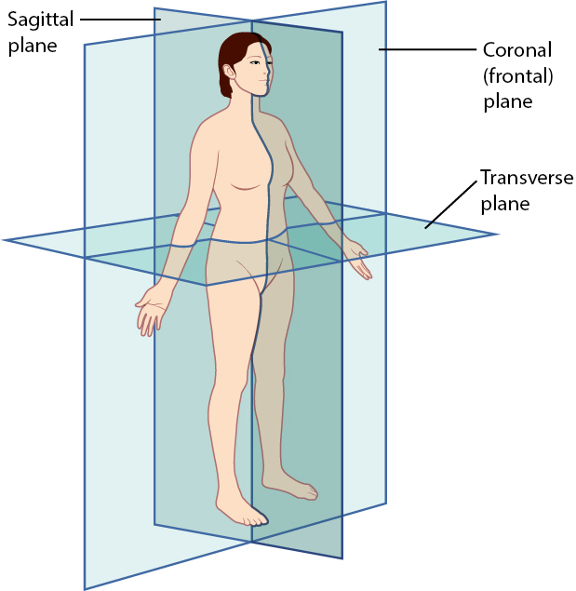
Anatomical Terminology: Anatomical Planes
Coronal (frontal) planes
Transverse planes
Sagittal planes
Midsagittal plane (median plane) follows the midline
Text
More text
More text

Slide 5
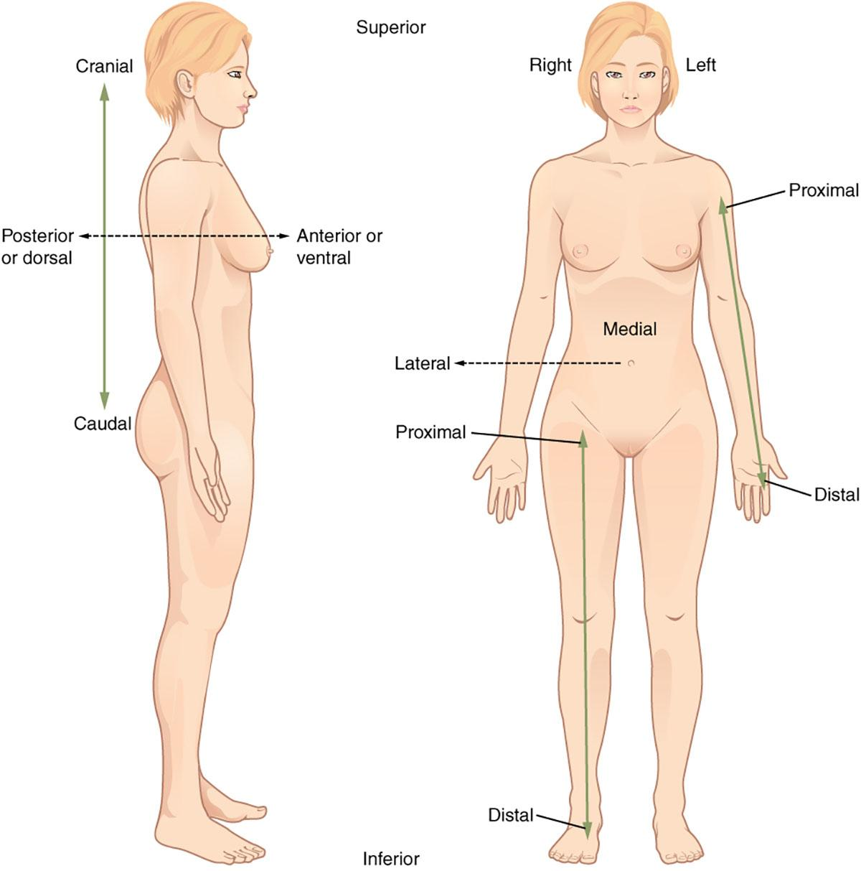
Anatomical Terminology: Directional Terms
Anterior (ventral)
Posterior (dorsal)
Medial
Lateral
Proximal
Distal
Superior (cranial)
Inferior (caudal)

Slide 6
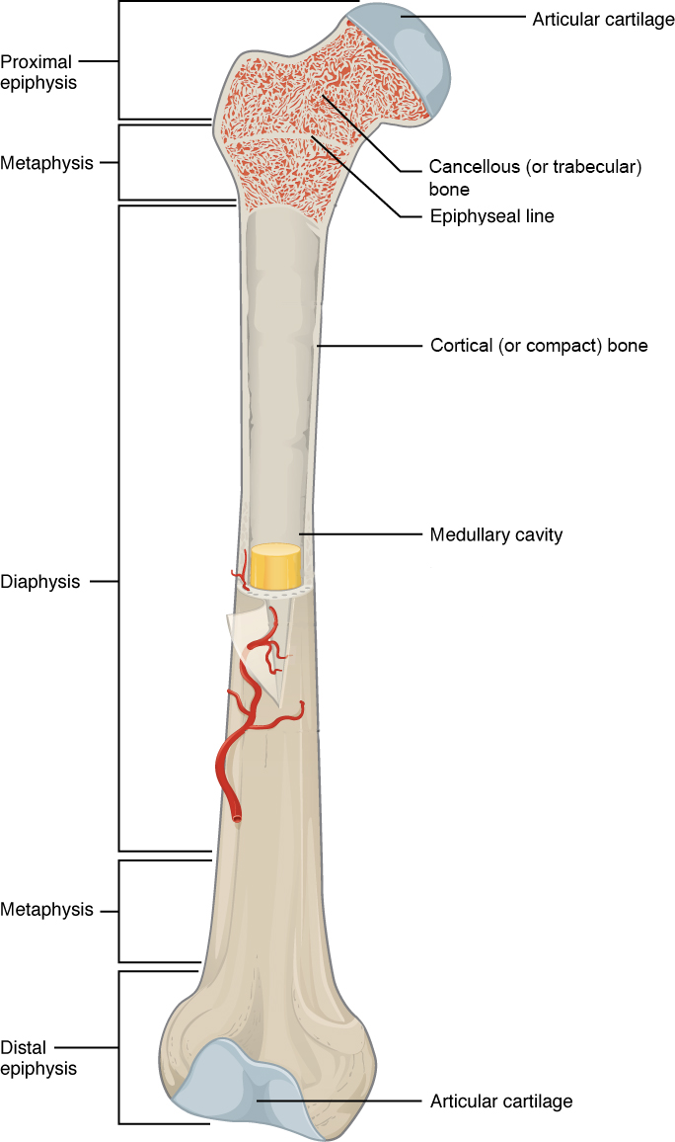
Skeletal Form and Function
Cortical (compact) bone
Cancellous (trabecular) bone
Diaphysis
Medullary cavity
Epiphysis
Metaphysis

Slide 7
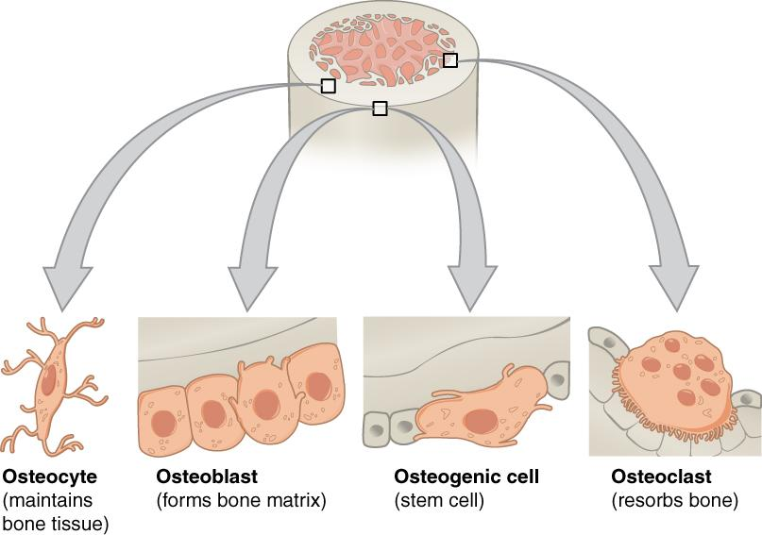
Skeletal Form and Function
Osteocytes
Osteoclast cells
Osteoblast cells
Osteogenic cells

Slide 8
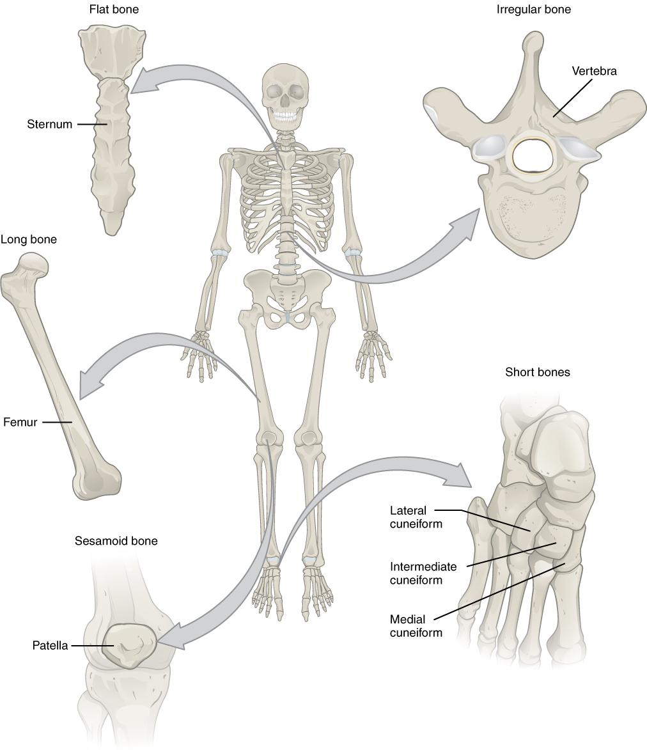
Skeletal Form and Function
Bone classification
Long
Short
Flat
Sesamoid
Irregular

Slide 9
Skeletal Form and Function
Metabolic functions
Maintain mineral (i.e., calcium) homeostasis
Production of red and white blood cells
Mechanical functions
Protect internal organs
Provide support
Serve as rigid levers for movement

Slide 10
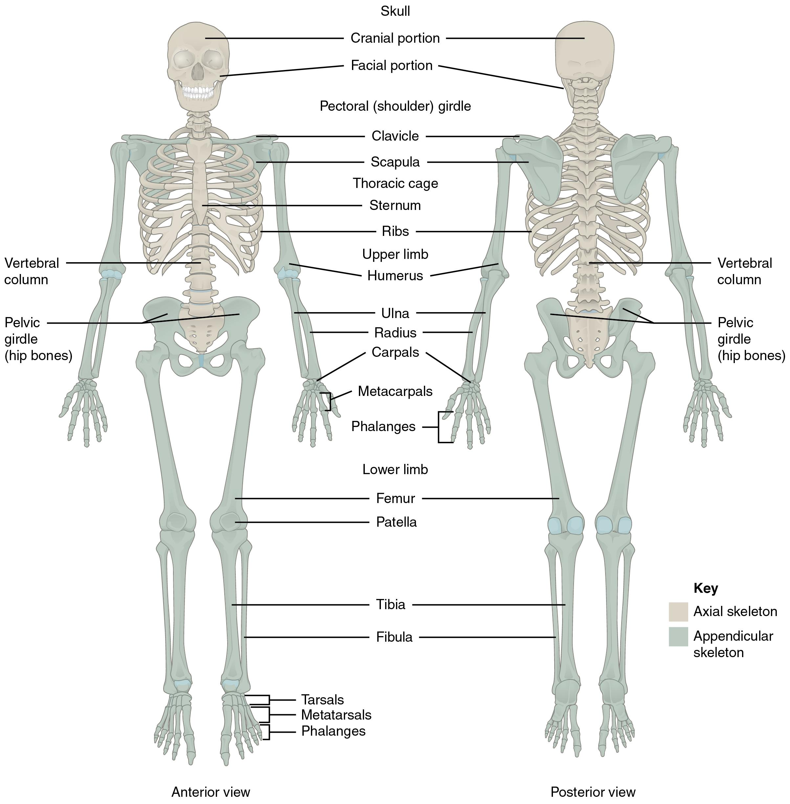
Human Skeletal System
Axial skeleton
Appendicular skeleton

Slide 11
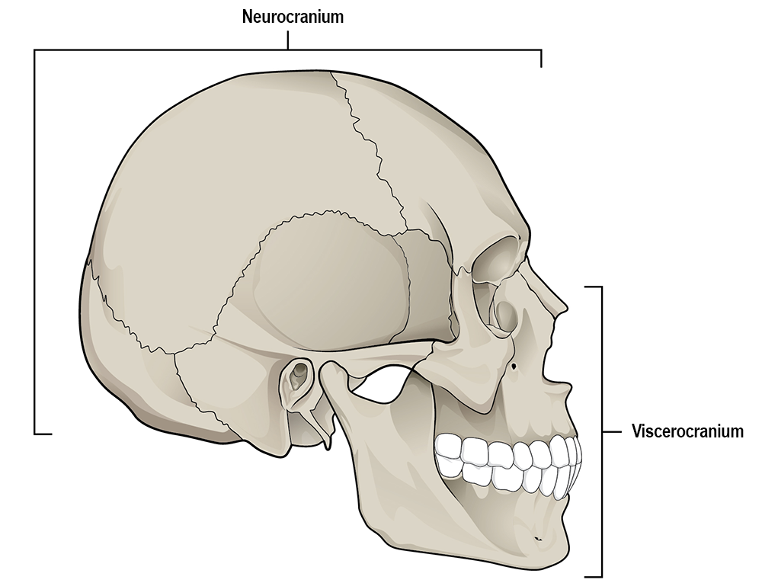
Axial Skeleton: Skull
Cranium
Mandible
Neurocranium (cranial vault)
Viscerocranium (facial skeleton)

Slide 12
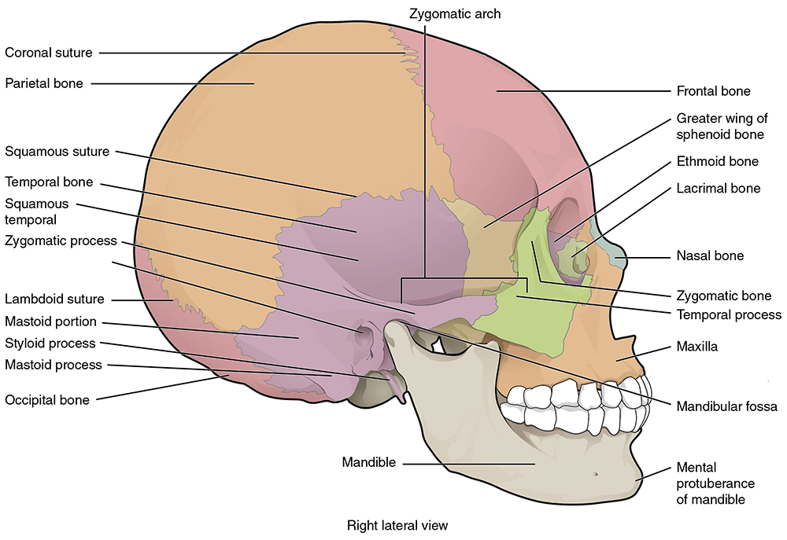
Axial Skeleton: Skull
Bones of the neurocranium
Frontal
Parietal
Temporal

Slide 13
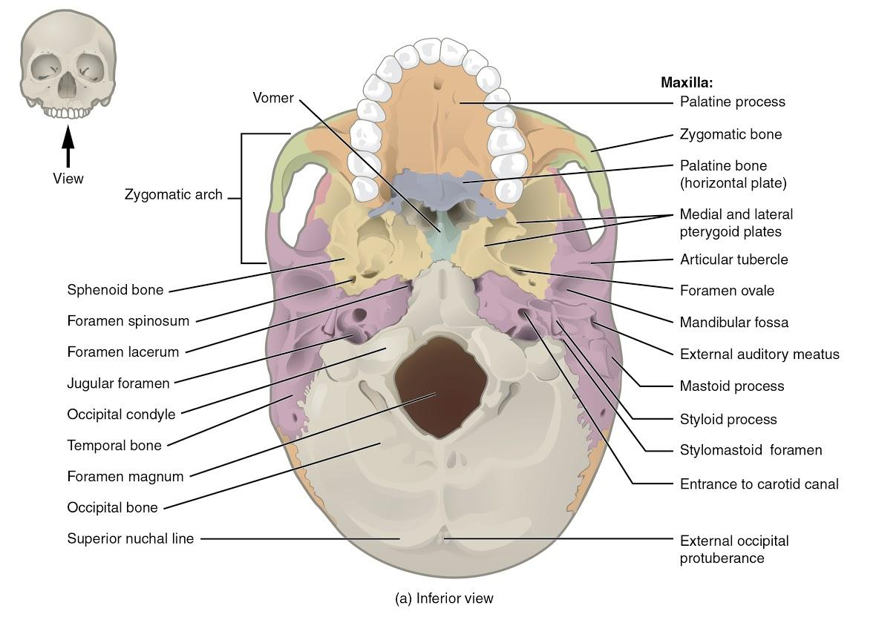
Axial Skeleton: Skull
Bones of the neurocranium
Frontal
Parietal
Temporal
Occipital

Slide 14
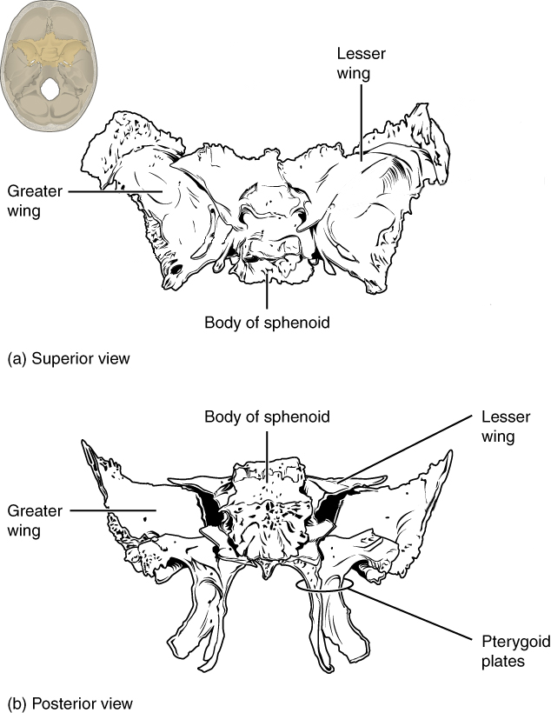
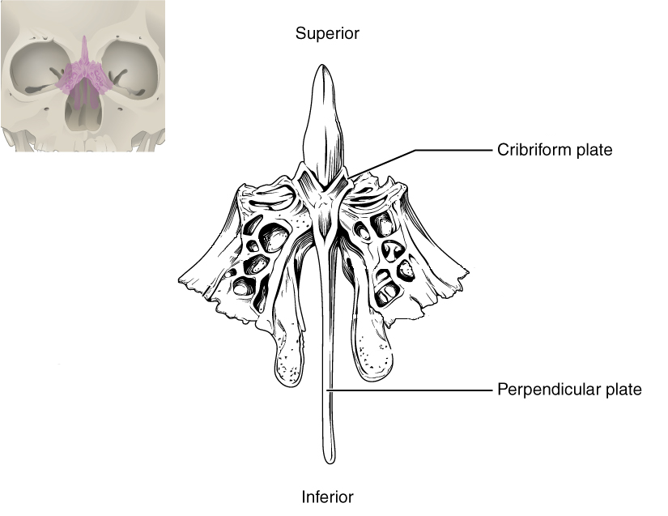
Axial Skeleton: Skull
Bones of the neurocranium
Frontal
Parietal
Temporal
Occipital
Sphenoid
Ethmoid

Slide 15
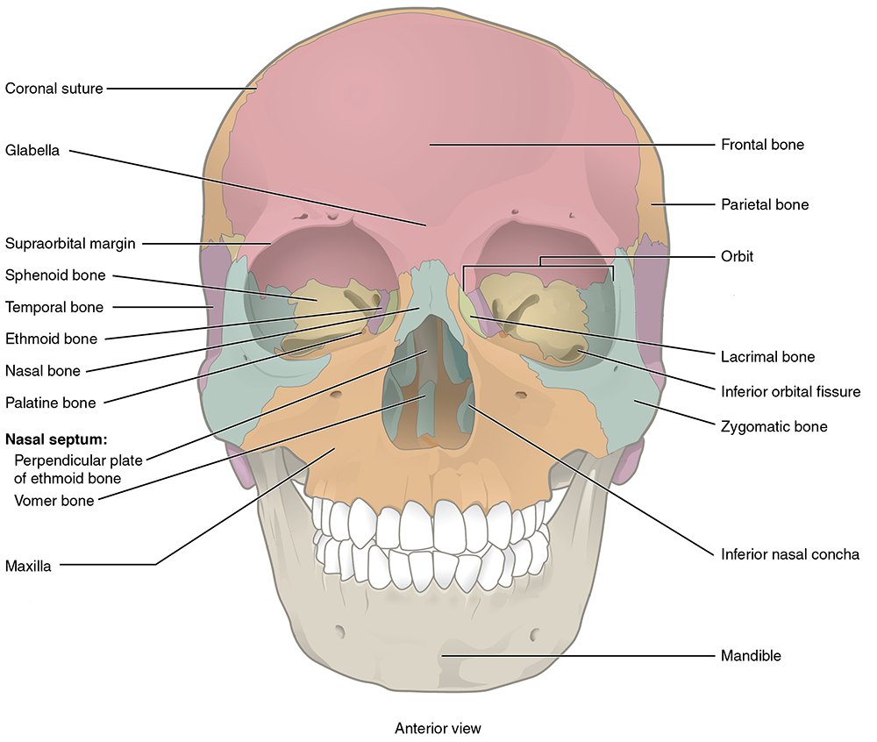
Axial Skeleton: Skull
Bones of the viscerocranium
Maxilla
Nasal
Zygomatic

Slide 16
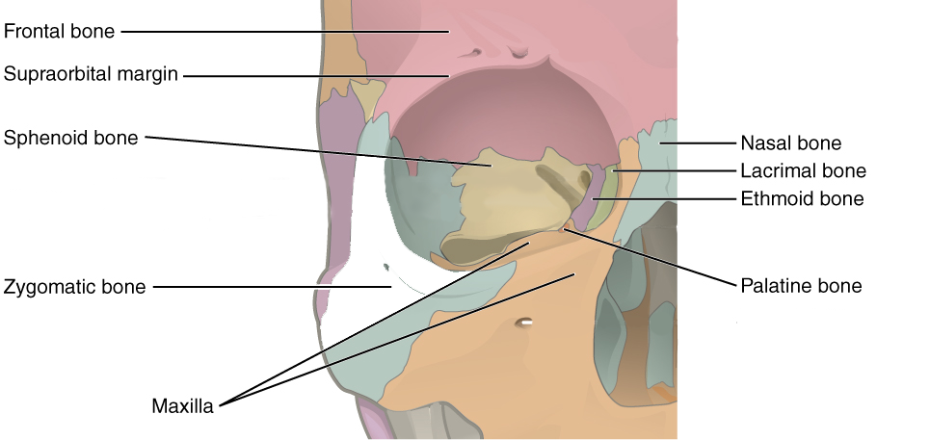
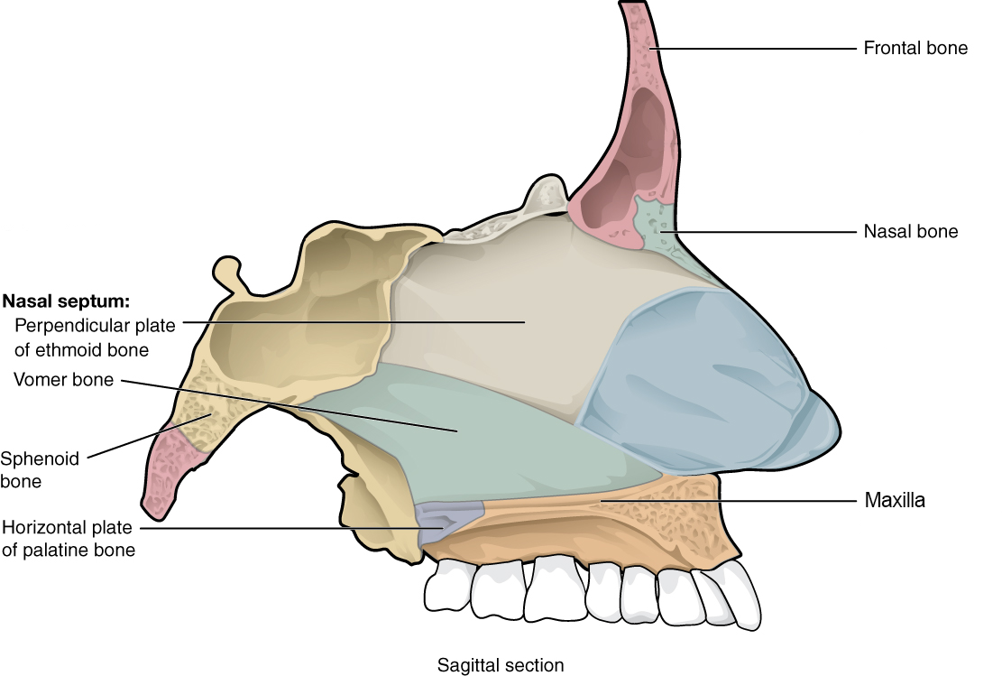
Axial Skeleton: Skull
Bones of the viscerocranium
Maxilla
Nasal
Zygomatic
Palatine
Lacrimal
Vomer
Inferior nasal concha

Slide 17
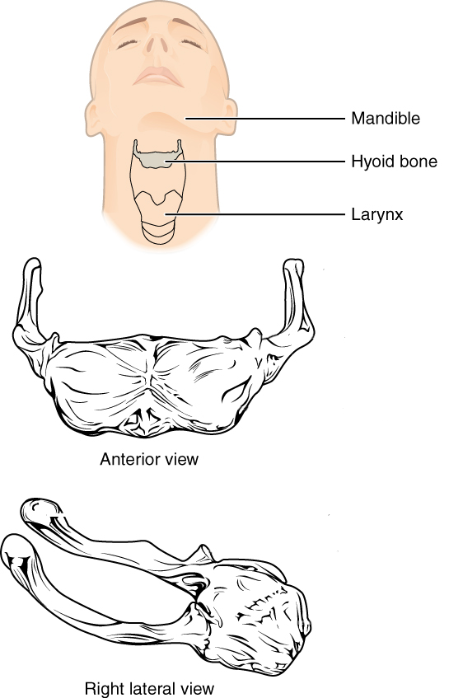
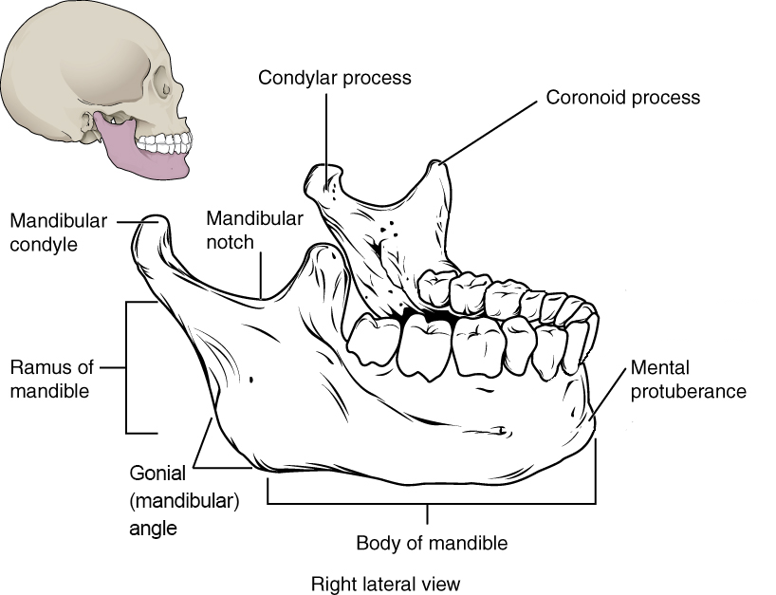
Axial Skeleton: Skull
Hyoid
Mandible
Teeth
Incisors
Canines
Premolars
Molars

Slide 18
Axial Skeleton: Vertebral Column
Cervical vertebrae
Atlas (C1)
Axis (C2)

Slide 19
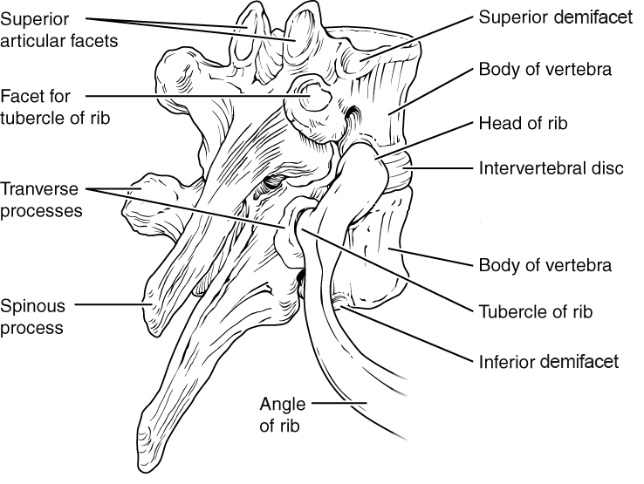
Axial Skeleton: Vertebral Column
Thoracic vertebrae

Slide 20
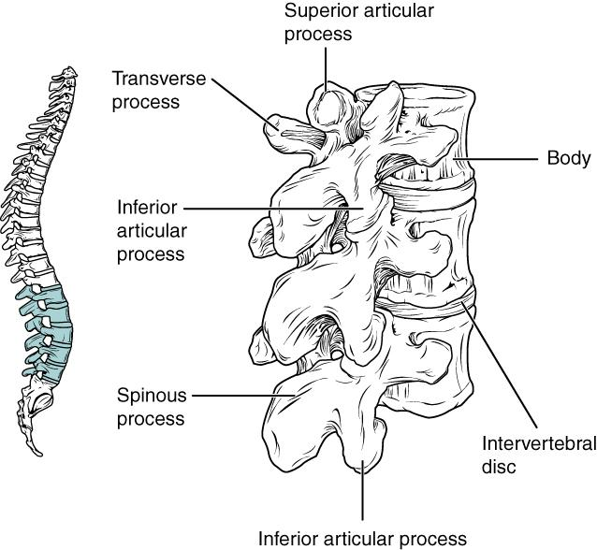
Axial Skeleton: Vertebral Column
Lumbar vertebrae

Slide 21
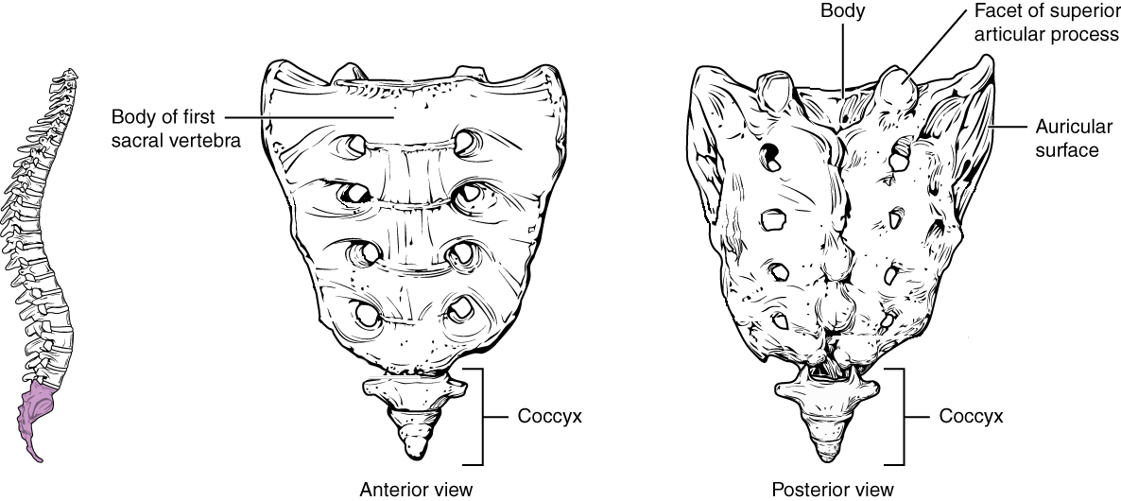
Axial Skeleton: Vertebral Column
Sacrum
Coccyx

Slide 22
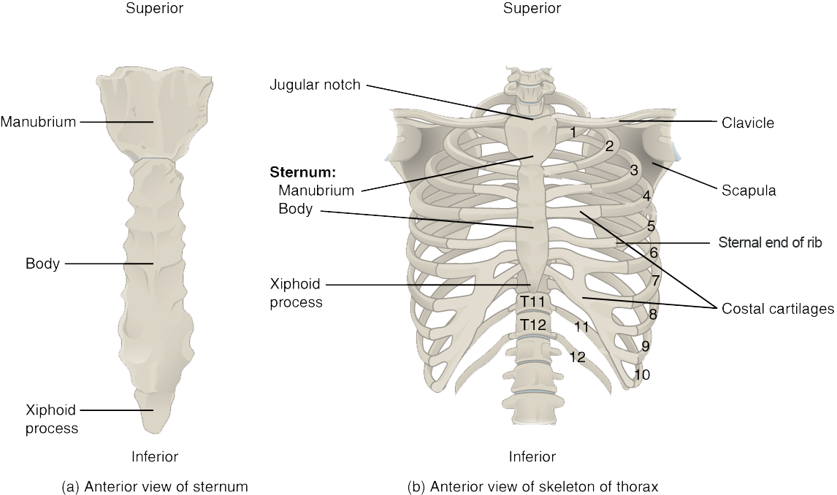
Axial Skeleton: Thoracic Cage
Sternum
Manubrium
Body
Xiphoid process
Ribs

Slide 23
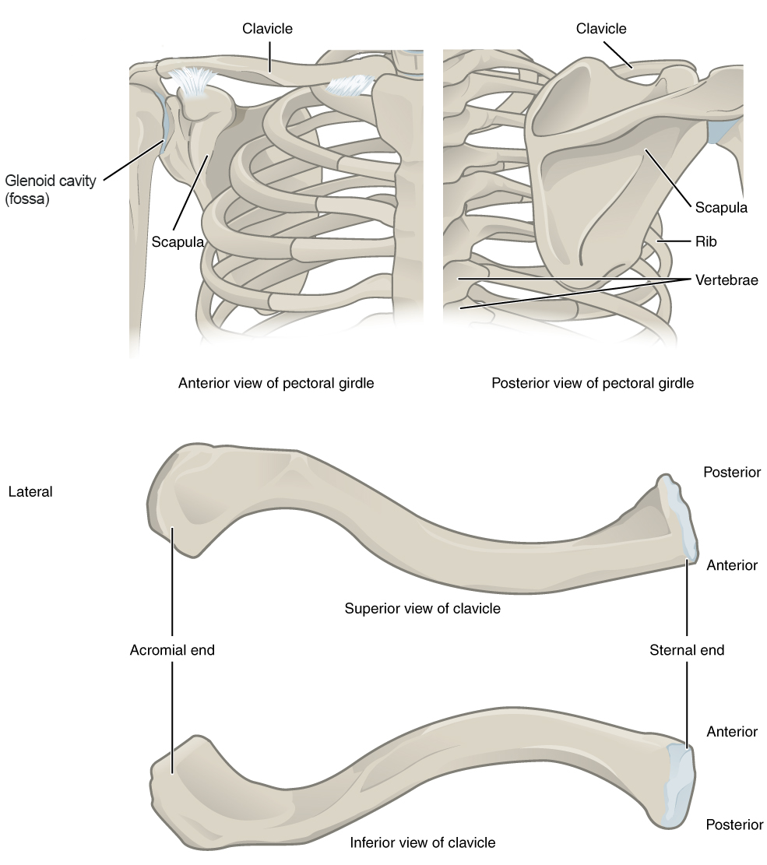
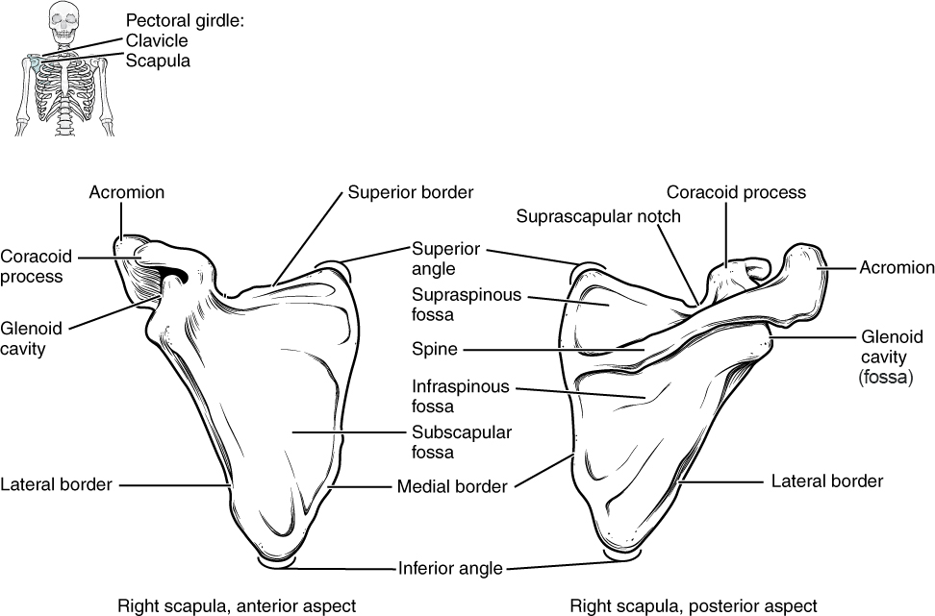
Appendicular Skeleton: Pectoral Girdle
Clavicle
Scapula
Text
More text
More text

Slide 24
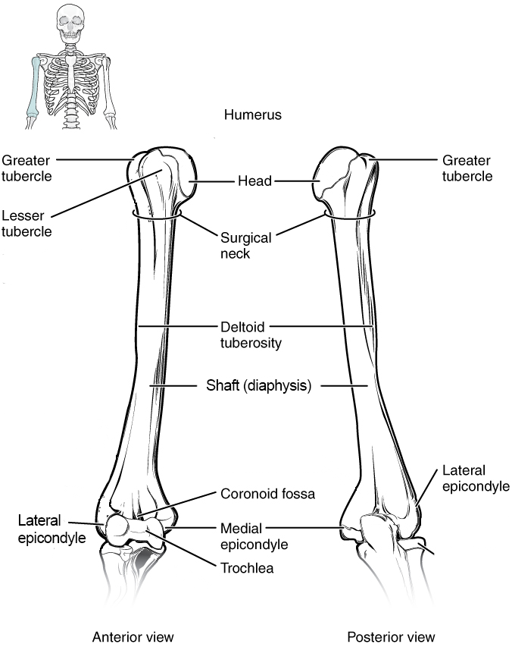
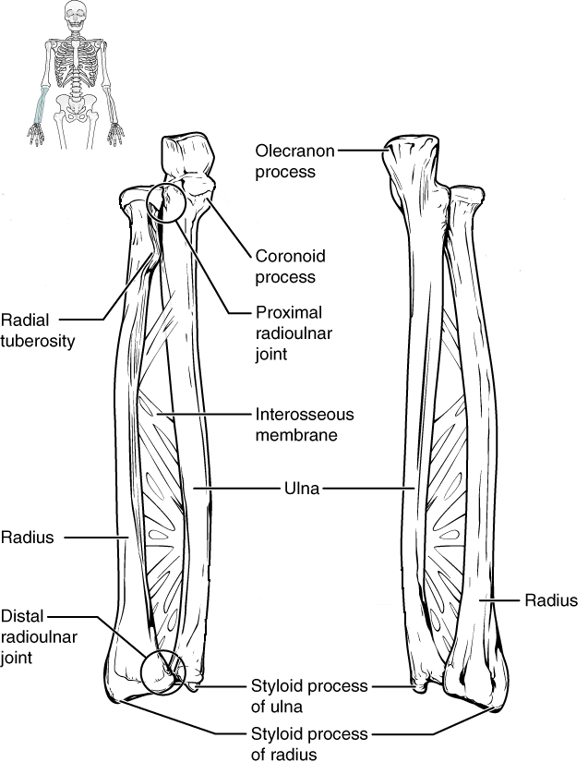
Appendicular Skeleton: Upper Limb
Humerus
Ulna
Radius
Text
More text
More text

Slide 25
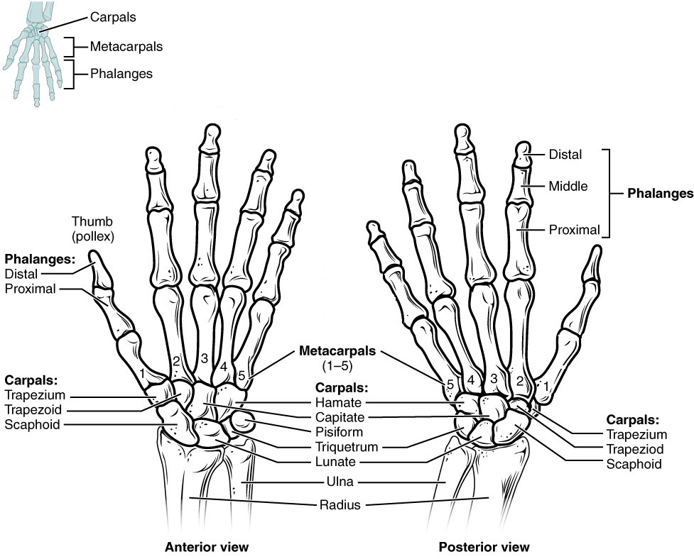
Appendicular Skeleton: Upper Limb
Carpals
Metacarpal bones
Phalanges

Slide 26
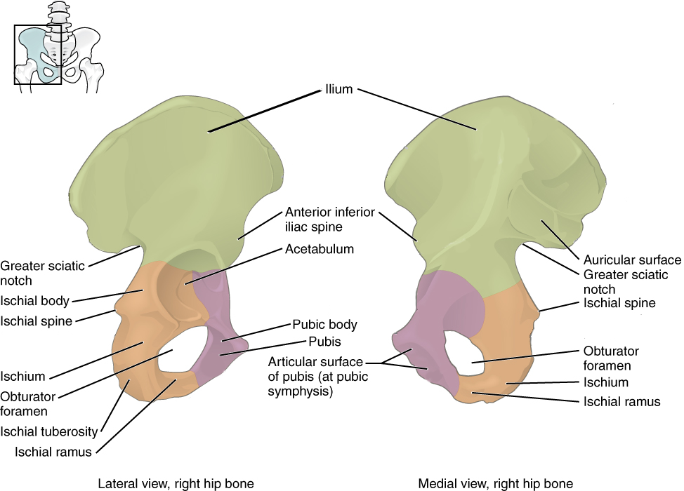
Appendicular Skeleton: Pelvic Girdle
Os coxae
Ilium
Ischium
Pubis
Ischiopubic ramus
Pubic symphysis
Subpubic concavity
Obturator foramen

Slide 27
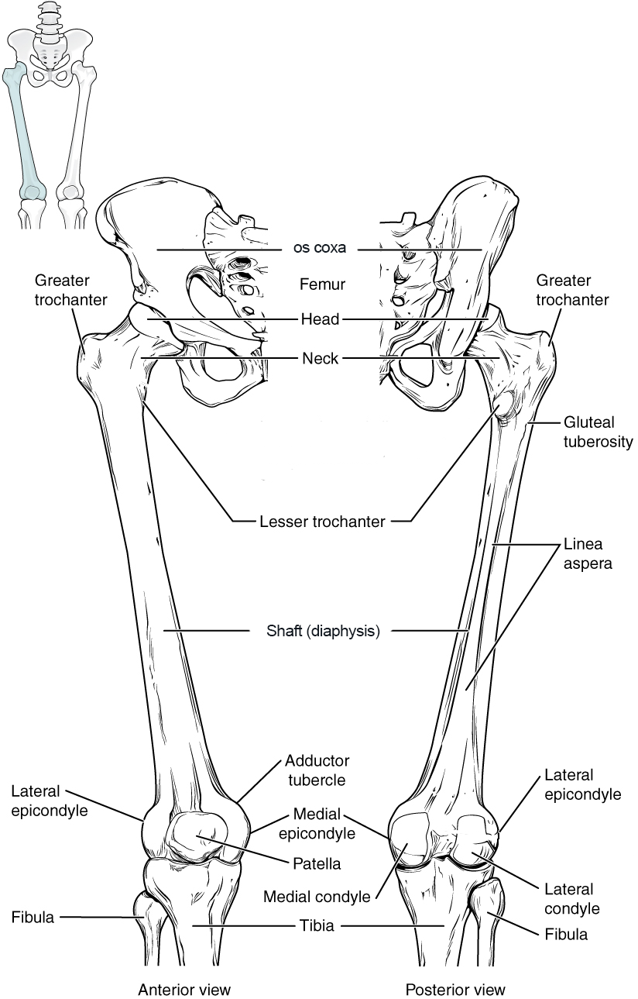
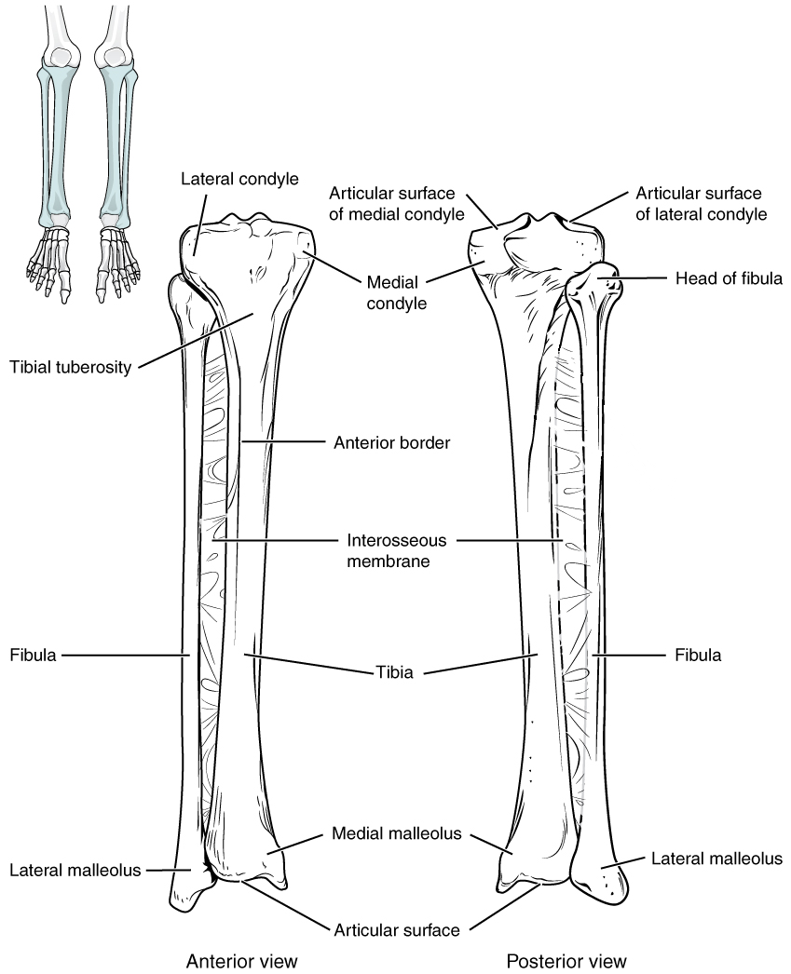
Appendicular Skeleton: Lower Limb
Femur
Tibia
Fibula

Slide 28
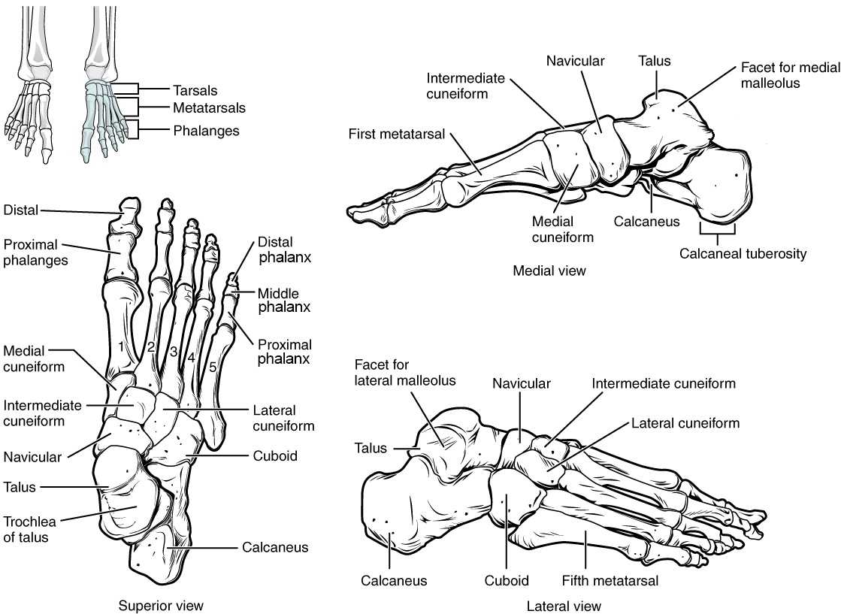
Appendicular Skeleton: Lower Limb
Tarsals
Metatarsals
Phalanges

Slide 29
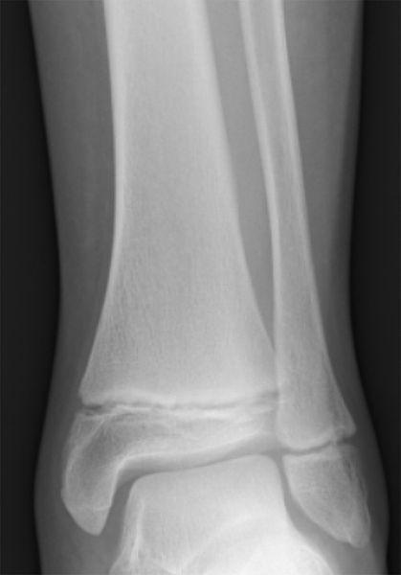
Differences in Adult and Subadult Skeletons
206 bones in adult skeleton
Each develops from multiple centers of ossification
Babies born with ~450 bones
Epiphyseal growth plate of cartilage
Dentition
Deciduous (baby)
Permanent (adult)
Useful for age estimation

Slide 30
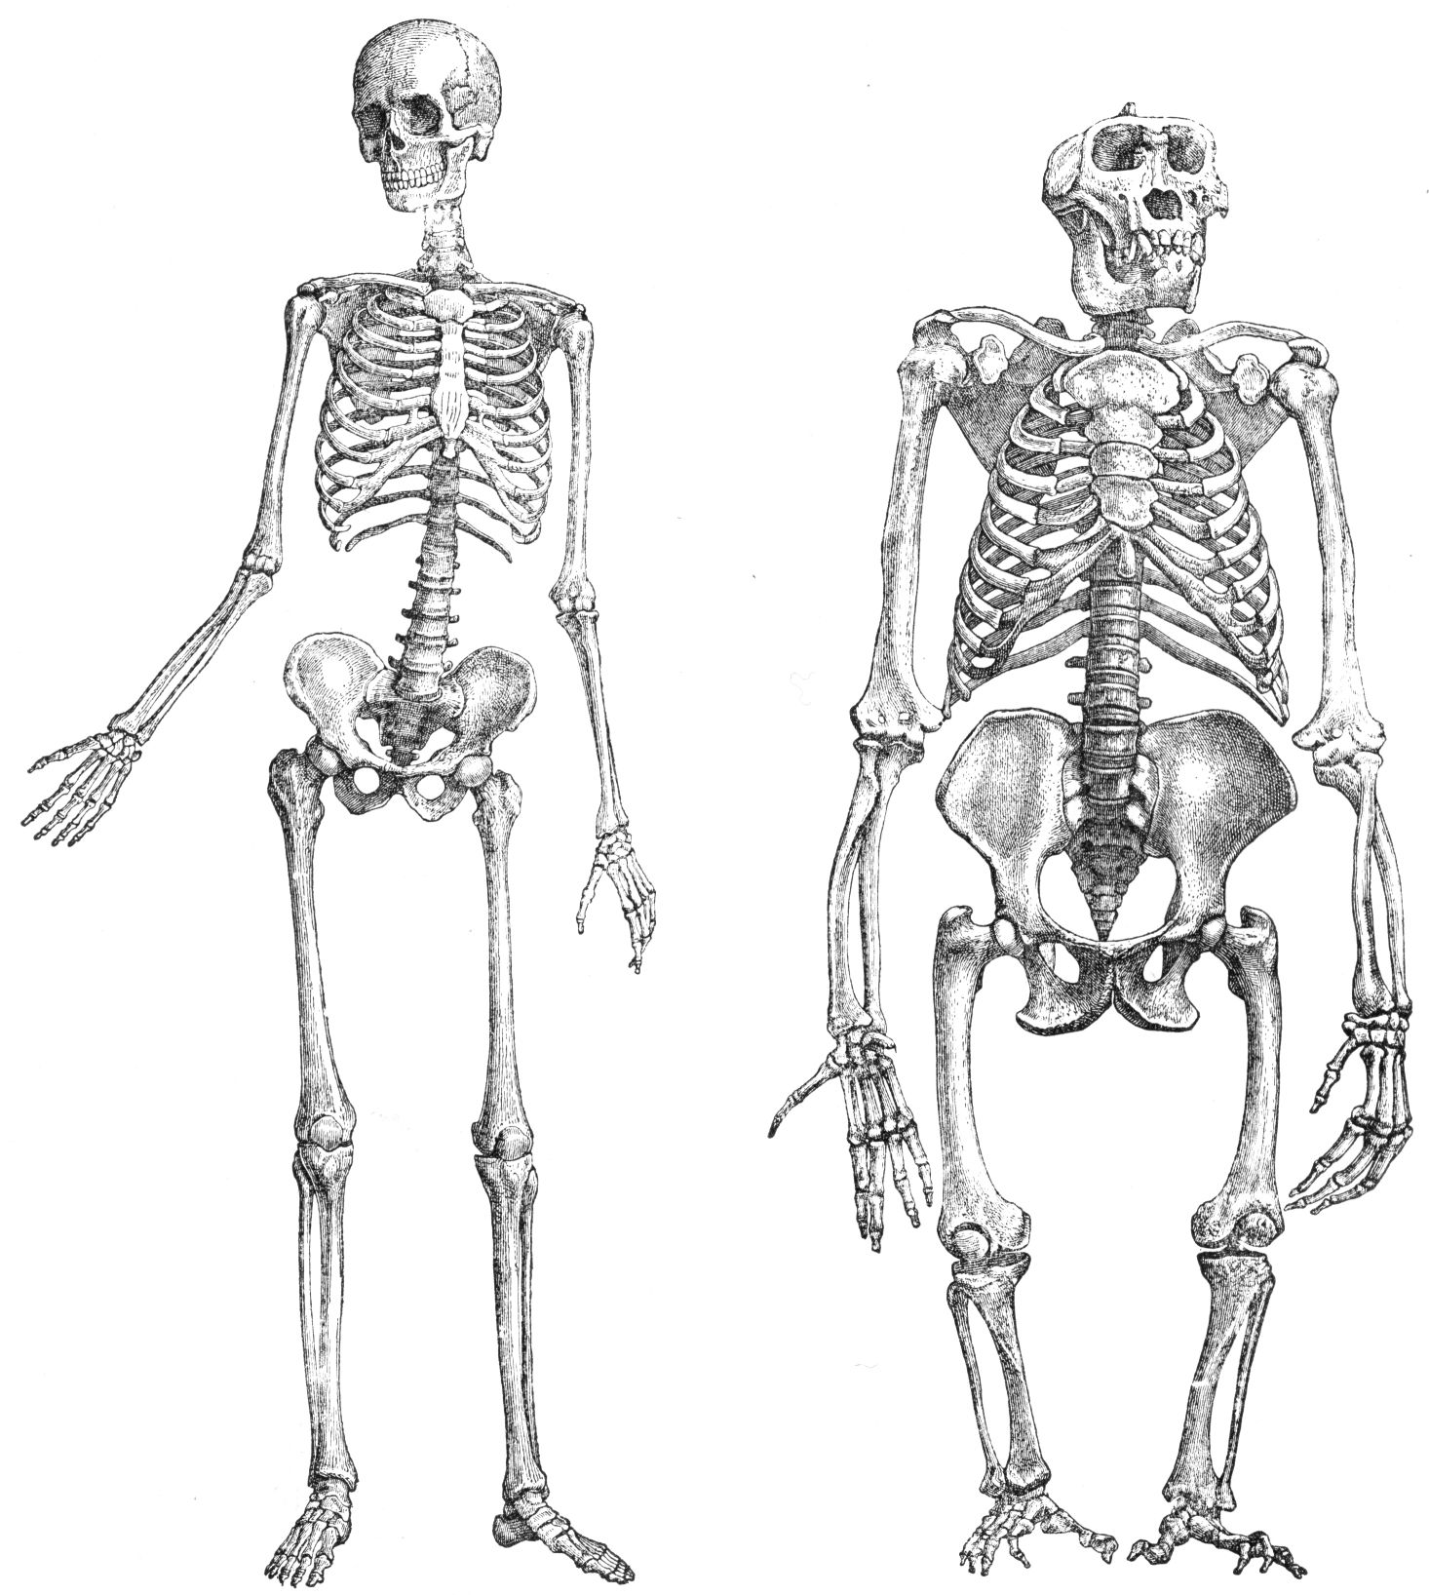
Comparative Skeletal Anatomy
Humans compared to chimpanzees (Pan troglodytes)
Adapted for bipedal locomotion
Anterior foramen magnum
S-curved vertebral column
Pelvic girdle
Ilium flares out laterally
Gluteus medius and minimus are hip abductors (vs. hip extensors)

Slide 31
Comparative Skeletal Anatomy
Adapted for bipedal locomotion
Angle of femoral diaphysis more oblique
Oversize hip and knee joints
Phalanges less curved
Convergent big toe

Slide 32
Attributions
Slide # | Figure # | Attribution
3 | A.1 | Regions of the Human Body (Anatomy & Physiology, Figure 1.12) by OpenStax has been modified (labels removed) and is used under a CC BY 4.0 License.
4 | A.2 | Planes of the Body (Anatomy & Physiology, Figure 1.14) by OpenStax has been modified (some labels modified) and is used under a CC BY 4.0 License.
5 | A.3 | Directional Terms Applied to the Human Body (Anatomy & Physiology, Figure 1.13) by OpenStax is used under a CC BY 4.0 License.
6 | A.4 | Anatomy of a Long Bone (Anatomy & Physiology, Figure 6.7) by OpenStax has been modified (some labels modified or removed) and is used under a CC BY 4.0 License.
7 | A.5 | Bone Cells (Anatomy & Physiology, Figure 6.11) by OpenStax is used under a CC BY 4.0 License.
8 | A.6 | Classifications of Bones (Anatomy & Physiology, Figure 6.6) by OpenStax is used under a CC BY 4.0 License.
10 | A.10 | Axial and Appendicular Skeleton (Anatomy & Physiology, Figure 7.2) by OpenStax is used under a CC BY 4.0 License.
11 | A.11 | Parts of the Skull (Anatomy & Physiology, Figure 7.3) by OpenStax has been modified (some labels modified or removed) and is used under a CC BY 4.0 License.
12 | A.13 | Lateral View of Skull (Anatomy & Physiology, Figure 7.5) by OpenStax has been modified (some labels removed) and is used under a CC BY 4.0 License.
13 | A.15 cropped | External and Internal Views of Base of Skull (Anatomy & Physiology, Figure 7.8) by OpenStax has been modified (some labels modified or removed) and is used under a CC BY 4.0 License.

Slide 33
Attributions
Slide # | Figure # | Attribution
14 | A.17 | Ethmoid Bone (Anatomy & Physiology, Figure 7.12) by OpenStax has been modified (some labels removed) and is used under a CC BY 4.0 License.
14 | A.16 | Sphenoid Bone (Anatomy & Physiology, Figure 7.10) by OpenStax has been modified (some labels removed) and is used under a CC BY 4.0 License.
15 | A.12 | Anterior View of Skull (Anatomy & Physiology, Figure 7.4) by OpenStax has been modified (some labels removed) and is used under a CC BY 4.0 License.
16 | A.19 | Bones of the Orbit (Anatomy & Physiology, Figure 7.16) by OpenStax has been modified (some labels removed) and is used under a CC BY 4.0 License.
16 | A.20 | Nasal Septum (Anatomy & Physiology, Figure 7.17) by OpenStax has been modified (some labels modified or removed) and is used under a CC BY 4.0 License.
17 | A.22 | Hyoid Bone (Anatomy & Physiology, Figure 7.19) by OpenStax has been modified (some labels removed) and is used under a CC BY 4.0 License.
17 | A.23 | Isolated Mandible (Anatomy & Physiology, Figure 7.15) by OpenStax has been modified (some labels modified or removed) and is used under a CC BY 4.0 License.
18 | A.25 split in 2 | Cervical Vertebra (Anatomy & Physiology, Figure 7.25) by OpenStax has been modified (some labels removed) and is used under a CC BY 4.0 License.
19 | A.26 | Rib Articulation in Thoracic Vertebrae (Anatomy & Physiology, Figure 7.27) by OpenStax has been modified (some labels removed) and is used under a CC BY 4.0 License.

Slide 34
Attributions
Slide # | Figure # | Attribution
20 | A.27 | Lumbar Vertebrae (Anatomy & Physiology, Figure 7.28) by OpenStax is used under a CC BY 4.0 License.
21 | A.28 | Sacrum and Coccyx (Anatomy & Physiology, Figure 7.29) by OpenStax has been modified (some labels removed) and is used under a CC BY 4.0 License.
22 | A.30 | Thoracic Cage (Anatomy & Physiology, Figure 7.32) by OpenStax has been modified (some labels modified or removed) and is used under a CC BY 4.0 License.
23 | A.31 cropped | Pectoral Girdle (Anatomy & Physiology, Figure 8.3) by OpenStax has been modified (some labels modified or removed) and is used under a CC BY 4.0 License.
23 | A.32 | Scapula (Anatomy & Physiology, Figure 8.4) by OpenStax has been modified (some labels modified or removed) and is used under a CC BY 4.0 License.
24 | A.33 | Humerus and Elbow Joint (Anatomy & Physiology, Figure 8.5) by OpenStax has been modified (some labels modified or removed) and is used under a CC BY 4.0 License.
24 | A.34 | Ulna and Radius (Anatomy & Physiology, Figure 8.6) by OpenStax has been modified (some labels removed) and is used under a CC BY 4.0 License.
25 | A.35 | Bones of the Wrist and Hand (Anatomy & Physiology, Figure 8.7) by OpenStax has been modified (some labels removed) and is used under a CC BY 4.0 License.
26 | A.37 | The Hip Bone (Anatomy & Physiology, Figure 8.13) by OpenStax has been modified (some labels removed) and is used under a CC BY 4.0 License.

Slide 35
Attributions
Slide # | Figure # | Attribution
27 | A.38 | Femur and Patella (Anatomy & Physiology, Figure 8.16) by OpenStax has been modified (some labels modified or removed) and is used under a CC BY 4.0 License.
27 | A.39 | Tibia and Fibula (Anatomy & Physiology, Figure 8.18) by OpenStax has been modified (one label removed) and is used under a CC BY 4.0 License.
28 | A.40 | Bones of the Foot (Anatomy & Physiology, Figure 8.19) by OpenStax has been modified (some labels modified or removed) and is used under a CC BY 4.0 License.
29 | 15.7 | Tib fib growth plates by Gilo1969 at English Wikipedia is used under a CC BY 3.0 License.
30 & 31 | 9.5 | Skeleton of human (1) and gorilla (2), unnaturally sketched by unknown from Brehms Tierleben, Small Edition 1927 is in the public domain.

