Slide 1
Chapter 5
Meet the Living Primates
Stephanie Etting, Ph.D.
CC BY-NC

Slide 2
Learning Objectives
Distinguish primates from other mammals
Explain the relevance of studying non-human primates
Identify traits for major primate subgroups
Describe the major primate taxa

Slide 3
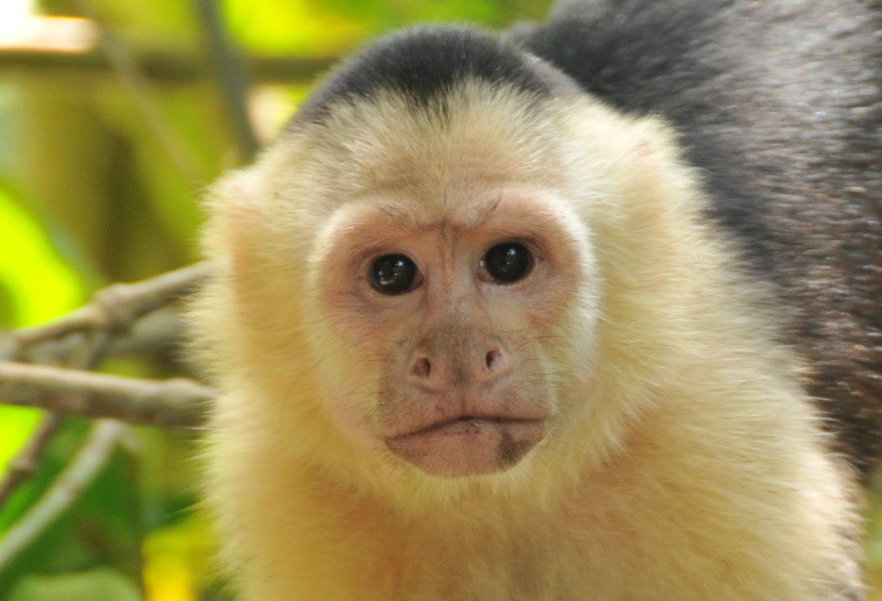
What Is A Primate?
Class Mammalia
Mammary glands
Warm-blooded
Live birth
Order Primates
Ancient (~90 million yrs)
Diverse

Slide 4
Types of Traits
Primitive: inherited from direct ancestor
Derived: more recently changed, distinguishes groups
Generalized: multi-purpose
Specialized: single purpose

Slide 5
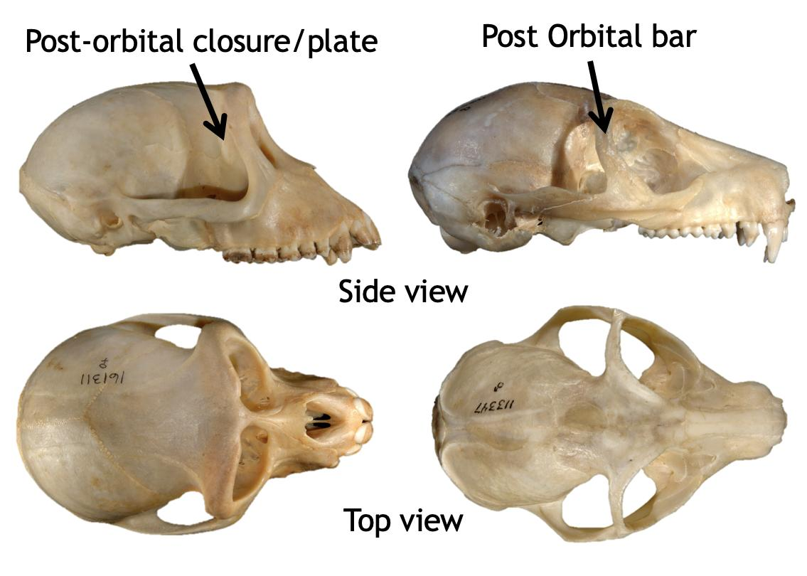
Primate Suite of Traits
Reliance on vision
Large brains
Grasping hands and feet
Extended life history
Sociality

Slide 6
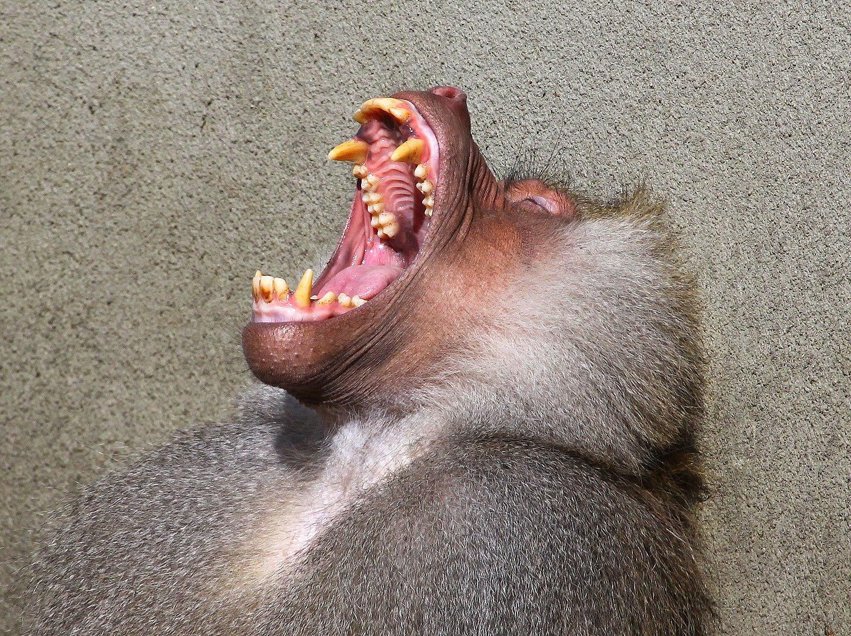
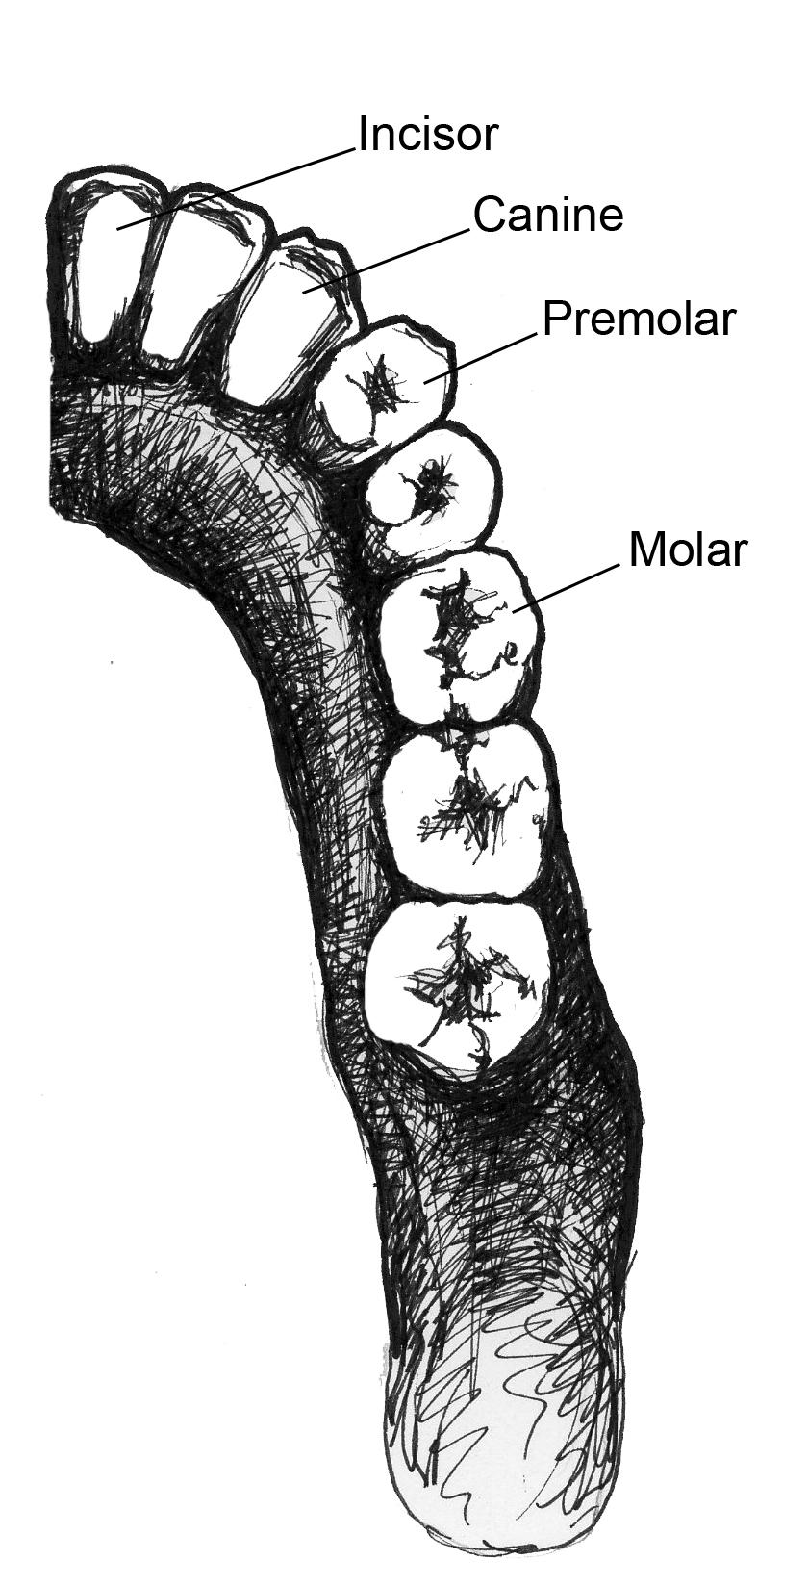
Dental Characteristics
Heterodont
Dietary adaptations
Sexually dimorphic canines
(sometimes)
Diastema
Dental formulas
2:1:3:3 (New world monkeys)
2:1:2:3 (Old world monkeys, apes, humans)

Slide 7
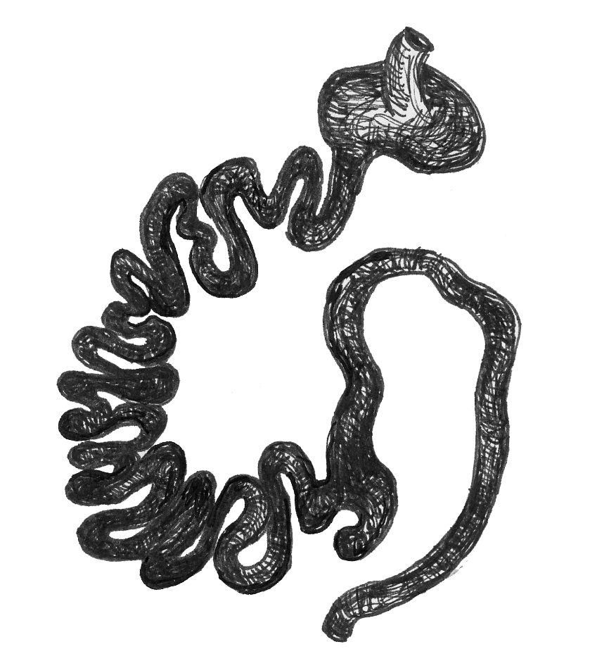
Dental Characteristics
Frugivores
Broad molars, rounded cusps
Intermediate digestive systems
Insectivores
Small molars, pointed cusps
Simple stomachs
Folivores
Broad molars, sharp cusps
Specialized digestive systems

Slide 8
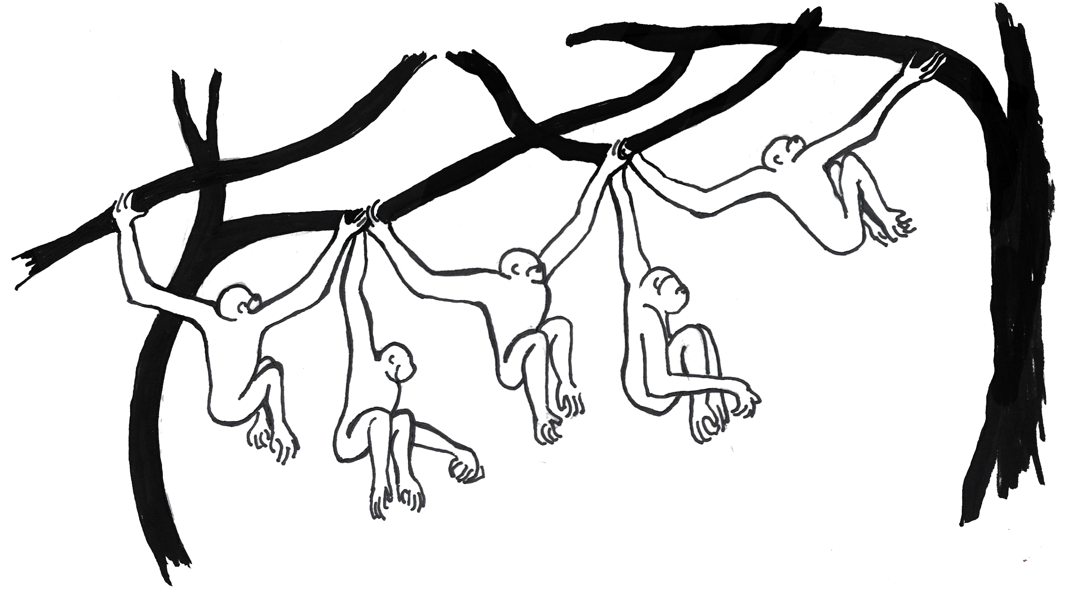
Locomotor Adaptation
Vertical clinging and leaping
Quadrupedalism
Brachiation
Bipedalism

Slide 9
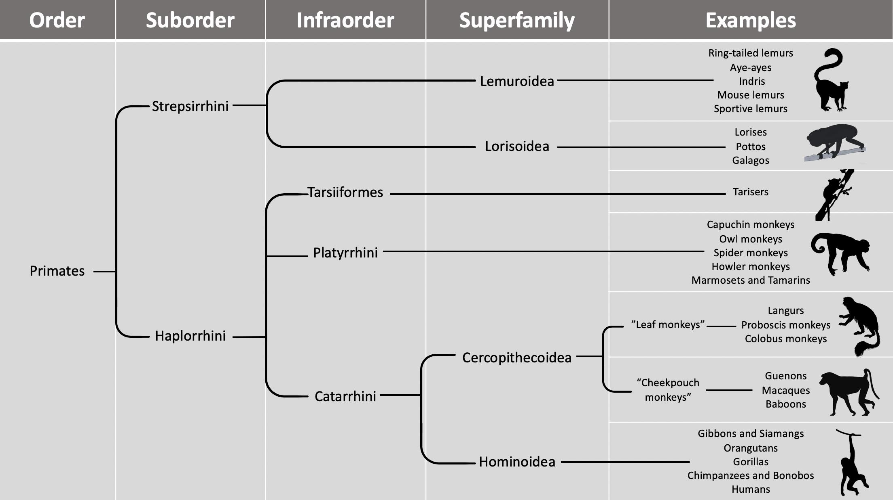
Primate Taxa

Slide 10
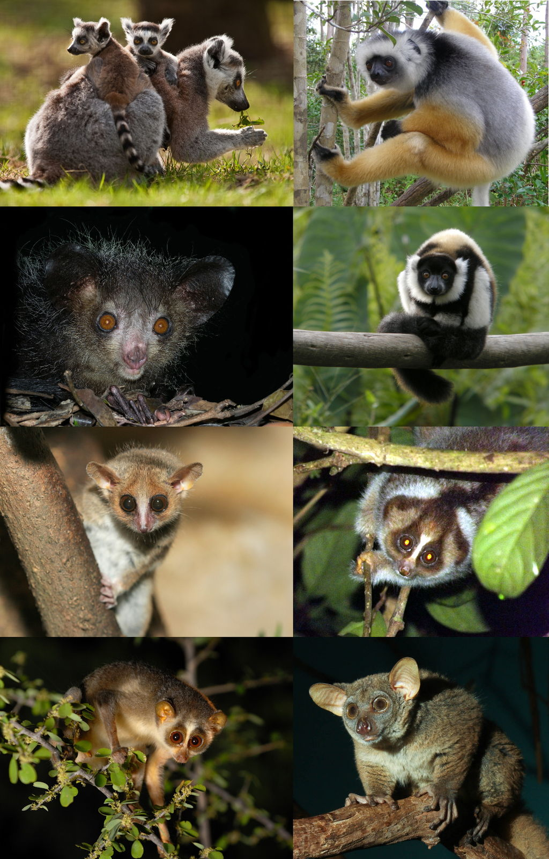
Suborder Strepsirrhini
Long snout
Wet noses
Small bodies
Solitary
Derived traits
Grooming claw, tooth comb
Two groups split 65 mya
Lemurs
Lorises, pottos, galagos

Slide 11
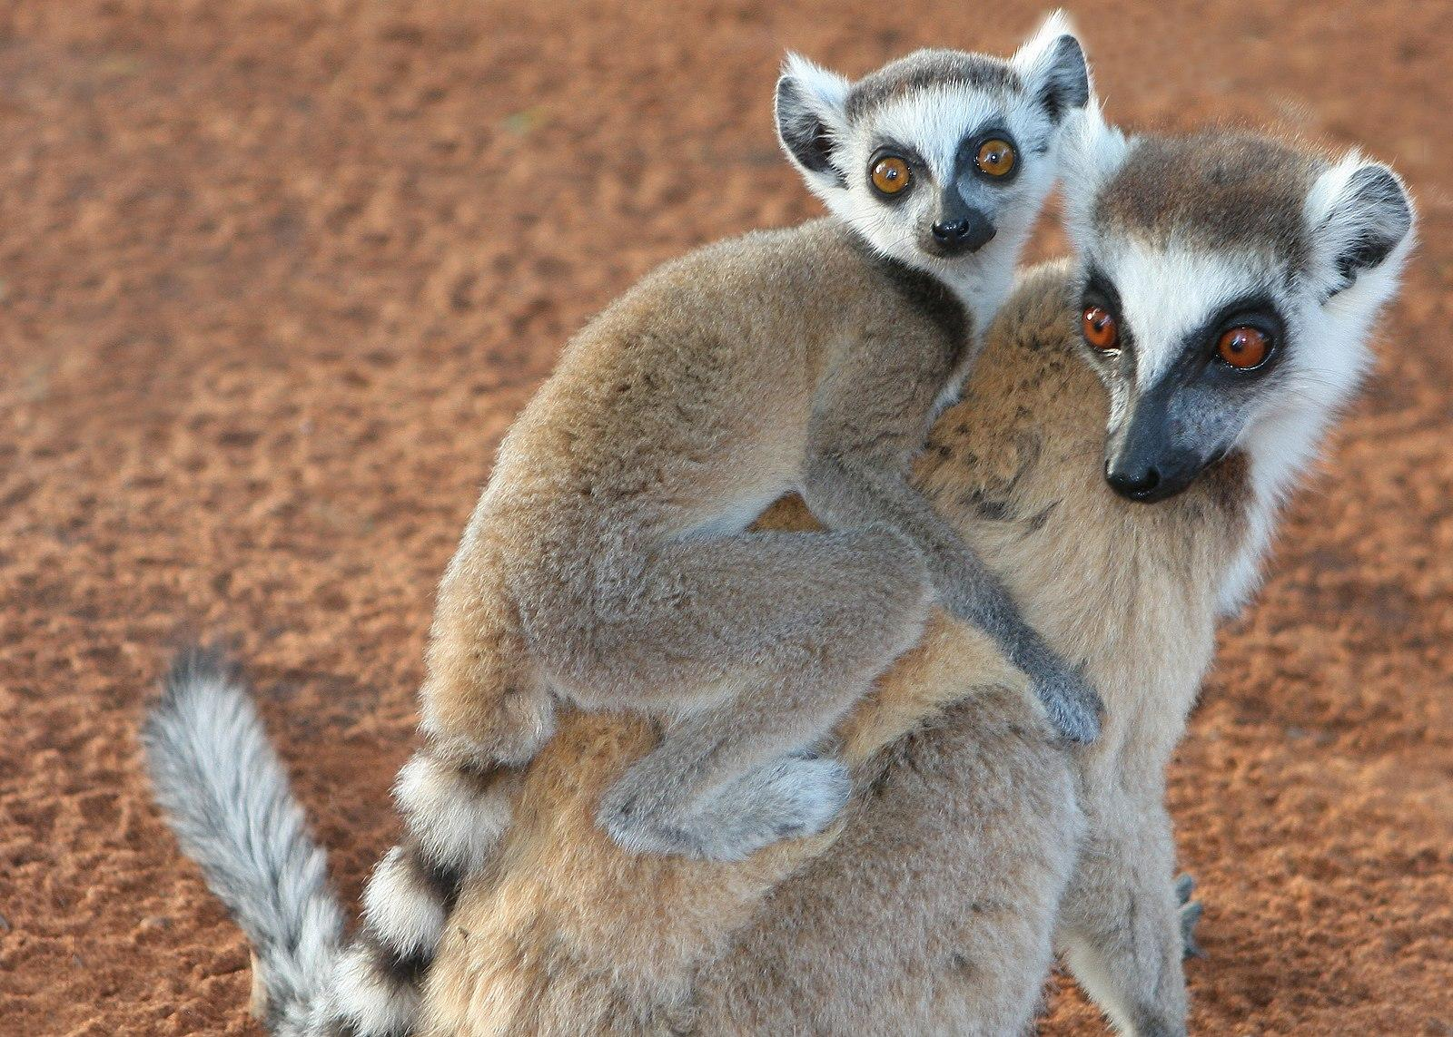
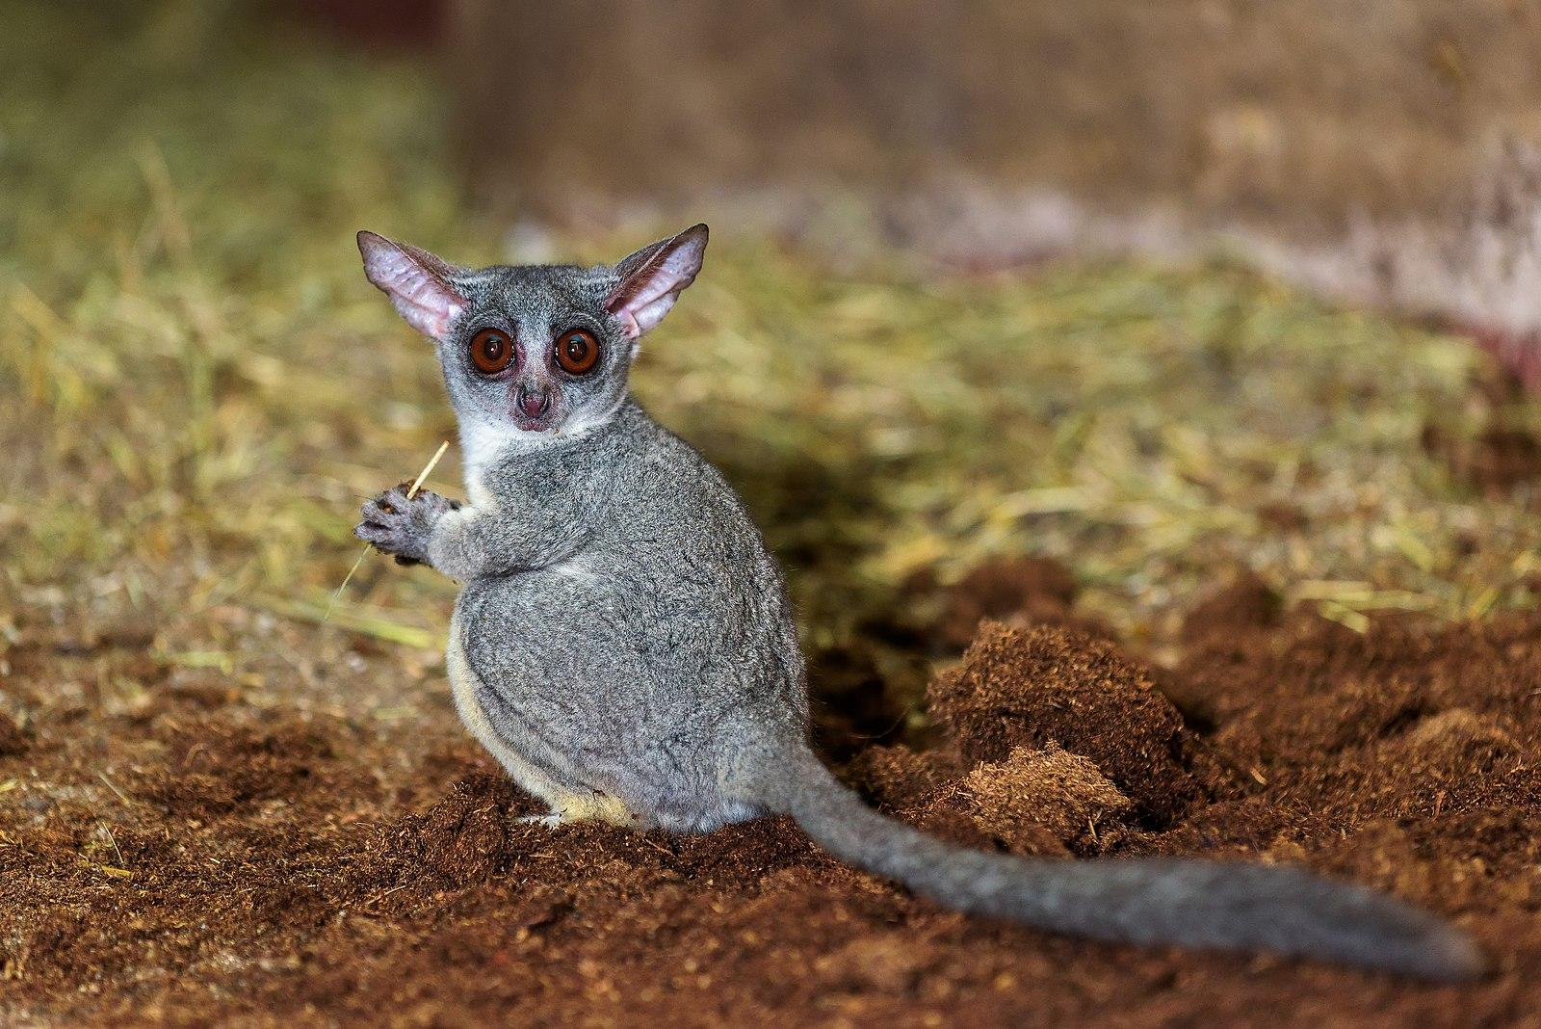
Suborder Strepsirrhini
 | Lemurs | Lorises, Pottos, Galagos
Geographic range | Madagascar | S. and S.E. Asia, Central Africa
Activity patterns | Diurnal, nocturnal or cathemeral | Nocturnal
Dietary types | Insectivore, frugivore or folivore | Insectivore, frugivore
Social groupings | Solitary, pairs, small to large groups | Solitary
Forms of locomotion | Vertical clinger leapers,quadrupedal | Slow quadrupedal climbers and active quadrupedal runners

Slide 12
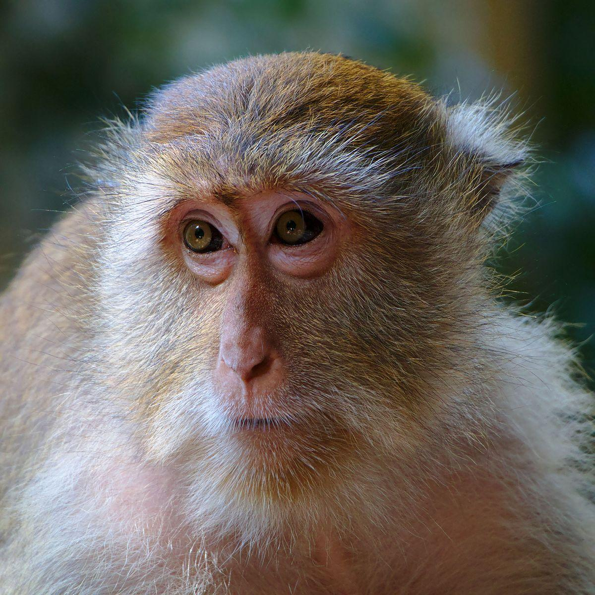
Suborder Haplorrhini
Good vision
Short, dry nose
Large brains and bodies
Broad teeth
Quadrupedal
Sexual dimorphism
Social groups
Infraorders
Tarsiiformes
Platyrrhini
Catarrhini

Slide 13
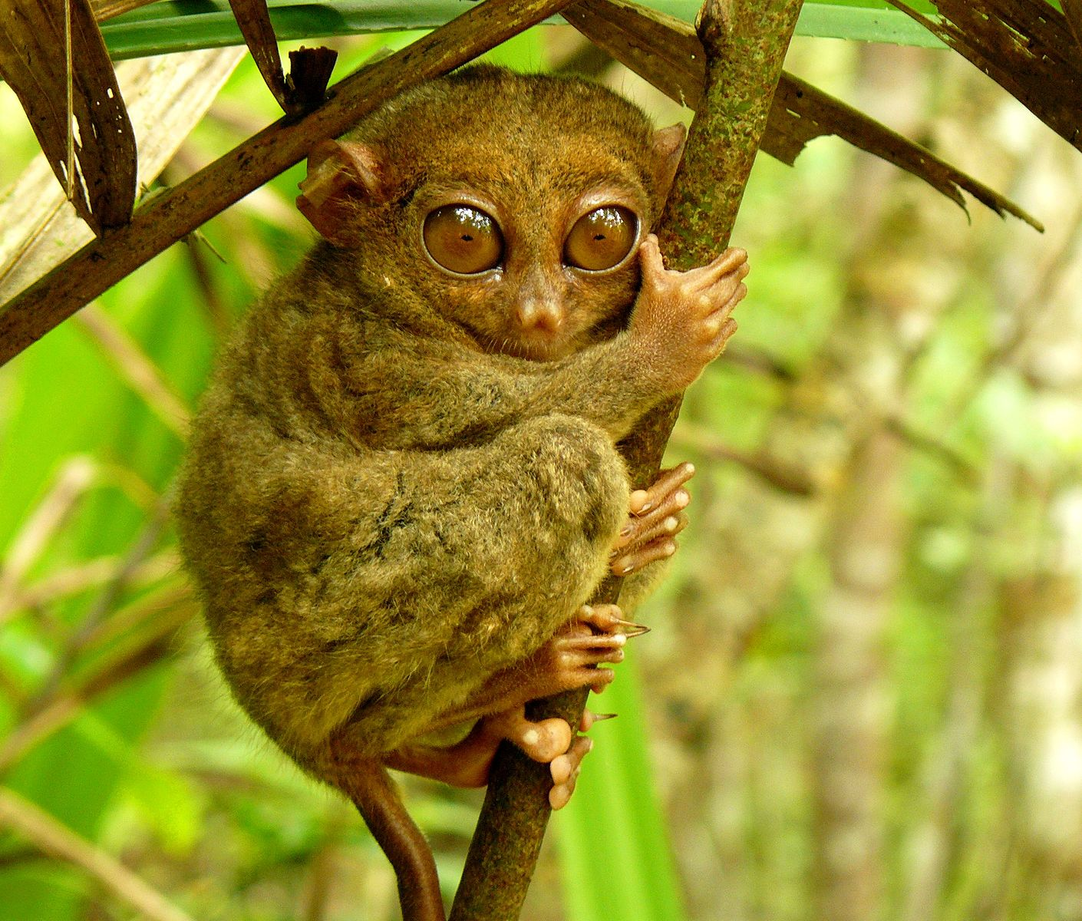
Tarsiiformes of Asia
Derived traits
Dry noses
Eyes close together
Primitive traits
Vertical leapers
Nocturnal
Small
Unique traits
Large eyes
Grooming claws
Faunivorous
Genetics
Haplorrhines

Slide 14
Platyrrhini of Central and South America
Flat nose
Rounded nostrils pointing
to side
Highly arboreal
Less sexually dimorphic
(on average)
2:1:3:3 dental formula
Polymorphic color vision

Slide 15
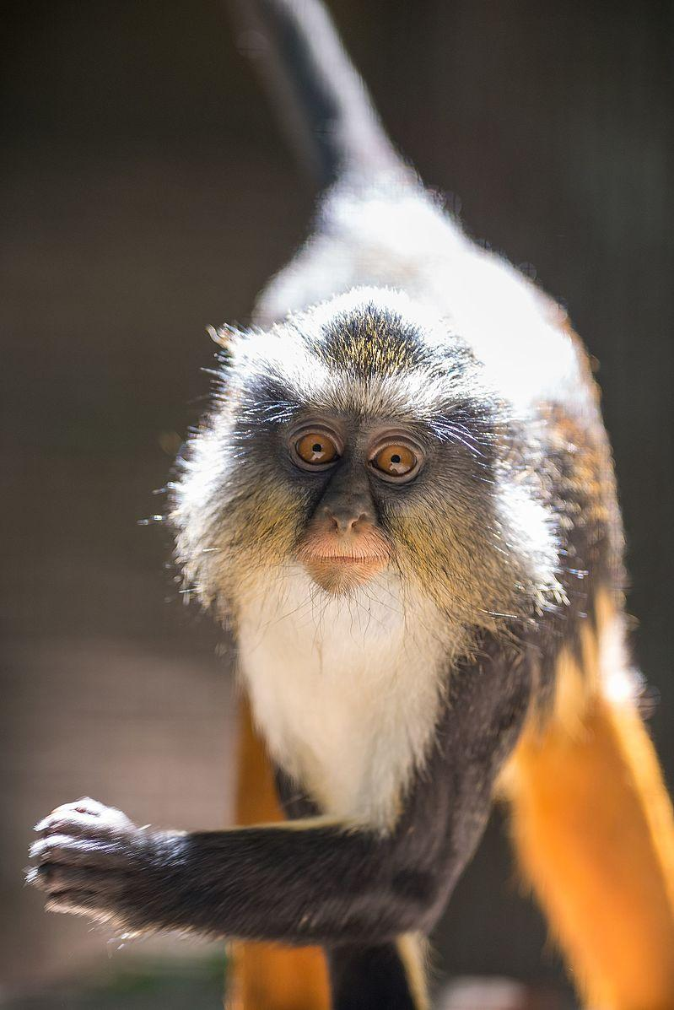
Catarrhini of Asia and Africa
Teardrop-shaped nose
Downward-pointing nostrils
Large bodies
Sexually dimorphic
Terrestrial
2:1:2:3 dental formula
Trichromatic color vision

Slide 16
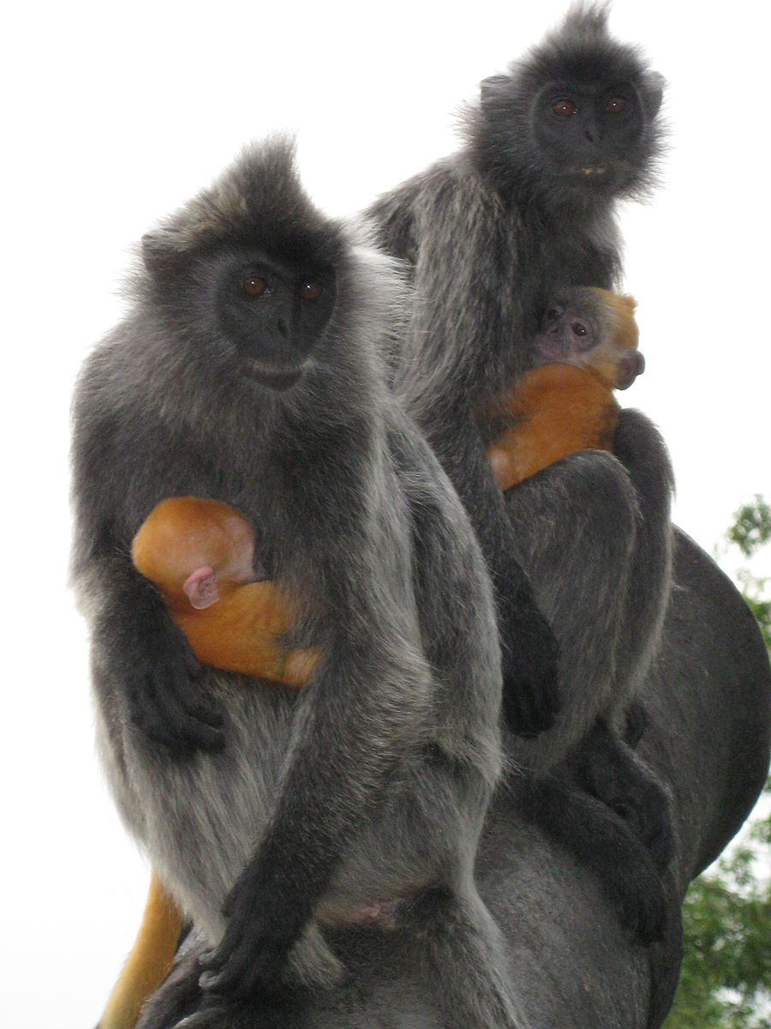
Superfamily Cercopithecoidea
Primitive, quadrupedal body plan
Bilophodont molars
Seat pads
Geographically widespread
Two groups
Leaf monkeys
Cheek-pouch monkeys

Slide 17
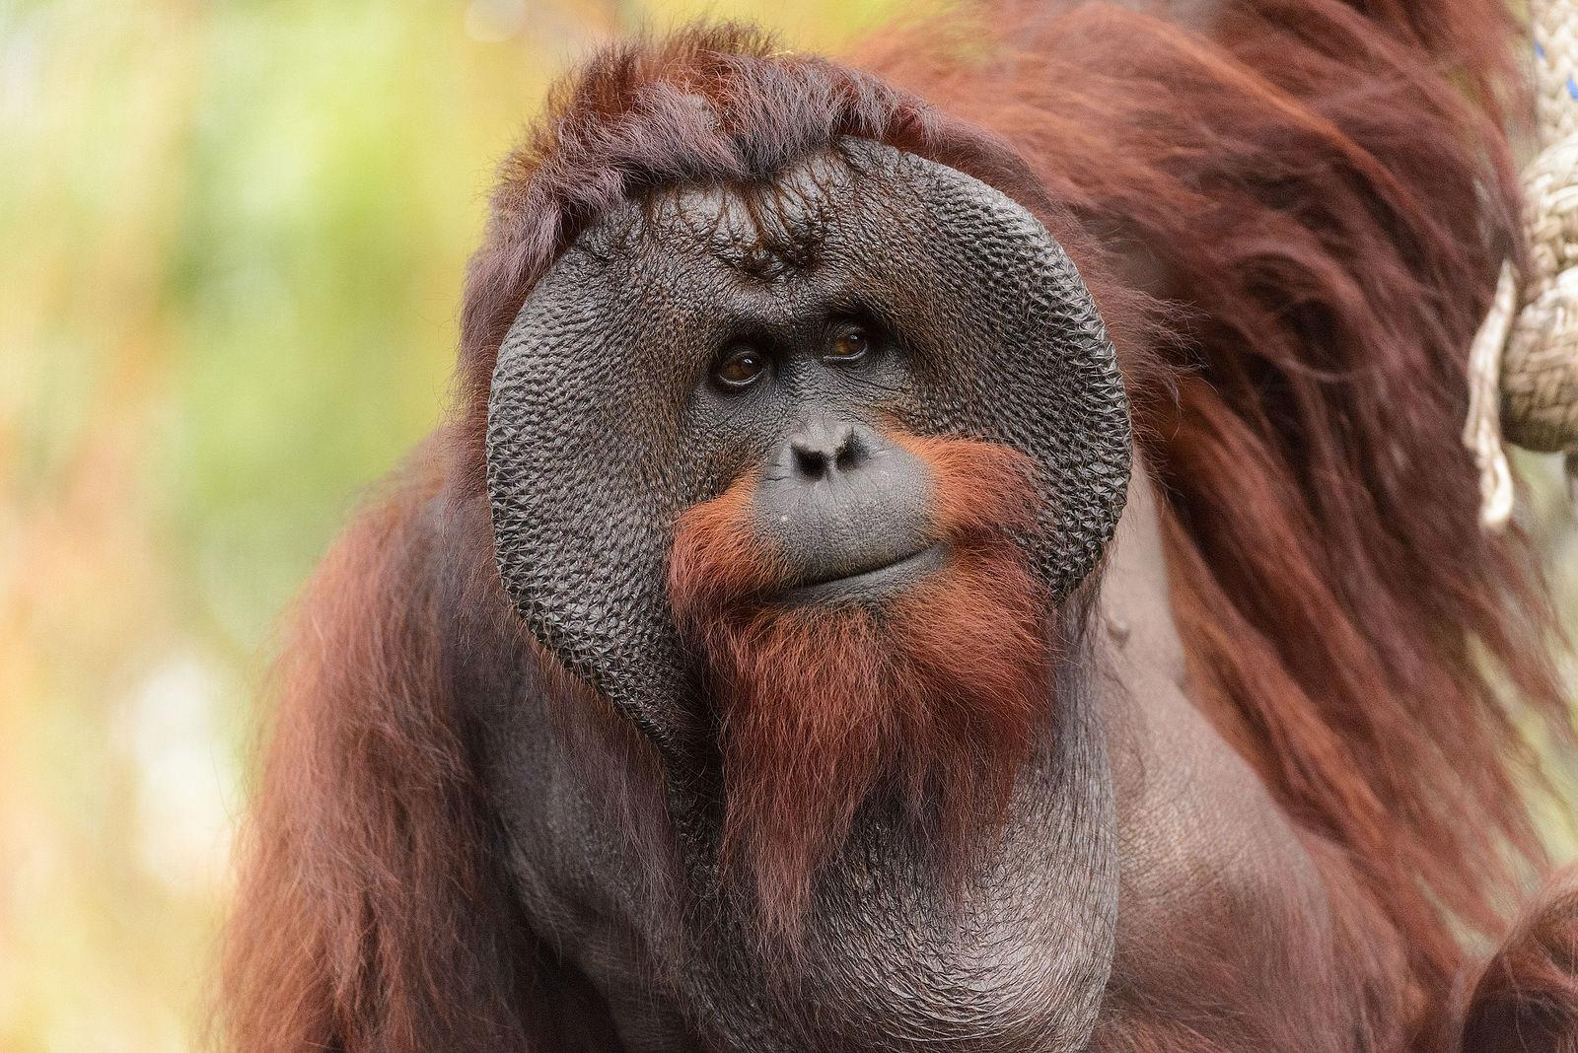
Superfamily Hominoidea
Hylobatidae
Pongo
Gorilla
Pan
Homo
Y-5 molars
Brachiation
Slow life history

Slide 18
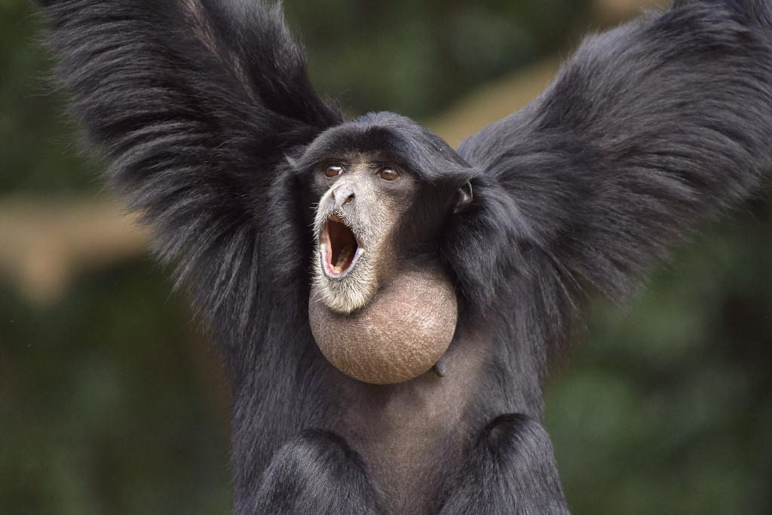
Hylobatidae
“Lesser apes”
Small-bodied
Pair-bond
Low sexual dimorphism
Gibbons
~13 pounds
Frugivorous
Siamangs
~25 pounds
Folivorous
Throat sacs

Slide 19
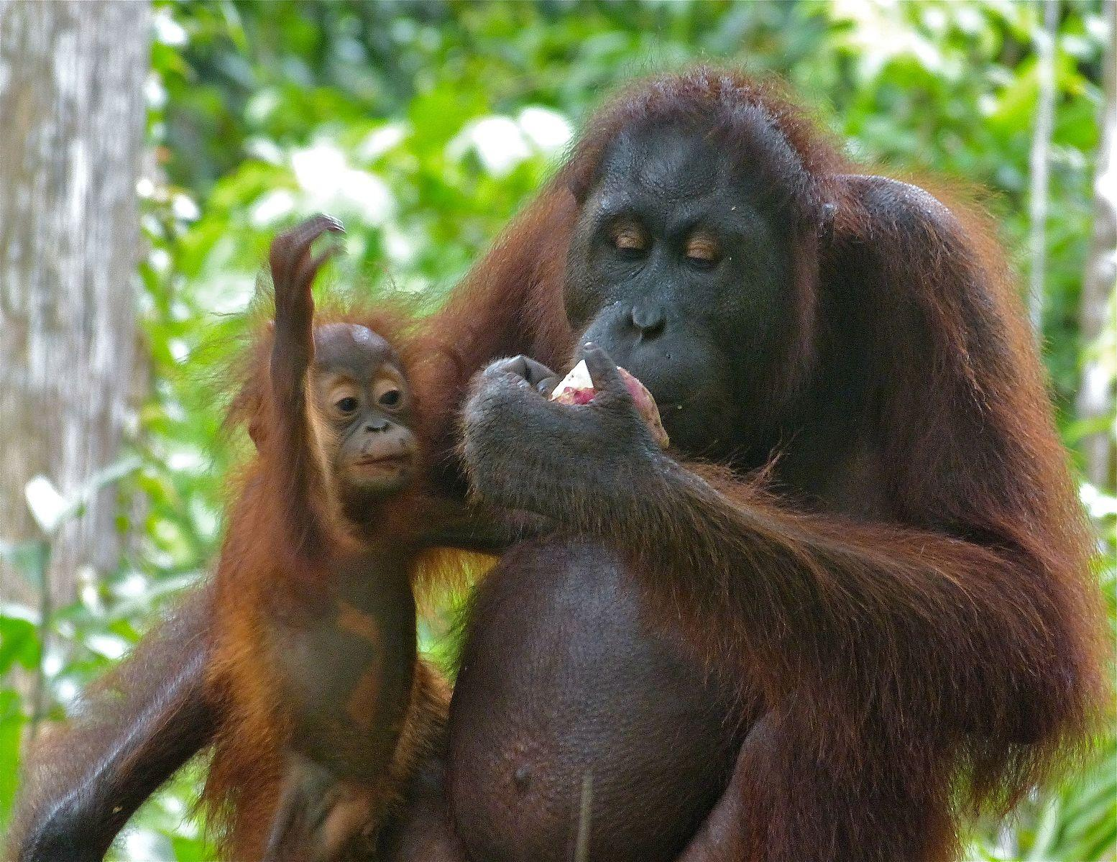
Pongo
Orangutans
Frugivorous
Diurnal
Solitary
Sexually dimorphic
Male bimaturism

Slide 20
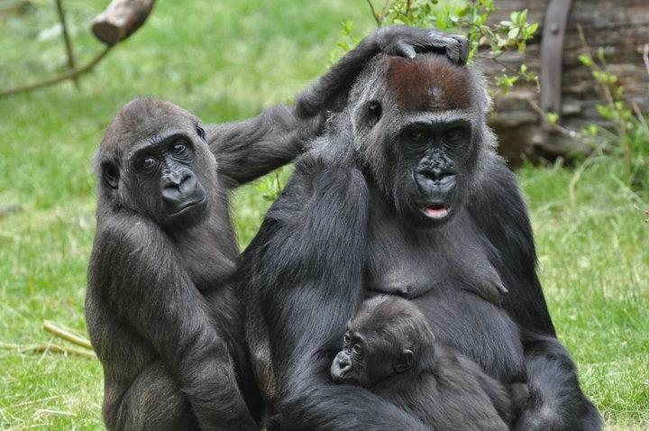
Gorilla
Folivorous
Knuckle-walking
Sexual dimorphism
Male “silverbacks”

Slide 21
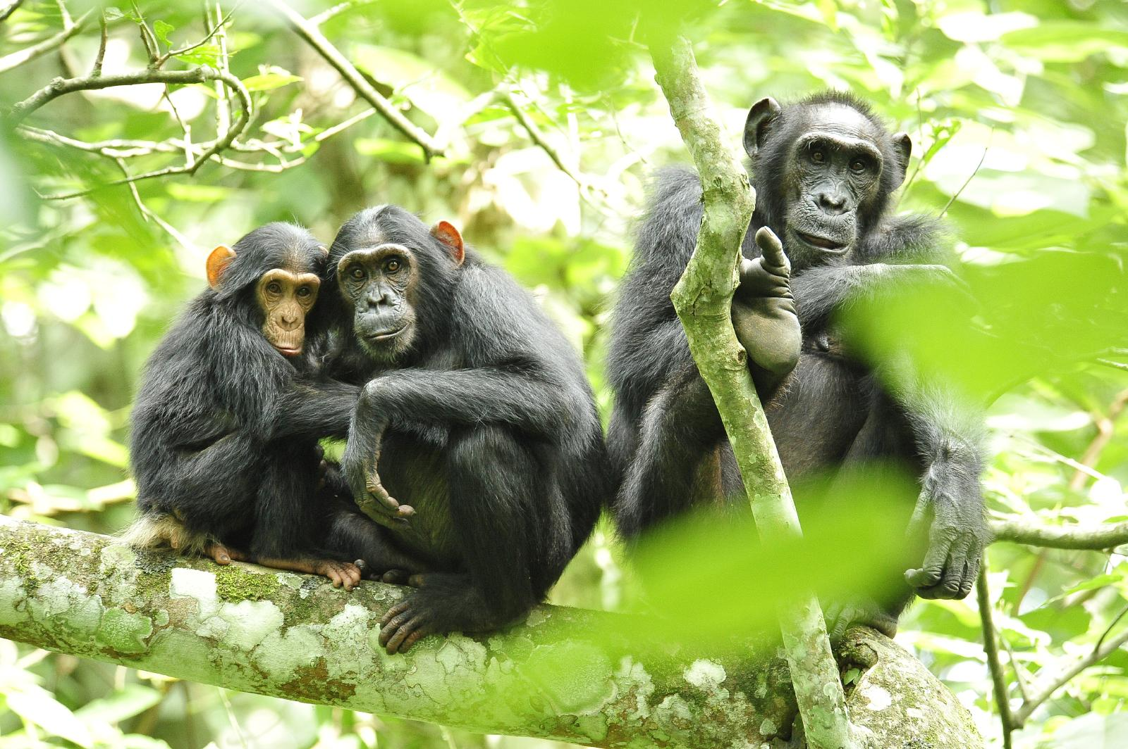
Pan
Chimpanzee
Pan troglodytes
Bonobo
Pan paniscus
Frugivorous
Knuckle-walking
Fission-fusion
Moderate sexual dimorphism

Slide 22
Homo
Shared traits of hominoids
No tail
Brachiation-adaptations
Y-5 molars
Extended life history
Large brains
Shared DNA
>96% with Gorilla
>98% with Pan

Slide 23
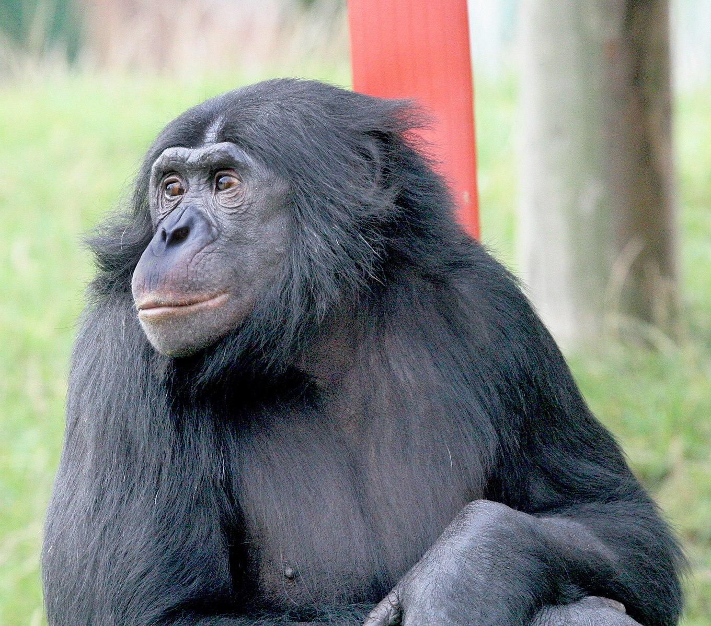
Learning From Primates
We learn about other primates and ourselves via:
Homology
Analogy
Primates have unique suite of traits

Slide 24
Attributions
Slide # | Figure # | Attribution
3 | 5.26 | CARABLANCA - panoramio by Manuel Velazquez is used under a CC BY 3.0 License.
5 | 5.1 | Post-orbital bar/Post-orbital closure a derivative work original to Explorations: An Open Invitation to Biological Anthropology by Stephanie Etting is under a CC BY-NC-SA 4.0 License. [Includes Otolemur crassicaudatus (greater galago) by Animal Diversity Web, CC BY-NC-SA 3.0; Macaca fascicularis (long-tailed macaque) by Animal Diversity Web, CC BY-NC-SA 3.0.]
5 | 5.2 | PrimateFeet by Richard Lydekker, original from The Royal Natural History 1:15 (1893), is in the public domain.
6 | 5.4 | Ha,ha,ha .... (14986571843) by Rolf Dietrich Brecher from Germany is under a CC BY-SA 2.0 License.
6 | 5.5 | Four types of human teeth original to Explorations: An Open Invitation to Biological Anthropology by Mary Nelson is under a CC BY-NC 4.0 License.
7 | 5.6a | Frugivore characteristics original to Explorations: An Open Invitation to Biological Anthropology by Mary Nelson is under a CC BY-NC 4.0 License.
8 | 5.9 | Brachiator original to Explorations: An Open Invitation to Biological Anthropology by Mary Nelson is under a CC BY-NC 4.0 License.

Slide 25
Attributions
Slide # | Figure # | Attribution
9 | 5.11 | Primate taxonomy chart a derivative work original to Explorations: An Open Invitation to Biological Anthropology by Stephanie Etting is under a CC BY-NC 4.0 License. [Includes Lemur catta Linnaeus, 1759 by Roberto Díaz Sibaja, CC BY 3.0; Lorisoidea original to Explorations: An Open Invitation to Biological Anthropology by Katie Nelson, CC BY-NC 4.0; Tarsiiformes original to Explorations: An Open Invitation to Biological Anthropology by Mary Nelson, CC BY-NC 4.0; Cebinae Bonaparte, 1831 by Sarah Werning, CC BY 3.0; Colobus guereza Ruppell, 1835 by Yan Wongfrom drawing in The Century Dictionary (1911) (flipped horizontally), designated to the public domain (CC0); Papiocynocephalus by Owen Jones, designated to the public domain (CC0); animals silhouette wolf elephant (2755766) by mohamed_hassan, Pixabay License.]
10 | 5.13 | Extant Strepsirrhini a derivative work by Mark Dumont is under a CC BY-SA 3.0 License. [Includes Katta család by Veszprémi Állatkert, CC BY-SA 3.0; Aye-aye at night in the wild in Madagascar by Frank Vassen, CC BY 2.0; Diademed ready to push off by Michael Hogan, designated to the public domain (CC0); Juvenile Black-and-White Ruffed Lemur, Mantadia, Madagascar by Frank Vassen, CC BY 2.0; Microcebus murinus -Artis Zoo, Amsterdam, Netherlands-8a by Arjan Haverkamp, CC BY 2.0; Slow Loris by Jmiksanek, CC BY-SA 3.0; Slender Loris by KalyanVarma (Kalyanvarma), CC BY-SA 4.0; Garnett's Galago (Greater Bushbaby) by Mark Dumont, CC BY 2.0.]
11 | 5.19 | Strepsirrhines at a glance a derivative work original to Explorations: An Open Invitation to Biological Anthropology by Stephanie Etting is under a CC BY-NC-SA 4.0 License. [Includes Ringtailed Lemurs in Berenty by David Dennis, CC BY-SA 2.0; Komba ušatá by Petr Hamerník, CC BY-SA 4.0.]

Slide 26
Attributions
Slide # | Figure # | Attribution
12 | 5.20 | Suborders at a glance a derivative work original to Explorations: An Open Invitation to Biological Anthropology by Stephanie Etting is under a CC BY-NC-SA 4.0 License. [Includes Black-and-White Ruffed Lemur, Mantadia, Madagascar by Frank Vassen, CC BY 2.0; Crab eating macaque face by Bruce89, CC BY-SA 4.0.]
13 | 5.22 | Tarsier Sanctuary, Corella, Bohol (2052878890) by yeowatzup is used under a CC BY 2.0 License.
14 | 5.26 | CARABLANCA - panoramio by Manuel Velazquez is used under a CC BY 3.0 License.
14 | 5.29 | Platyrrhini at a glance table original to Explorations: An Open Invitation to Biological Anthropology by Stephanie Etting is under a CC BY-NC 4.0 License.
15 | 5.30 | Wolf's Guenon Picking Up Food (19095137693) by Eric Kilby from Somerville, MA, USA, is used under a CC BY-SA 2.0 License.
16 | 5.34 | Silverleaf Monkey (Kuala Lumpur) by Andrea Lai from Auckland, New Zealand is used under a CC BY 2.0 License.
17 | 5.40 | Catarrhini at a glance a derivative work original to Explorations: An Open Invitation to Biological Anthropology by Stephanie Etting is under a CC BY-NC 4.0 License. [Includes Duskyleafmonkey1 by Robertpollai, CC BY 3.0 AT; Male Bornean Orangutan - Big Cheeks by Eric Kilby from Somerville, MA, USA, CC BY-SA 2.0.]
18 | 5.41 | Shout (373310729) by su neko is used under a CC BY-SA 2.0 License.

Slide 27
Attributions
Slide # | Figure # | Attribution
19 | 5.42a | Orang Utan (Pongo pygmaeus) female with baby (8066259067) by Bernard DUPONT from FRANCE is used under a CC BY-SA 2.0 Licence.
20 | 5.43a | Enzo naomi echo by Zoostar is used under a CC BY 3.0 License.
21 | 5.45 | Chimpanzees in Uganda (5984913059) by USAID Africa Bureau uploaded by Elitre is in the public domain.
23 | 5.44 | Bonobo male Jasongo 15yo Twycross 582a (2014 11 14 01 04 18 UTC) by William H. Calvin is used under a CC BY-SA 4.0 License.

