Slide 1
Chapter 6
Primate Ecology and Behavior
Karin Enstam Jaffe, Ph.D.
CC BY-NC

Slide 2
Learning Objectives
Describe primate behavioral variation
Explain why primates live in groups
Distinguish primate social systems from mating systems
Contrast male and female reproductive and parental investment strategies
Describe primate communication
Evaluate evidence for primate cultural variation

Slide 3
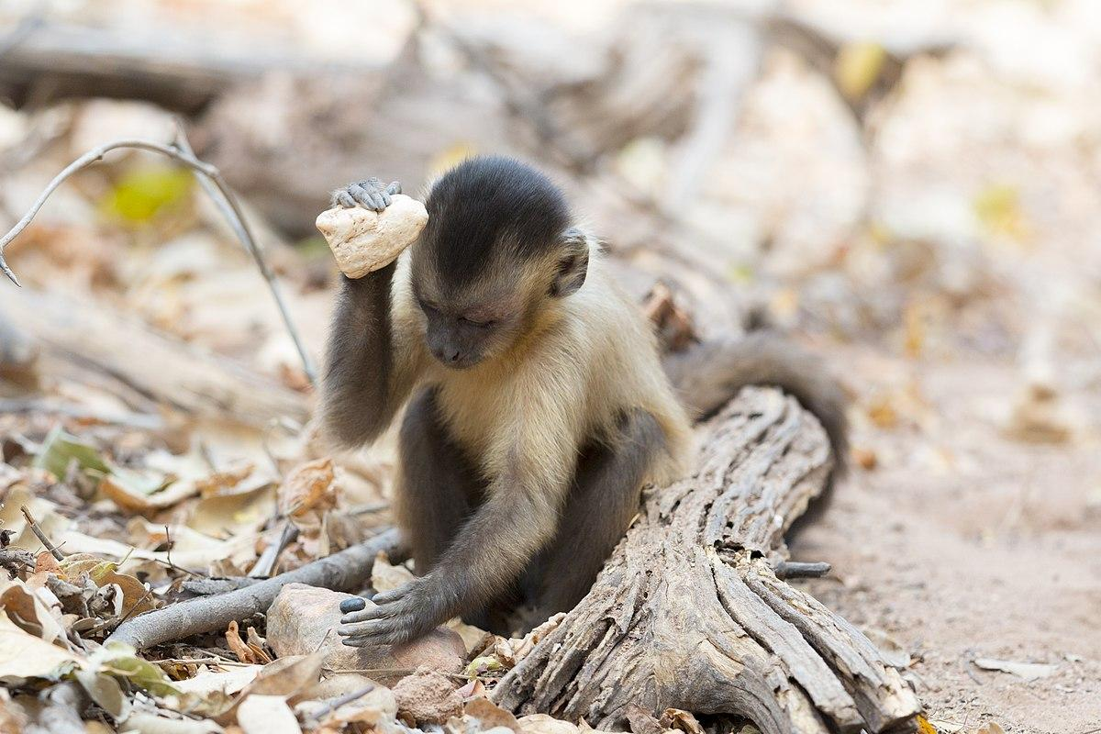
What is Primatology?
Branch of science that studies primates
Different disciplines and foci
Evolutionary theories
Primate intelligence
Conservation studies
Social complexity
Behavioral variation

Slide 4
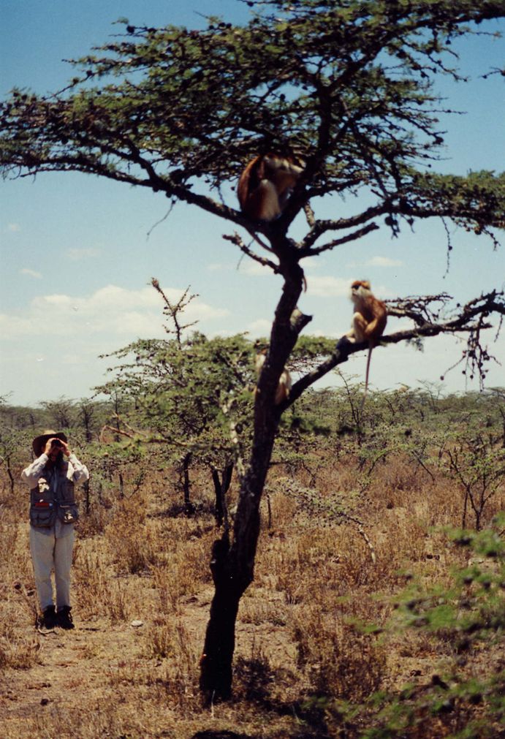
Ecology
600 species and subspecies
Primate ecology impacts
Morphology
Physiology
Body size
Social behavior

Slide 5
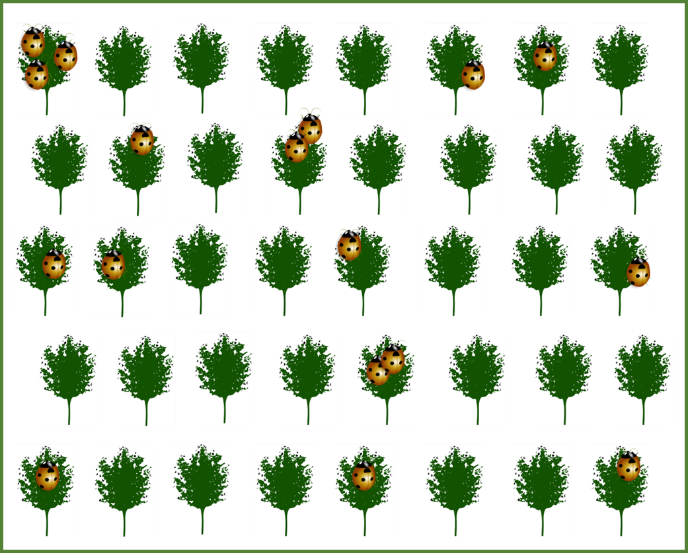
Primate Diet
Folivores: food is abundant and everywhere
Body size
Food factors
Abundance
Distribution
Quality
High quality foods are less abundant, patchy
Frugivores: food is scarce and found in clumps
Insectivores: insects are scarce and randomly distributed

Slide 6
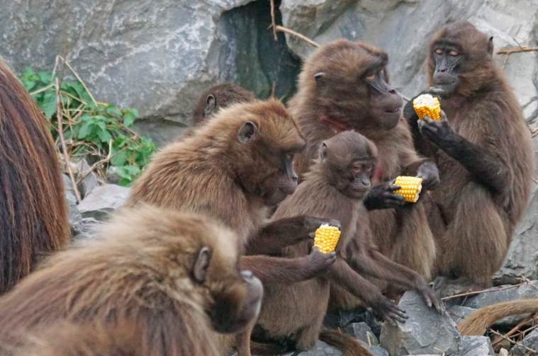
Competition for Food
Direct competition: fight over resources
Indirect competition: eat food first
Food abundance
Intergroup fighting
Food distribution
Intragroup competition

Slide 7
Community Ecology: Key Concepts
Sympatric: Two species occupy same area
Allopatric: Two species occupy different areas
Competitive exclusion principle: Two species competing for the same resources cannot occupy the same niche
Niche partitioning: Sympatric species avoid competition through different uses of the environment

Slide 8
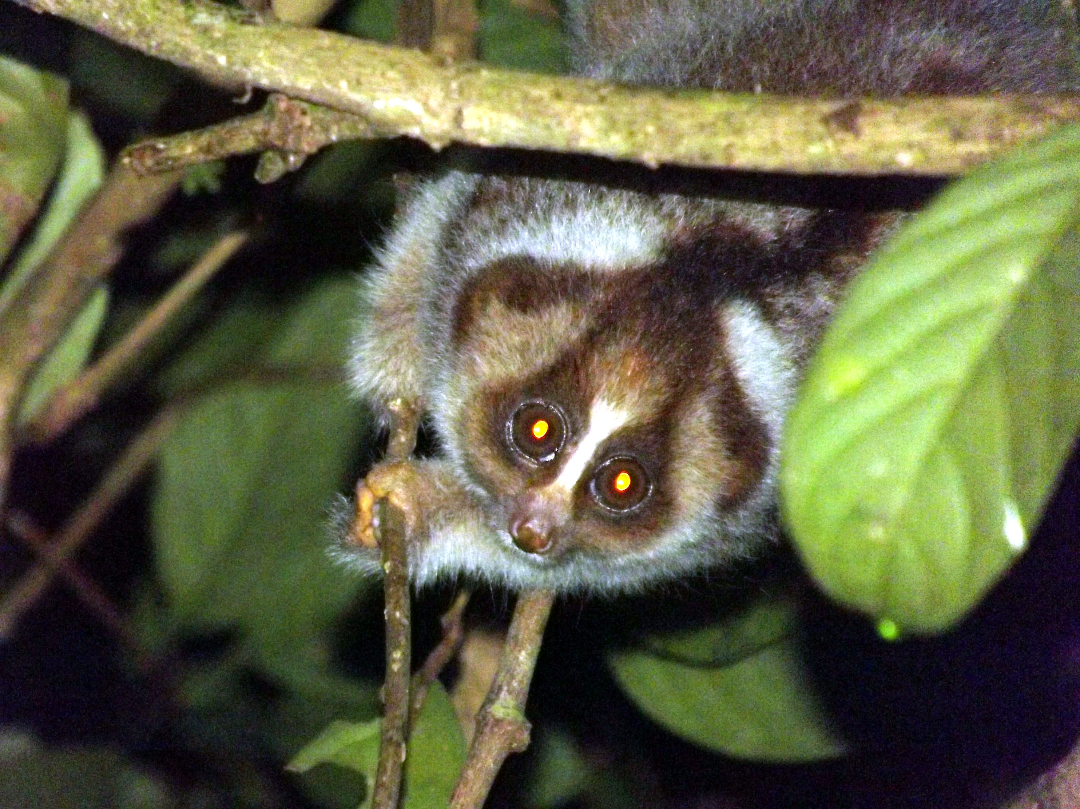
Predation
Carnivores, birds of prey, reptiles
Predation avoidance tactics
Crypsis
Nocturnal behavior
Vigilance
Alarm calling
Mobbing
Venom (slow loris)

Slide 9
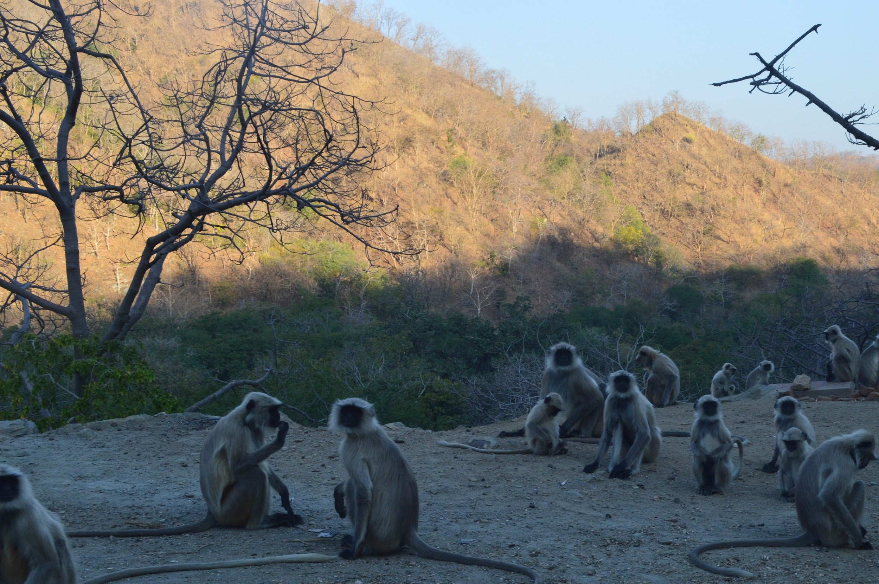
Why Live in Groups?
Feeding competition
Dominance hierarchy reduces aggression
Intergroup conflict
Larger groups more successful
Predation avoidance
Group members share anti-predator tactics

Slide 10
Polyspecific Associations
Associations between two or more species in which at least one species changes behavior
Foraging or anti-predator benefits

Slide 11
Dispersal
One or both sexes disperse at sexual maturity
Costs
Aggression from same-sex members of new group
Low rank in new group
Lack of alliances
Lack ecological and predator knowledge in new home range
Benefits
Reproductive success
Avoid inbreeding

Slide 12
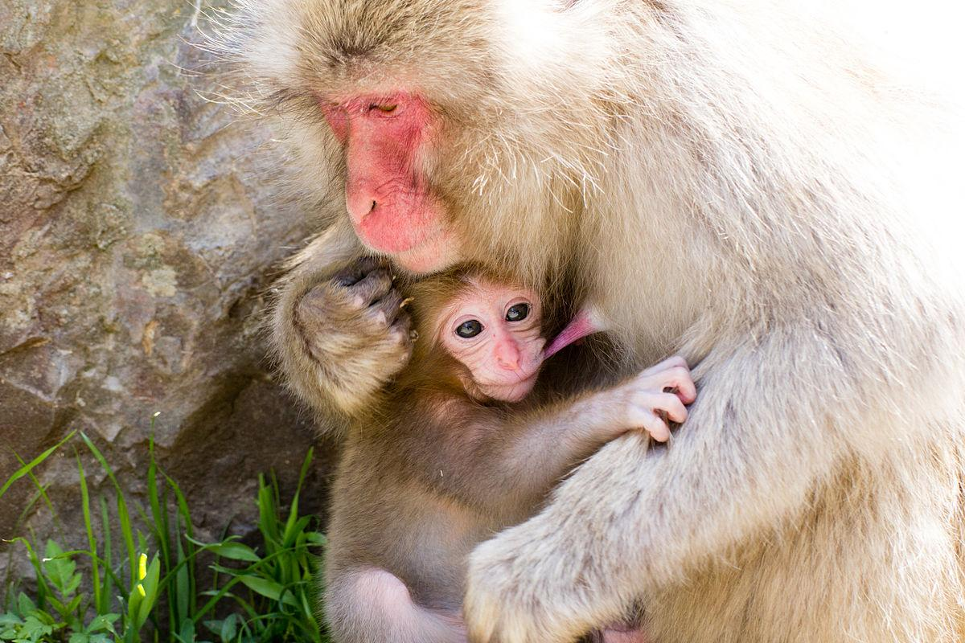
Reproductive Strategies: Parental investment
Time or energy a parent invests to enhance offspring survival
Females
Highly involved
Energetic expense
Social learning
Males
Variable involvement
Paternal certainty

Slide 13
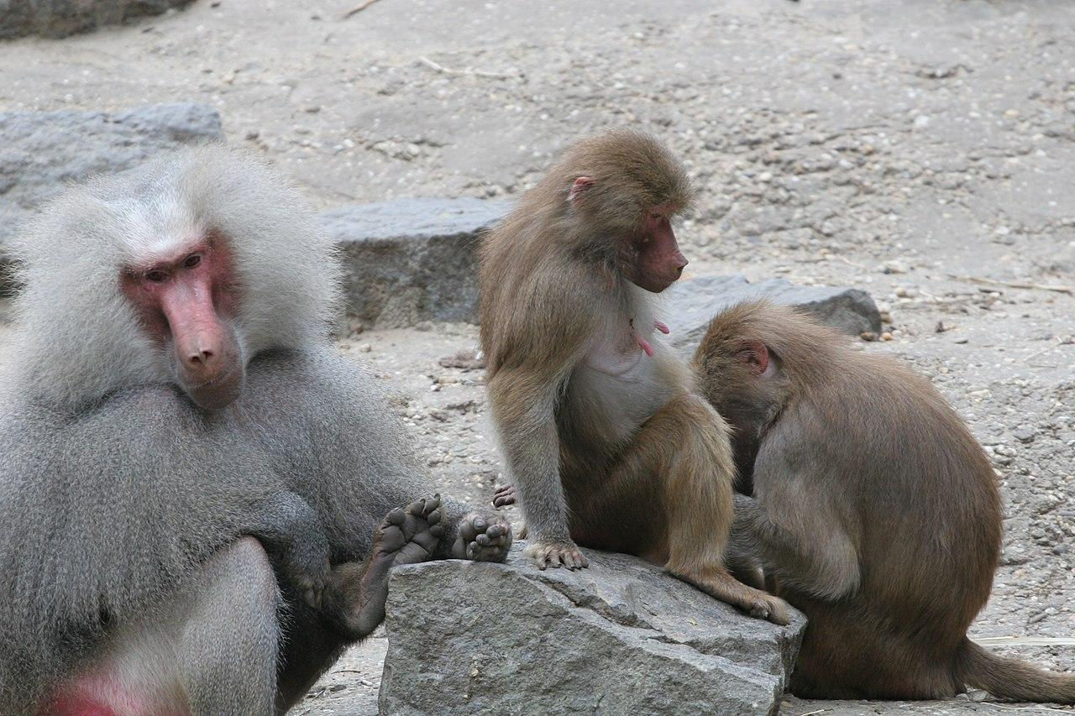
Reproductive Strategies: Sexual Selection
Selection for traits that maximize mating success
Intrasexual selection
Selection for traits that enhance
the ability of same-sex members
to compete amongst themselves
Intersexual selection
Selection for traits that enhance
the ability of one sex to attract the other

Slide 14
Reproductive Strategies: Social & Mating Systems
Social system
Typical number of males and females
Mating system
Who mates with who
Depends on distribution of food, females, males

Slide 15
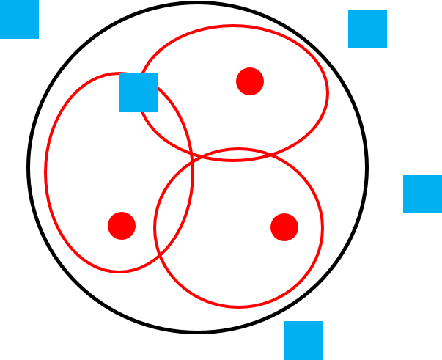
When Females are Solitary
Monogamy
Gibbons: long-term pair-bonding,
low male-male competition
Sexual monomorphism
Polygyny
Orangutans: male-male competition for
solitary females
Sexual dimorphism
Polyandry
Tamarins, marmosets
Monogamy
Polygyny
Polyandry
Blue square:
adult male
Red circle:
adult female

Slide 16
When Females Live in Groups
Polygyny
One male, multiple females
Polygamy
Multi-male, multi-female
Ecological conditions
Food abundance, large patch distribution
Polygyny
Polygamy
Blue square:
adult male
Red circle:
adult female

Slide 17
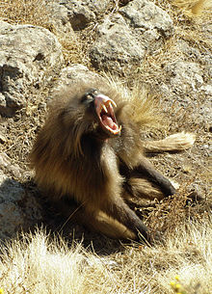
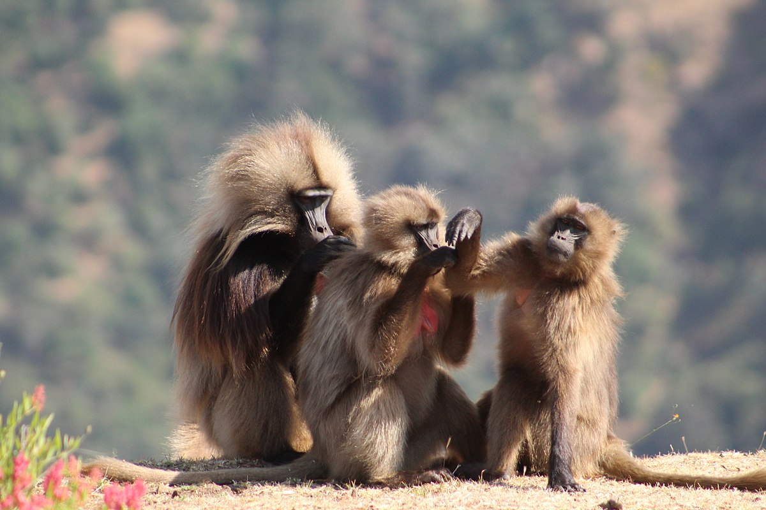
Communication
Vocal
Loud calls, contact calls, screeches
Visual
Facial expressions, piloerection,
sexual swelling, facial coloration
Olfactory
Anogenital scents, urine washing
Tactile
Grooming

Slide 18
The Question of Culture
One definition of culture
Transmission of behavior via social learning
Cultural tradition
Distinctive pattern of behavior shared by multiple individuals in a social group that persists over time

Slide 19
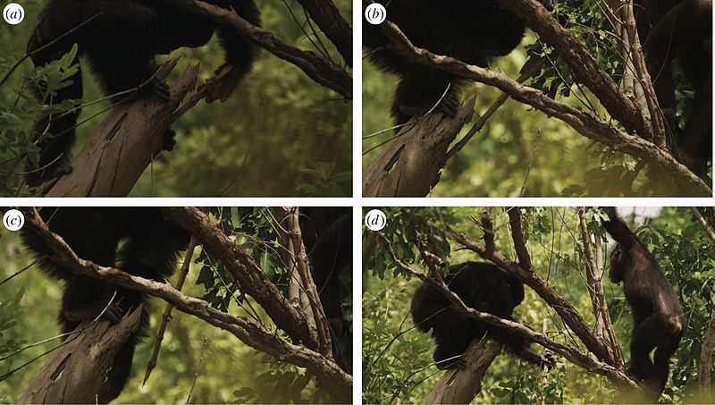
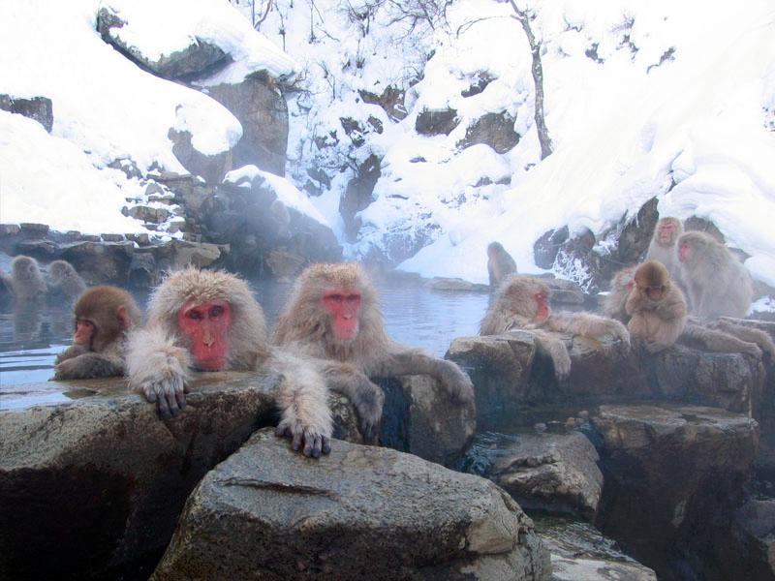
Examples of Culture in Primates
Chimpanzees
40+ traditions across sites
Macaques
Unique foraging behaviors
Hot spring bathing

Slide 20
Attributions
Slide # | Figure # | Attribution
3 | 6.1b | Stone tool use by a capuchin monkey by Tiago Falótico is used under a CC BY-SA 4.0 License.
4 | 6.5 | Karin Enstam Jaffe observing patas monkeys in Laikipia, Kenya by Rebecca Chancellor is under a CC BY-NC 4.0 License.
5 | 6.9 | Food distribution patterns of folivores, frugivores, and insectivores a derivative work by Karin Enstam Jaffe original to Explorations: An Open Invitation to Biological Anthropology is under a CC BY-NC 4.0 License. [Includes Green fruit tree, Lemon tree, and Ladybug image, all from publicdomainvectors.org designated to the public domain (CC0)].
6 | NA | Photo/1057756 by Camera/671 at https://pxhere.com/ has been designated to the public domain (CC0).
8 | 6.16 | Slow Loris by Jmiksanek is used under a CC BY-SA 3.0 License.
9 | 6.17 | Monkey group by Natureloverperson is used under a CC BY-SA 4.0 License.
12 | 6.1a | Snow monkey baby milk time by Daisuke tashiro is used under a CC BY-SA 2.0 License.
13 | 6.19a | Dierenpark Emmen baboon (2679944324) by robin bos from heerenveen, the Netherlands is used under a CC BY 2.0 License.
15 | 6.22 | Social and Mating Systems by Karin Enstam Jaffe original to Explorations: An Open Invitation to Biological Anthropology is under a CC BY-NC 4.0 License.

Slide 21
Attributions
Slide # | Figure # | Attribution
16 | 6.22 | Social and Mating Systems by Karin Enstam Jaffe original to Explorations: An Open Invitation to Biological Anthropology is under a CC BY-NC 4.0 License.
17 | 6.26 | BabouinGeladaAuReveil by BluesyPete is used under a CC BY-SA 3.0 License.
17 | 6.30c | Baboons Wunania 012018 by Kim Toogood is used under a CC BY-SA 4.0 License.
19 | 6.31 | Pan troglodytes, tool use in Senegal by J. D. Pruetz, P. Bertolani, K. Boyer Ontl, S. Lindshield, M. Shelley, and E. G. Wessling is used under a CC BY 4.0 License.
19 | 6.32 | Jigokudani hotspring in Nagano Japan 001 by Yosemite is used under a CC BY-SA 3.0 License.

