Slide 1
What’s a Scientific Approach? (slide 1 of 4)
Science, the search for answers through a process that is objective, systematic, logical, predictive, and public.
Science is empirical, or objective, concerned with the observable, measurable world.
© 2017 Cengage Learning. All Rights Reserved.

Slide 2
What’s a Scientific Approach? (slide 2 of 4)
Questions are scientific:
if they are concerned with the detectable properties of things and
if the result of observations designed to answer a question cannot be predetermined by the biases of the observer.

Slide 3
What’s a Scientific Approach? (slide 3 of 4)
Science is systematic and explicit, collecting data relevant to solving a problem and specifying procedures so that any trained observer under the same conditions would make the same observations.
Science is logical, working with data and ideas that link data to interpretations, and with ideas that link the ideas together; linkages are grounded in previously demonstrated principles.
© 2017 Cengage Learning. All Rights Reserved.

Slide 4
What’s a Scientific Approach? (slide 4 of 4)
Science is explanatory and predictive, concerned with causes. It seeks theories – explanatory statements that predict what will happen under a specified set of conditions and why it will happen.
Science is self-critical and based on testing, acquiring understanding not through proof, but by showing that competing theories are wrong.
Science is public and available for scrutiny.
© 2017 Cengage Learning. All Rights Reserved.

Slide 5
What’s a Scientific Approach?: How Science Explains Things (slide 1 of 4)
The Moundbuilder Myth surrounding the mounds and earthworks, especially in the Ohio and Mississippi River valleys.
© 2017 Cengage Learning. All Rights Reserved.

Slide 6
What’s a Scientific Approach?: How Science Explains Things (slide 2 of 4)
Moundbuilders were thought to be anyone, except the ancestors of Native Americans who destroyed the people thought to be a superior race.
Thomas Jefferson did not take sides in the debate, for lack of the necessary information.
© 2017 Cengage Learning. All Rights Reserved.

Slide 7
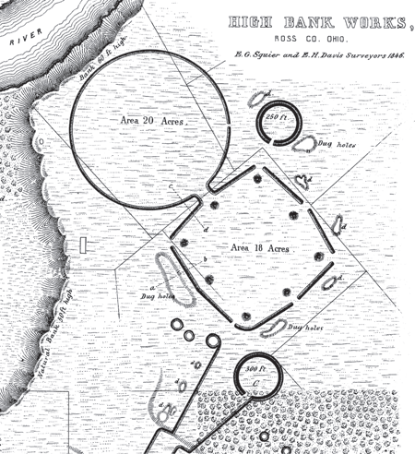
What’s A Scientific Approach?: How Science Explains Things (slide 3 of 4)
Ephraim Squier, Edwin Davis distinguished between Moundbuilders and American Indians.
They supported hypothesis that Moundbuilders were related to nations of Mexico and Central America.
© 2017 Cengage Learning. All Rights Reserved.

Slide 8
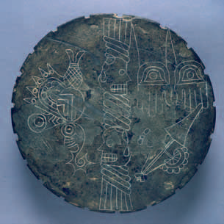
What’s A Scientific Approach?: How Science Explains Things (slide 4 of 4)
Cyrus Thomas objectively concluded there was no lost race of Moundbuilders.
They were not destroyed by Native Americans, and there was no reason for Europeans to take revenge.
An etched slate from Moundville, Alabama. Artifacts such as these convinced nineteenth-century scholars that the Moundbuilders were a superior culture.
© 2017 Cengage Learning. All Rights Reserved.

Slide 9
The Scientific Method (slide 1 of 3)
The following are accepted principles and procedures for the systematic pursuit of secure knowledge.
Define a relevant problem.
Establish one or more hypotheses.
Determine the empirical implications of the hypotheses.
Collect appropriate data.
Test the hypothesis by comparing these data with the expected implications.
Reject, revise, and/or retest hypotheses as necessary.
© 2017 Cengage Learning. All Rights Reserved.

Slide 10
The Scientific Method (slide 2 of 3)
Hypothesis, a proposition proposed as an explanation of some phenomena.
Inductive reasoning, working from specific observations to more general hypotheses.
© 2017 Cengage Learning. All Rights Reserved.

Slide 11
The Scientific Method (slide 3 of 3)
Deductive reasoning, reasoning from theory to account for specific observational or experimental results.
Testability, the degree to which one’s observations and experiments can be reproduced.
Theory, an explanation for observed, empirical phenomena, seeking to explain the relationships between variables; it is an answer to a “why” question.
© 2017 Cengage Learning. All Rights Reserved.

