Slide 1
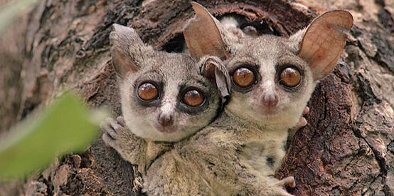
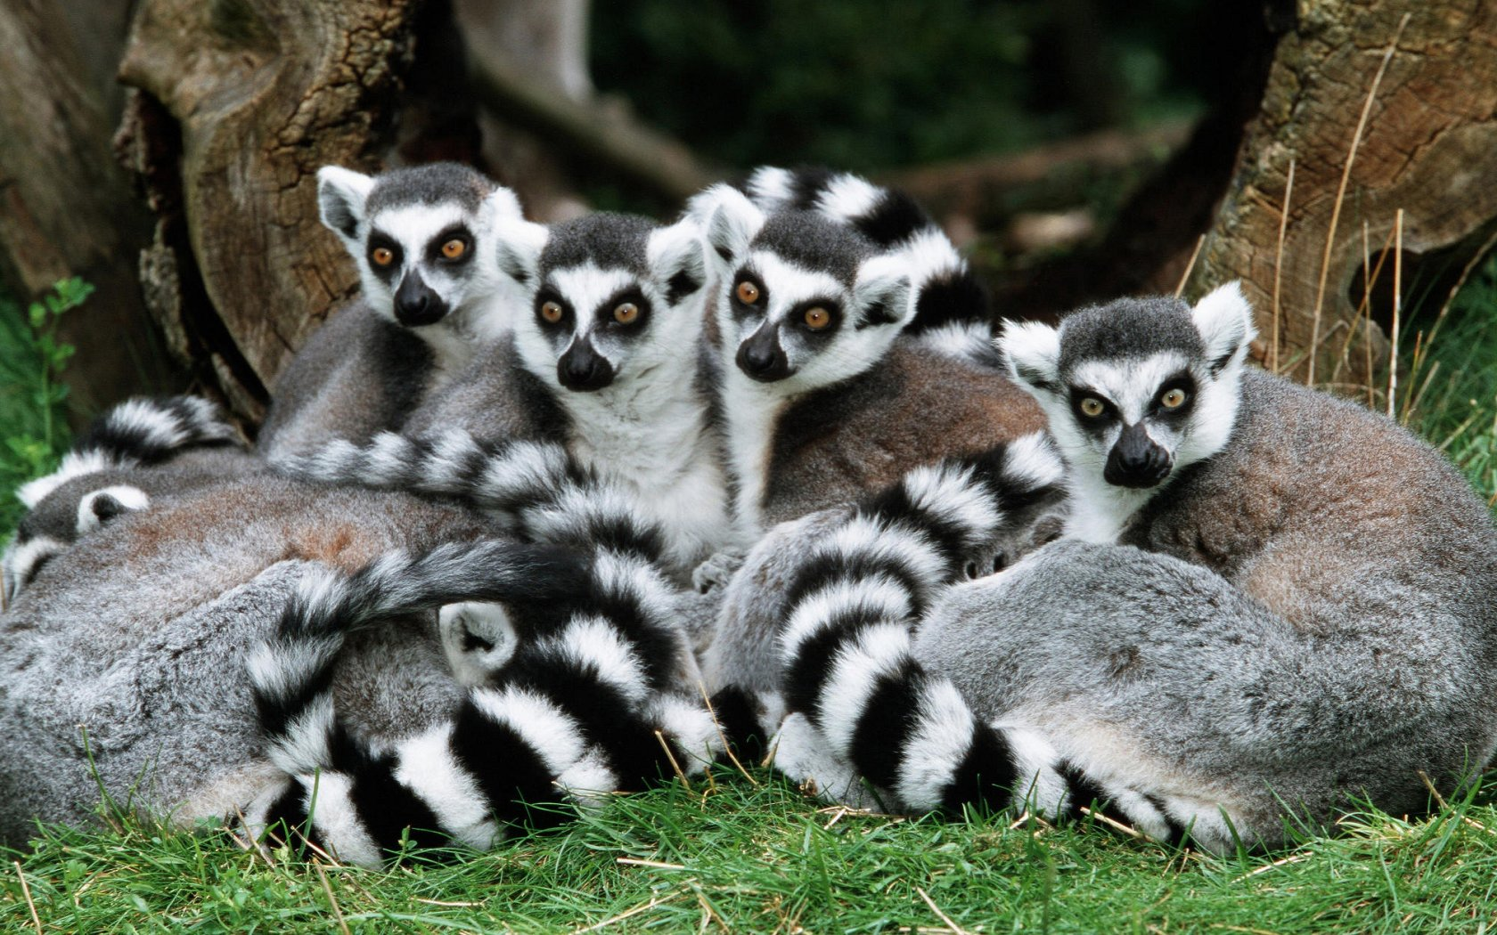
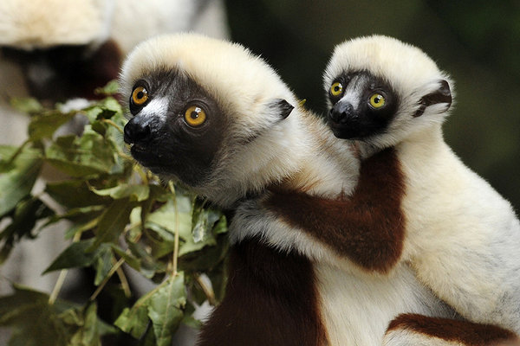
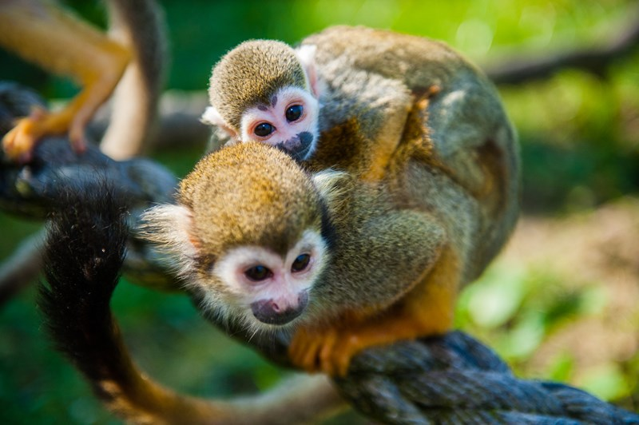
Primate Mating Patterns

Slide 2
Overview
Primate Social Structure
Primate Reproductive Strategies
Primate Mating and Residency Patterns
Summary: Primate Mating Patterns and their implications for Primate Behavior
Conclusion: Primate Mating Patterns and their implications for human behavior.

Slide 3
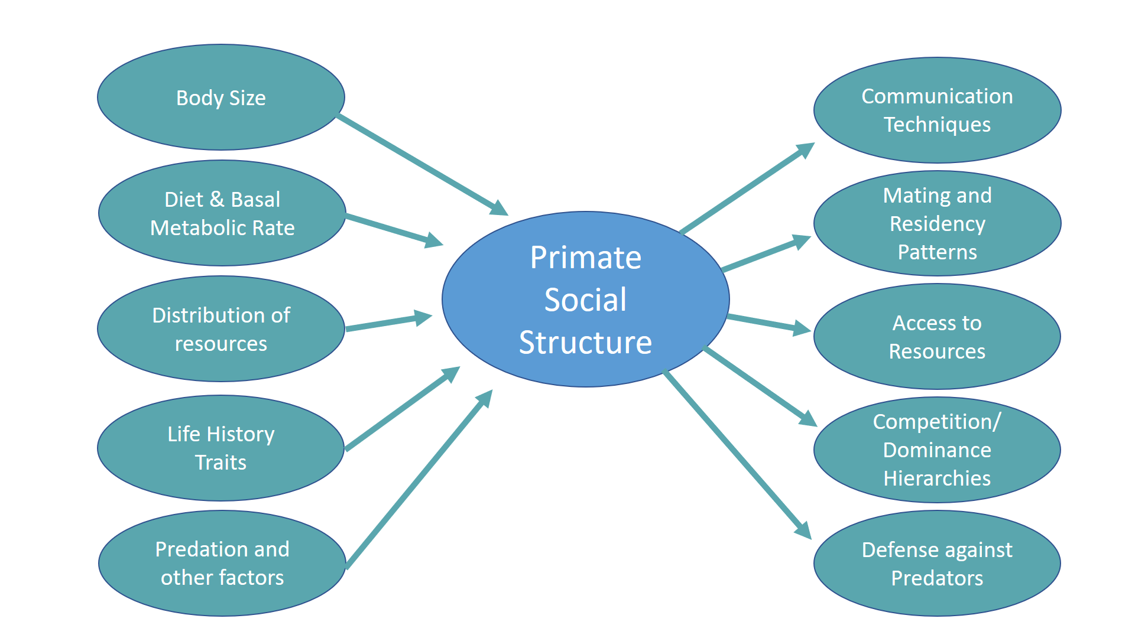
Primate Social Structures

Slide 4
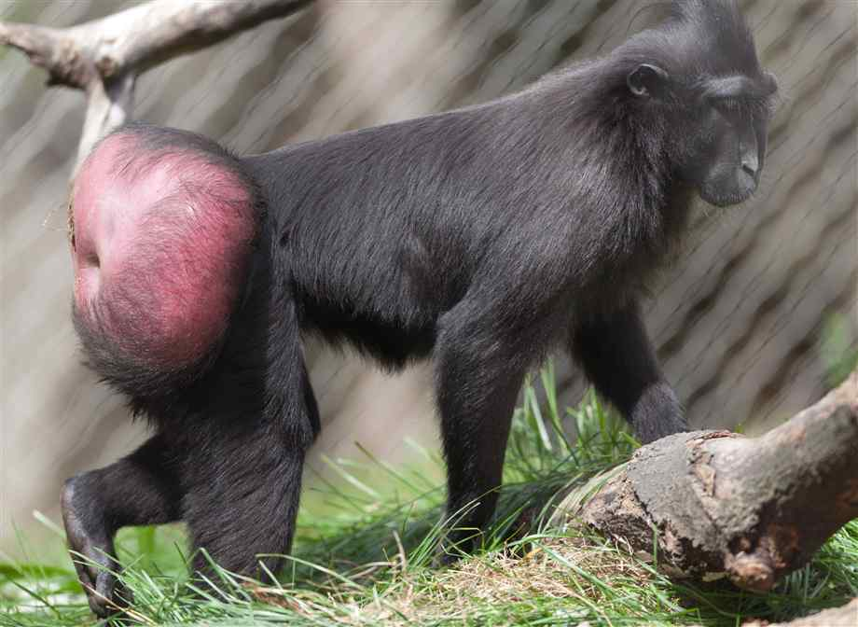
Primate Reproductive Strategies
Female Reproductive Strategies
Acquire food and care for infants
Dominance Hierarchies and Territory defense
Estrus: signals mating availability to males.
Male Reproductive Strategies
Dominance Hierarchies (aggressive signals and displays)
Protecting Territories and Core Areas
Infanticide
Female Black Crested Macaque with estrus swelling

Slide 5
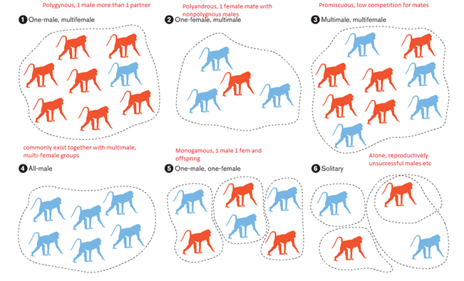
Primate Mating & Residency Patterns
.

Slide 6
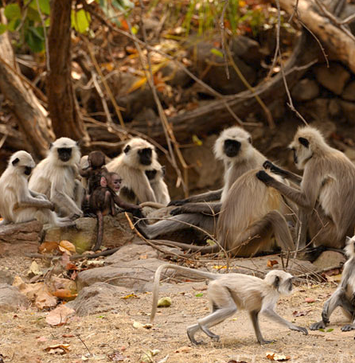
1. Polygynous (One-male, multifemale)
Common among some New World monkeys. Ex: Hanuman Langurs, Gorillas, and Gelada baboons.
High competition among males for mates
Primates in these groups usually exhibit more sexual dimorphism and highest levels of competition/violence.
A Hanuman Langur group

Slide 7
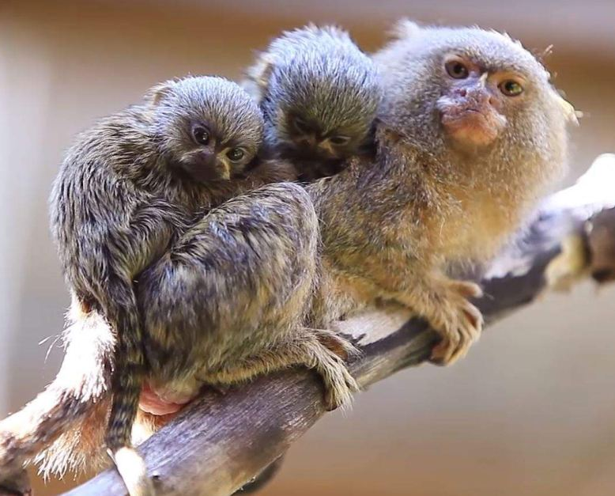
2. Polyandry (One-female, multimale)
This mating pattern is relatively rare among non-human primates
Only seen with some marmosets and tamarins.
Pygmy Marmoset carrying twins.

Slide 8
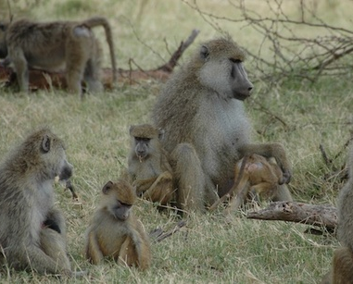
3. Polygynous (Multimale, multifemale)
Males and females live together in a group.
Males compete in dominance hierarchies and the alpha male has the best access to mates and resources.
Practiced by some old and new world monkeys. Ex: chimpanzees and savanna baboons
Savanna Baboons

Slide 9
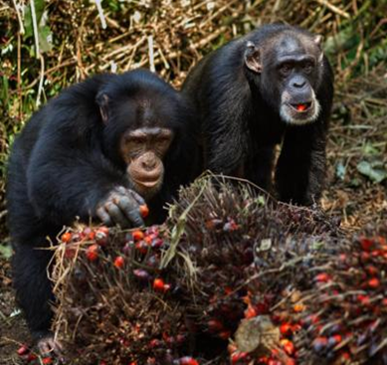
3a. Fission-Fusion Polygyny
Occurs when primates separate to form individual foraging parties rather than one cohesive group.
This unique form of Polygyny is thought to have come about due to a reliance on ripe fruit.
Practiced by some chimpanzees, bonobos, and spider monkeys.
Chimpanzees

Slide 10
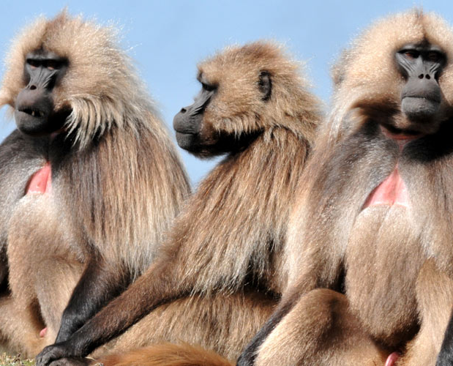
4. All male
These groups are usually temporary groups, sometimes called bachelor groups, that are formed before a male joins a group of multiple males and females.
Gelada Baboons

Slide 11
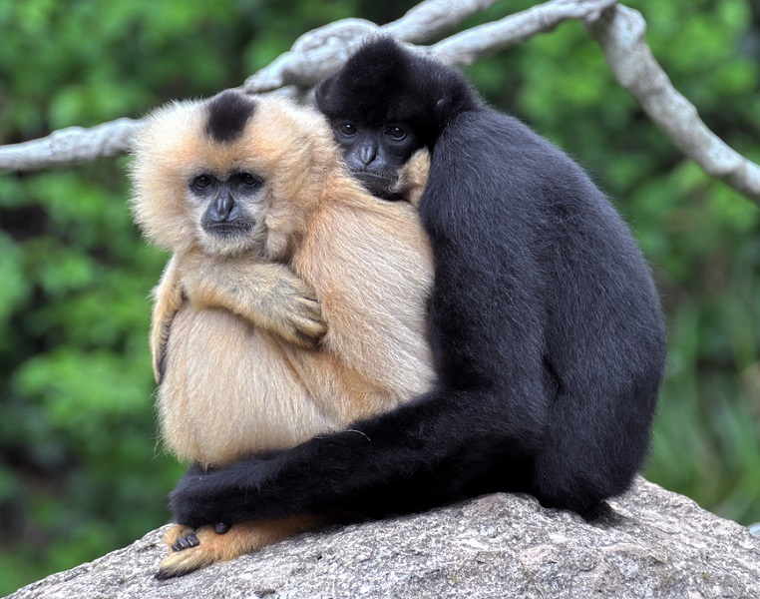
5. Monogamy
A male and female living together in a pair bond for an extended period of time.
Monogamy is best understood as a female reproductive strategy to maximize resources for their dependent offspring.
Some marmosets, gibbons, and siamangs.
A pair of Gibbons

Slide 12
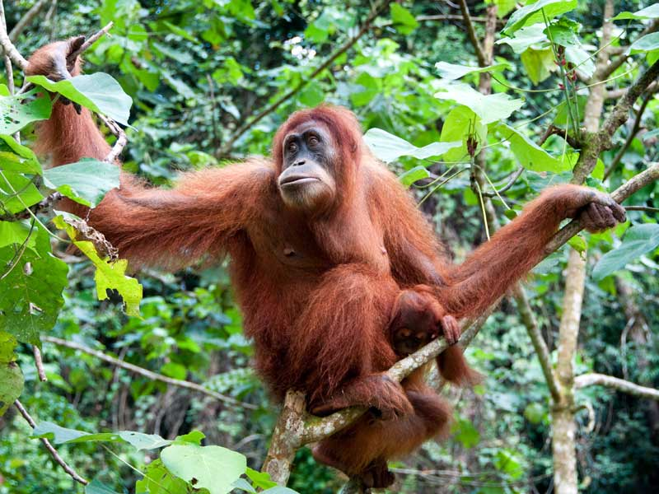
6. Solitary
A male or a female and her dependent offspring that only socialize together for mating purposes.
This is more common among some prosimians and Orangutans.
Solitary Foragers: Nocturnal Prosimians
Orangutan

Slide 13
Summary: Primate Mating Patterns and their implications for Primate Behavior
High variability in types of social and mating patterns are dependent on various factors, all primate groups are flexible.
Male/ Female reproductive asymmetry lead to large differences in Female and Male reproductive strategies and sexual selection habits in all primates.
Goal of most primate social groupings is to have reproductive success, although forming social groups has other benefits.
Types of social groups can influence competition levels, types of bonding practices, and other group behaviors.
All primate behavior is influenced by complex interactions between genetic, environmental, and cultural factors.

Slide 14
Conclusion: What do primate mating patterns tell us about human behavior?
Humans social grouping structures and mating patterns are even more fluid than other primates because of our stronger reliance on culture.
There is no given natural social group or mating patterns for any primates including humans. Levels of sexual dimorphism in our ancestors could indicate a tendency towards Polygyny.
Primate Sexual Selection is similar in humans. Men and women have different reproductive strategies. (ex: men more likely to take risks/violence because of evolutionary link to higher reproductive success)
Incest Taboo and non-human primates (leaving natal groups) to avoid incest and inbreeding depression.

Slide 15
References
Essentials of Physical Anthropology: Discovering Our Origins by Clark Spencer Larsen.
Exploring Biological Anthropology: The Essentials by Craig Stanford, John Allen, and Susan Anton.
Essentials of Physical Anthropology by Robert Jurmain, Lynn Kilgore, and Wenda Trevathan.
What’s Love Got to Do with It: The Evolution of Human Mating by Meredith Small.
Primate Adaptations and Evolution by John Fleagle
New Views on the Origin of Primate Social Organization by Alexandra Muller, Christophe Soligo, and Urs Thalmann

Slide 16
Discussion Questions:
What do you think are some of the advantages and disadvantages of living in the seven types of social groups we discussed today?
In what type of primate social group is sexual dimorphism the highest and why is this the case?
Humans and non-human primates have similar reproductive strategies. How would you explain the tendency for humans and some non-human primates to participate in sexual activities that are not linked to reproduction?

