Slide 1
Chapter 8
Primate Evolution
Jonathan Perry, Ph.D.
Stephanie Canington, B.A.
CC BY-NC

Slide 2
Learning Objectives
Understand major trends in primate evolution
Learn about primate adaptations
Name and describe extinct primate groups
Discuss evidence related to extinct primates
Recognize how the Earth’s geography and climate influenced primates

Slide 3
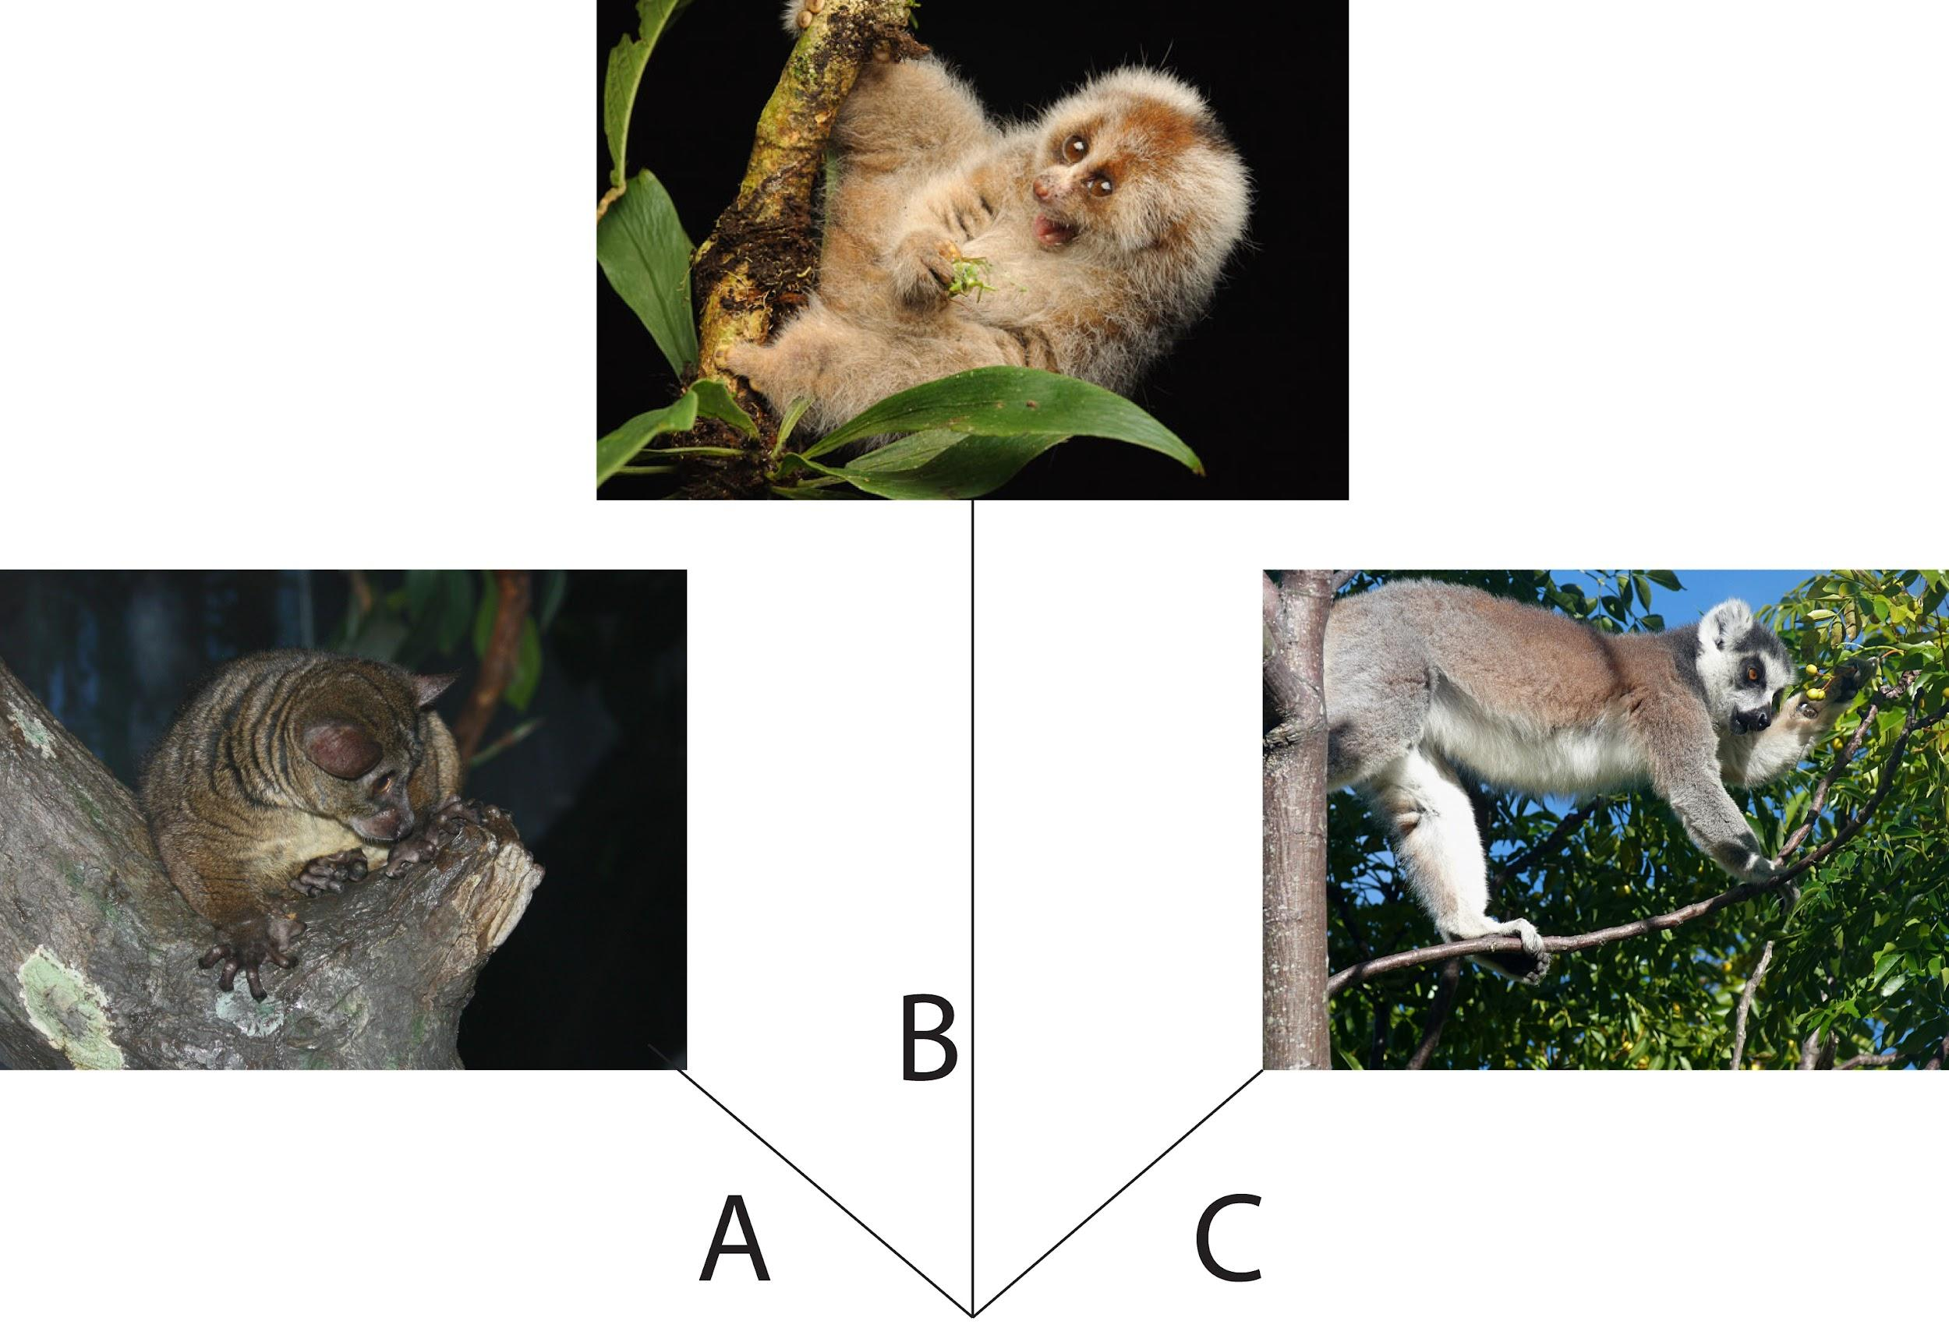
Primate Origins: Major Hypotheses
Arboreal hypothesis
Visual predation hypothesis
Angiosperm-primate coevolution hypothesis

Slide 4
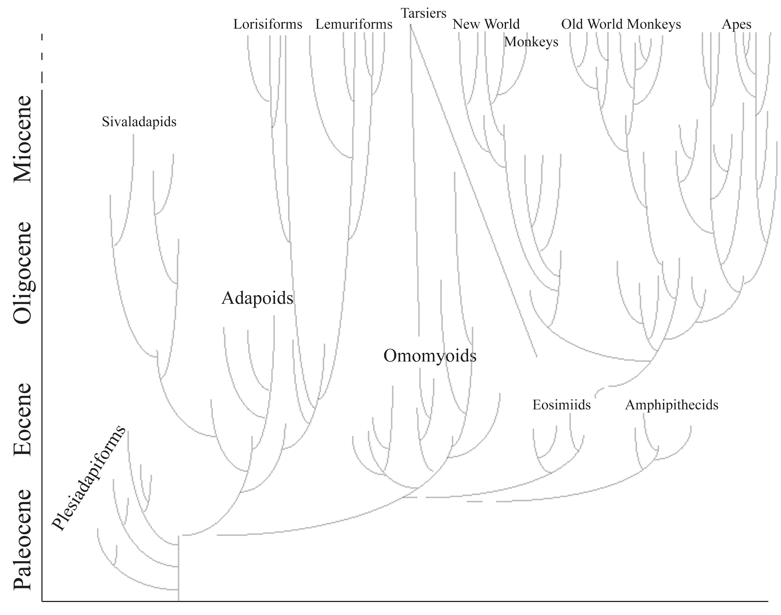
Primate Family Tree

Slide 5
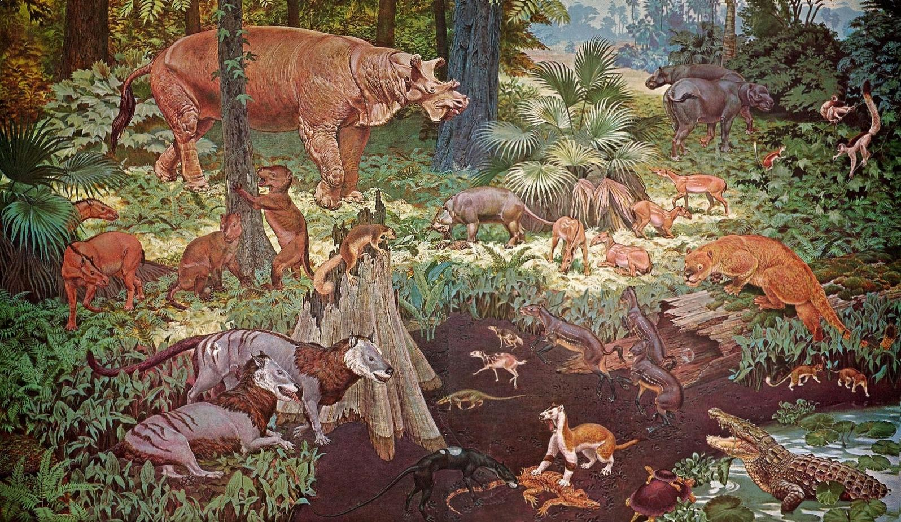
Primate Origins: Paleocene
Mesozoic (251-65.6 mya)
Age of dinosaurs
End of Cretaceous (145.5-65.5 mya)
Extinction of dinosaurs
Paleocene (66-56 mya)
Age of mammals

Slide 6
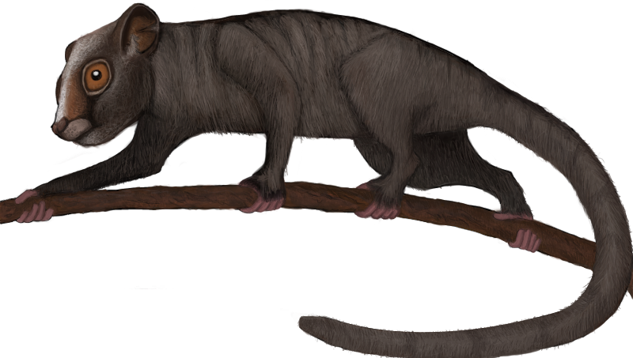
Plesiadapiforms: Archaic Primates
Diverse families
North America & West Europe
Examples
Purgatorius (earliest)
Carpolestes

Slide 7
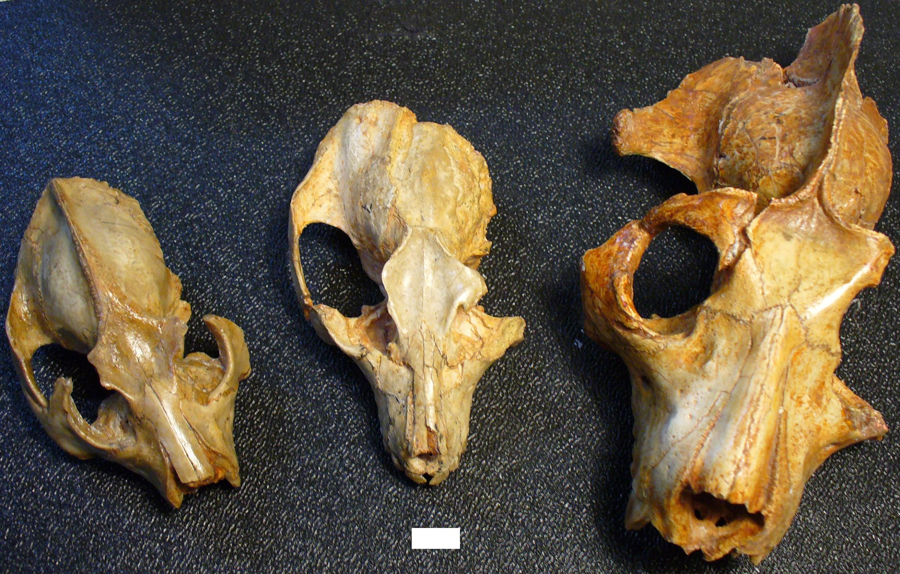
Eocene Euprimates
Adapoids
Diurnal
Herbivorous
Large
Omomyoids
Nocturnal
Insectivorous
Frugivorous
Small

Slide 8
Emergence of Modern Primate Groups
Strepsirrhines origins
Eocene and Oligocene
Afro-Arabia
Tarsiers origins
Miocene fossil from Thailand
Eocene fossils from China

Slide 9
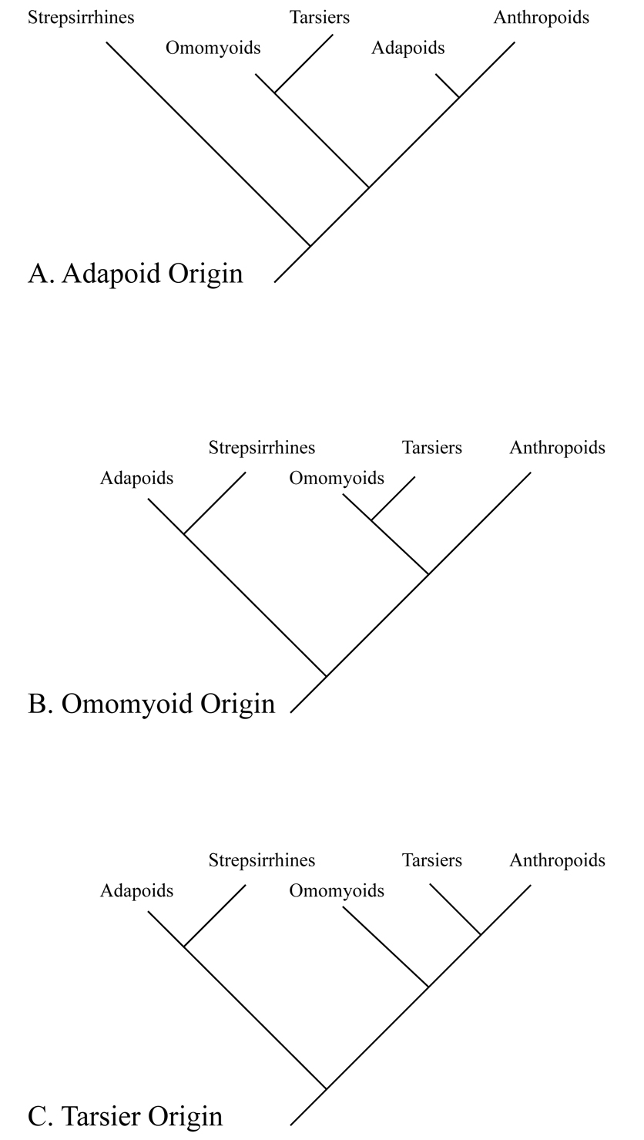
Origins of Anthropoids: Hypotheses
Adapoid origin
Diurnal lifestyle, large body, robust chewing system
Omomyoid origin
Cranial and hindlimb morphology
Tarsier origin
Olfactory system, visual system, bony similarities

Slide 10
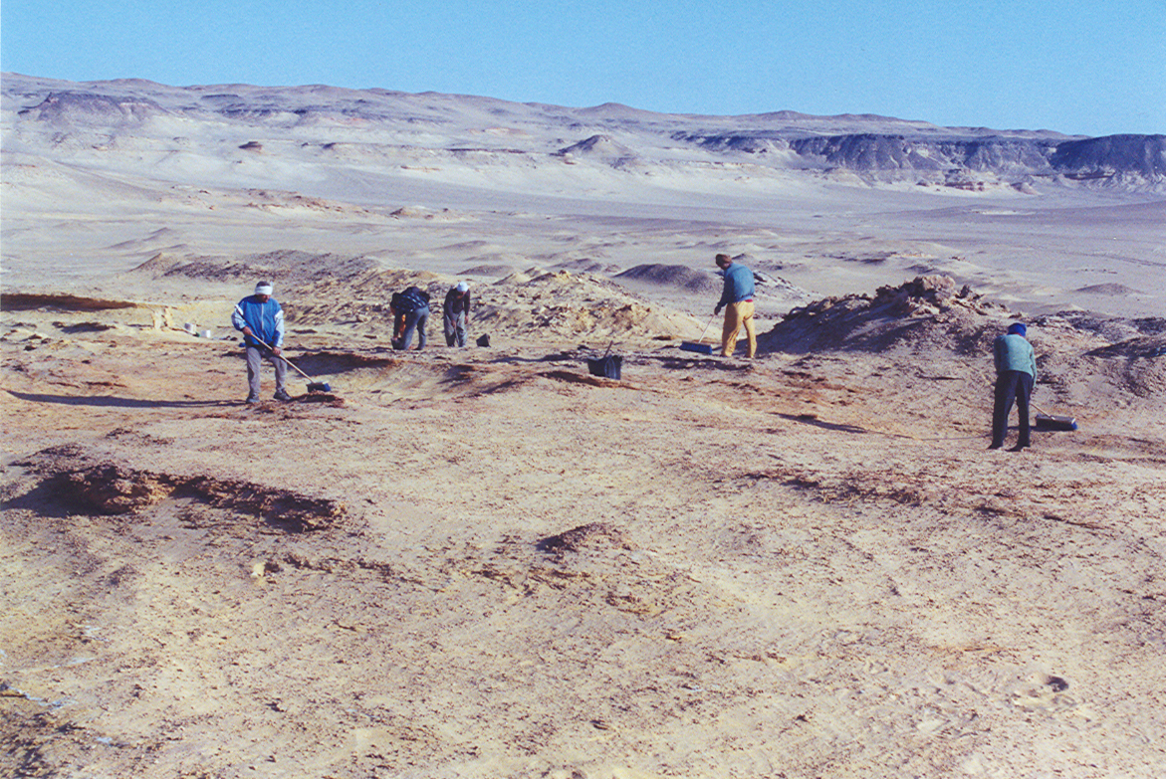
Anthropoid Fossils in Africa
Fayum Basin, Egypt
Dental formula
2.1.2.3 or 2.1.3.3
<500 grams to 15 lbs
Frugivorous
Diurnal
Quadrupeds
Leapers

Slide 11
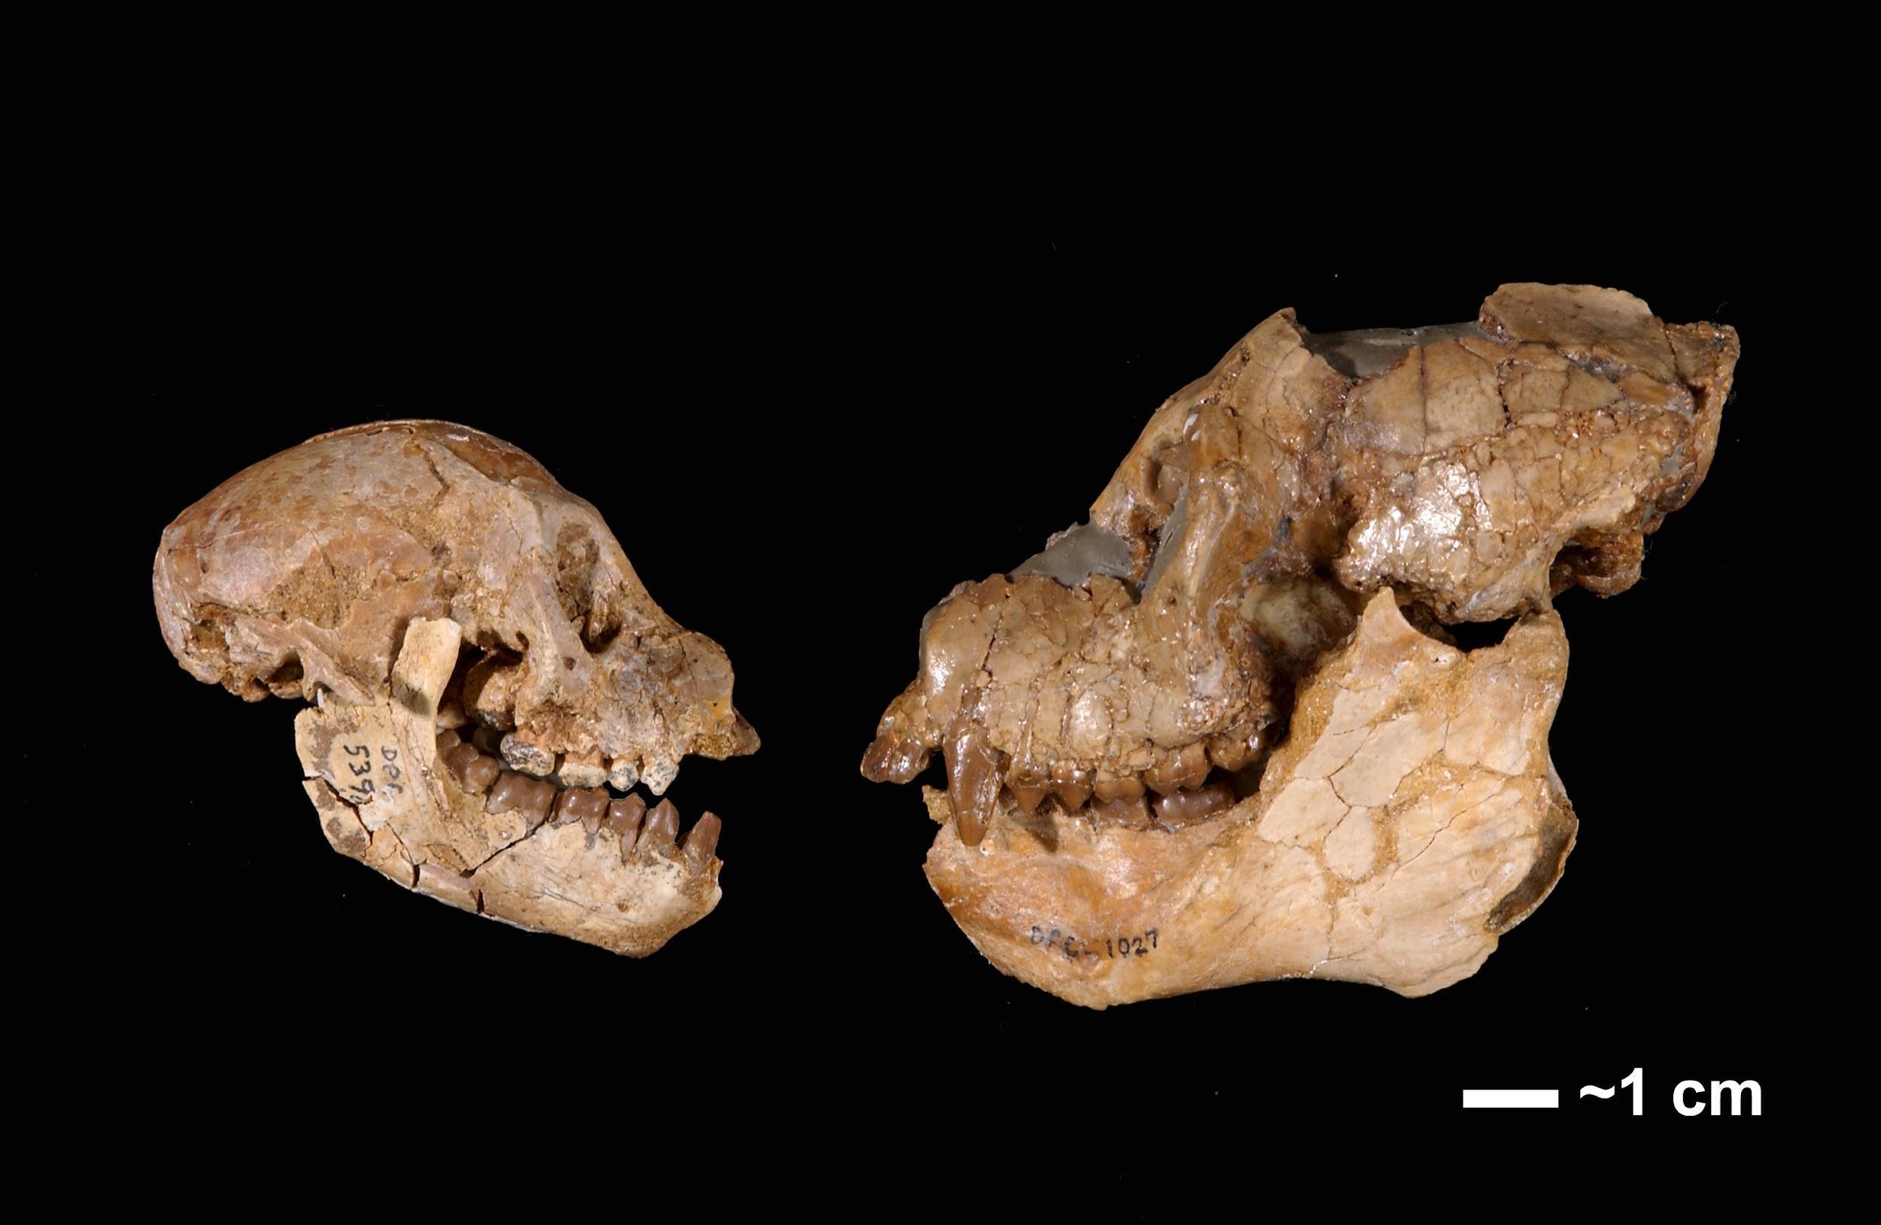
Propliopithecid: Aegyptopithecus
Large (15+ lbs)
Cranial features
Large chewing muscles
Low, round molars
Large canines
Long snout
Arboreal quadruped

Slide 12
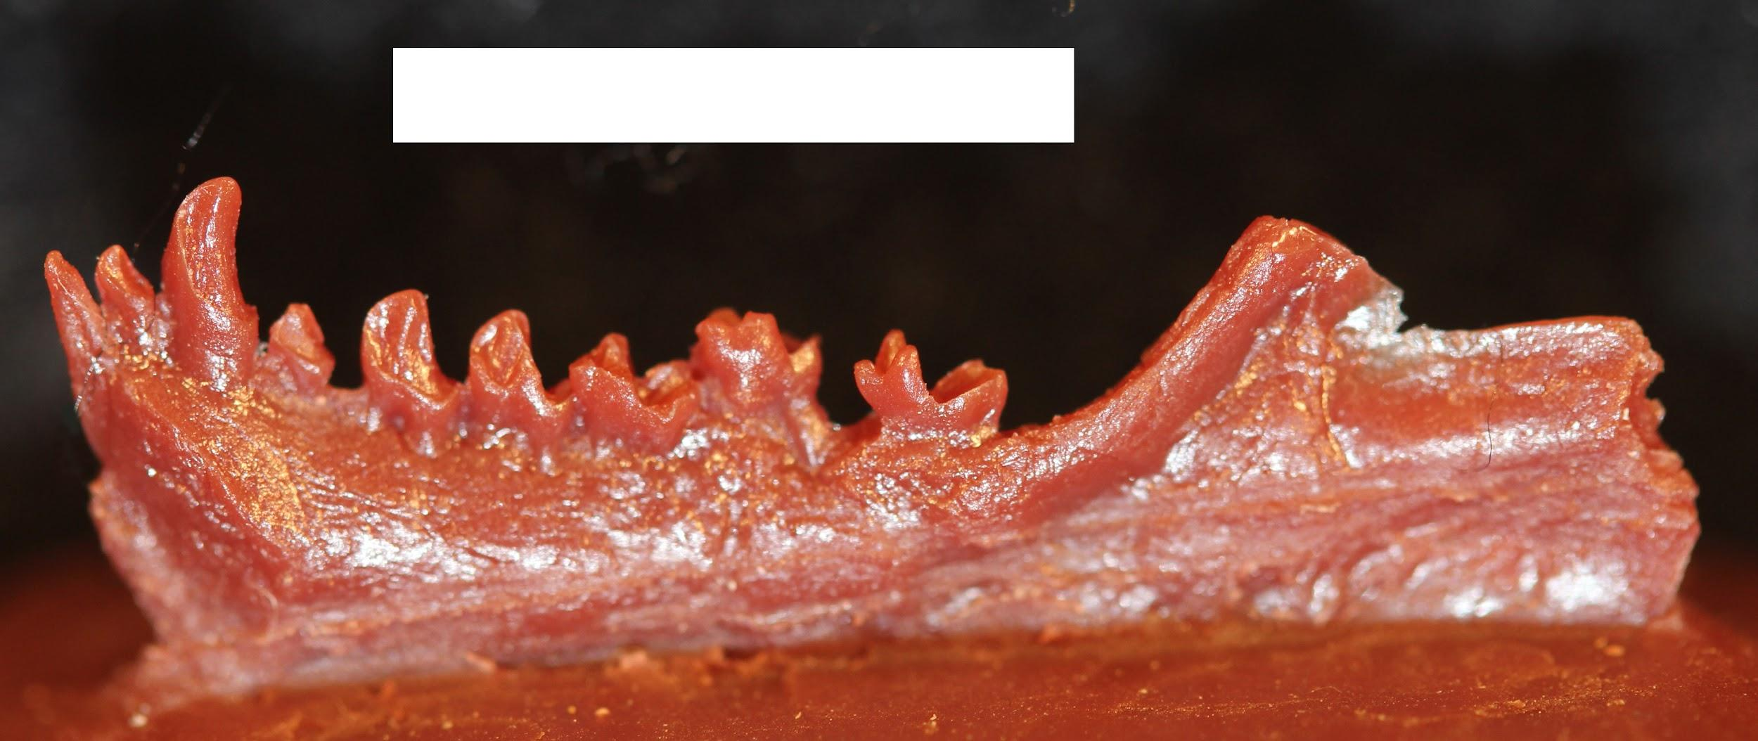
Early Anthropoids in Asia
Eosimiids
Small size
Deep lower jaw
Pointed incisors
Lower premolars
Amphipithecids
Up to 22 lbs
Deep jaws
Low molar cups
Folivorous, seed-eater

Slide 13
Platyrrhine Dispersal to South America
Africa → South America
Eocene
Rafts of vegetation
Rapid diversification and geographic spread

Slide 14
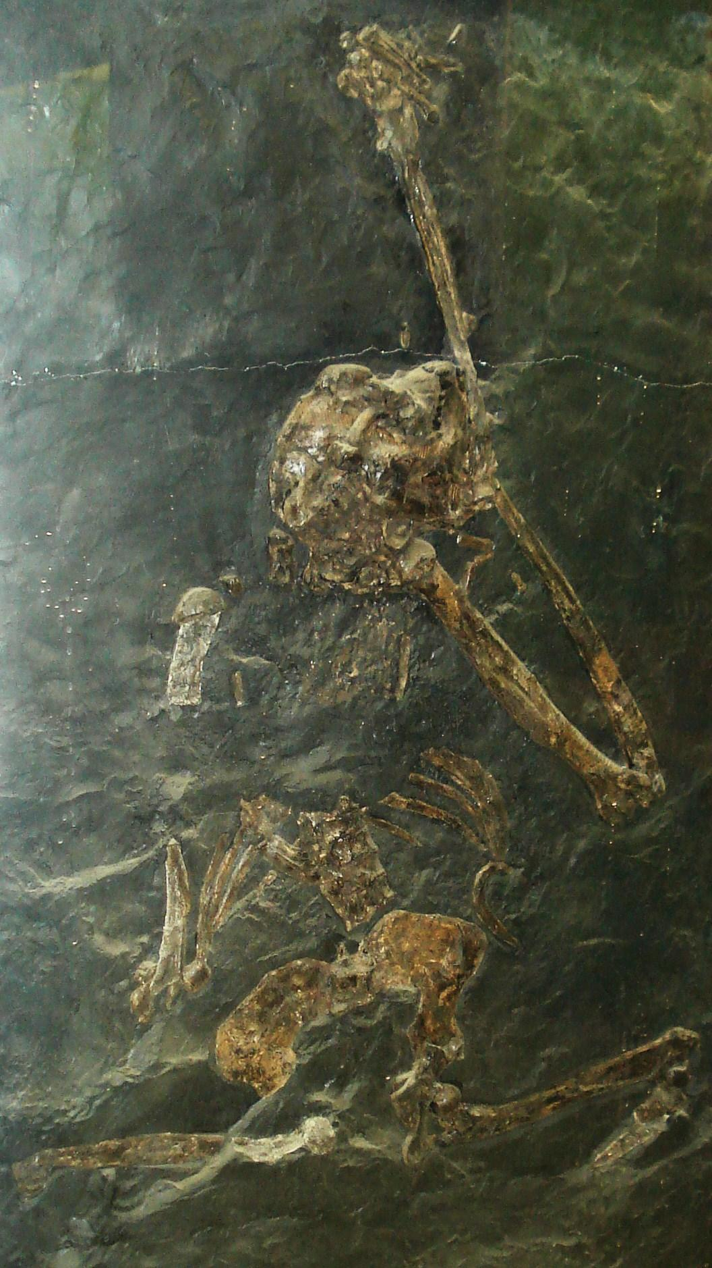
Miocene: Ape Diversity
Mammalian diversification
Warming trend
Diversification of apes
Africa
Proconsul
Euroasia
Oreopithecus
Gigantopithecus

Slide 15
Origins of Extant Apes
Lesser apes
Laccopithecus robustus
Yuanmoupithecus xiaoyuan
Great apes
Sivapithecus
Chororapithecus abyssinicus
Nakalipithecus nakayamai

Slide 16
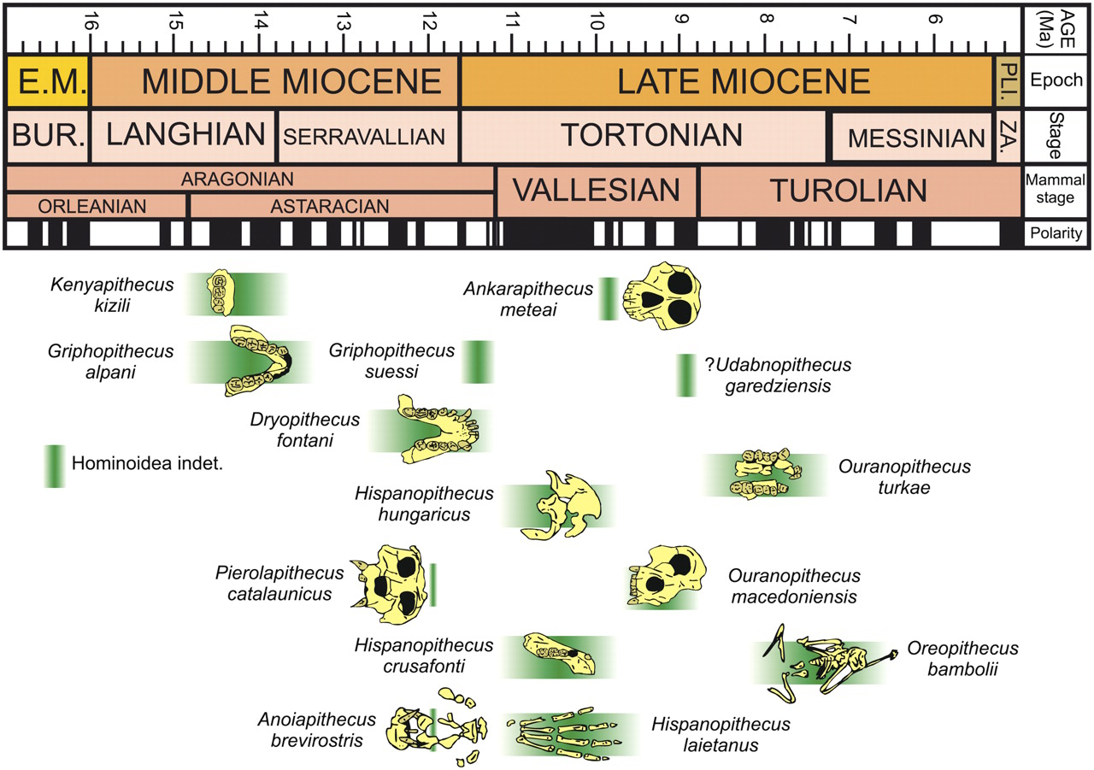
Miocene Apes

Slide 17
Major Families of Fossil Primates
Broad Group | Family | Example Taxon | Approximate Age for Group ¹
Plesiadapiforms | Paromomyidae | Ignacius | Middle Paleocene–Late Eocene
 | Carpolestidae | Carpolestes | Late Paleocene–Early Eocene
 | Plesiadapidae | Plesiadapis | Late Paleocene–Early Eocene
Early Euprimates | Asiadapidae | Asiadapis | Early Eocene
 | Cercamoniidae | Donrussellia | Early Eocene
 | Omomyidae | Teilhardina | Early Eocene
 | Caenopithecidae | Darwinius | Eocene
 | Adapidae | Notharctus | Middle Eocene
 | Sivaladapidae | Sivaladapis | Late Miocene
Early Anthropoids | Eosimiidae | Eosimias | Middle Eocene
 | Amphipithecidae | Amphipithecus | Middle–Late Eocene
 | Oligopithecidae | Catopithecus | Late Eocene
 | Proteopithecidae | Proteopithecus | Late Eocene
 | Parapithecidae | Apidium | Early Oligocene
 | Propliopithecidae | Aegyptopithecus | Early Oligocene
 | Homunculidae | Homunculus | Early–Middle Miocene
Later Anthropoids | Proconsulidae | Proconsul | Early Miocene
 | Victoriapithecidae | Victoriapithecus | Middle Miocene
 | Pliopithecidae | Pliopithecus | Middle–Late Miocene
 | Hylobatidae | Yuanmoupithecus | Late Miocene
 | Hominidae | Gigantopithecus | Late Miocene–Pleistocene
¹ Derived from Fleagle (2013)

Slide 18
Attributions
Slide # | Figure # | Attribution
3 | 8.1 | Hypotheses about primate origins a derivative work by Jonathan M. G. Perry and Stephanie L. Canington is under a CC BY-NC 4.0 License. [Includes Garnett's Galago by Ltshears, CC BY-SA 3.0; Nycticebus bancanus by Gunay M.E., CC BY-SA 4.0; Anja réserve (Madagascar) - 06 by Wayne77, CC BY-SA 4.0].
4 | 8.2 | Primate family tree by Jonathan M. G. Perry is under a CC BY-NC 4.0 License.
5 | 8.3 | Eocene Jay Matternes by Jay Matternes creator QS:P170,Q16732146 is in the public domain.
6 | 8.5 | CarpolestesCL by Sisyphos23 is used under a CC BY-SA 3.0 License.
7 | 8.7 | Representative crania of adapids (European adapoids) from the Museum d’Histoire Naturelle Victor Brun in Montauban, France original to Explorations: An Open Invitation to Biological Anthropology by Jonathan M. G. Perry is under a CC BY-NC 4.0 License.
9 | 8.11 | Competing Trees for Anthropoid Origins by Jonathan M. G. Perry is under a CC BY-NC 4.0 License.
10 | 8.12 | Egyptian workers sweeping Quarry I in the Fayum Basin (2004) by Jonathan M. G. Perry is under a CC BY-NC 4.0 License.
11 | 8.14 | Female and male cranium of A. zeuxis by Simons, Elwyn L., Erik R. Seiffert, Timothy M. Ryan, and Yousry Attia. Original from Simons, et al. 2007. A remarkable female cranium of the early Oligocene anthropoid Aegyptopithecus zeuxis (Catarrhini, Propliopithecidae). Proceedings of the National Academy of Sciences of the United States of America 104 (21): 8,731-8,736. doi.org/10.1073/pnas.0703129104.

Slide 19
Attributions
Slide # | Figure # | Attribution
12 | 8.15 | Cast of the right half of the mandible of Eosimias centennicus, type specimen, from K.D. Rose cast collection, photo by Jonathan M. G. Perry is under a CC BY-NC 4.0 License.
14 | 8.23 | Oreopithecus bambolii 1 by Ghedoghedo is used under a CC BY-SA 3.0 License.
16 | 8.20 | Range chart for Miocene hominoids of Western Eurasia by Casanovas-Vilar, Isaac, David M. Alba, Miguel Garcés, Josep M. Robles, and Salvador Moyà-Solà. Original from Casanovas-Vilar et al. 2011. Updated chronology for the Miocene hominoid radiation in Western Eurasia. Proceedings of the National Academy of Sciences 108 (14): 5,554-5,559.

