Slide 1
Chapter 13
Race and Human Variation
Michael B. C. Rivera, Ph.D.
CC BY-NC

Slide 2
Learning Objectives
Review the history of “race” concepts
Critique earlier “race” concepts
Explain human biological variation
Identify phenotypic traits that reflect selective and neutral evolution
Identify key insights into human variation

Slide 3
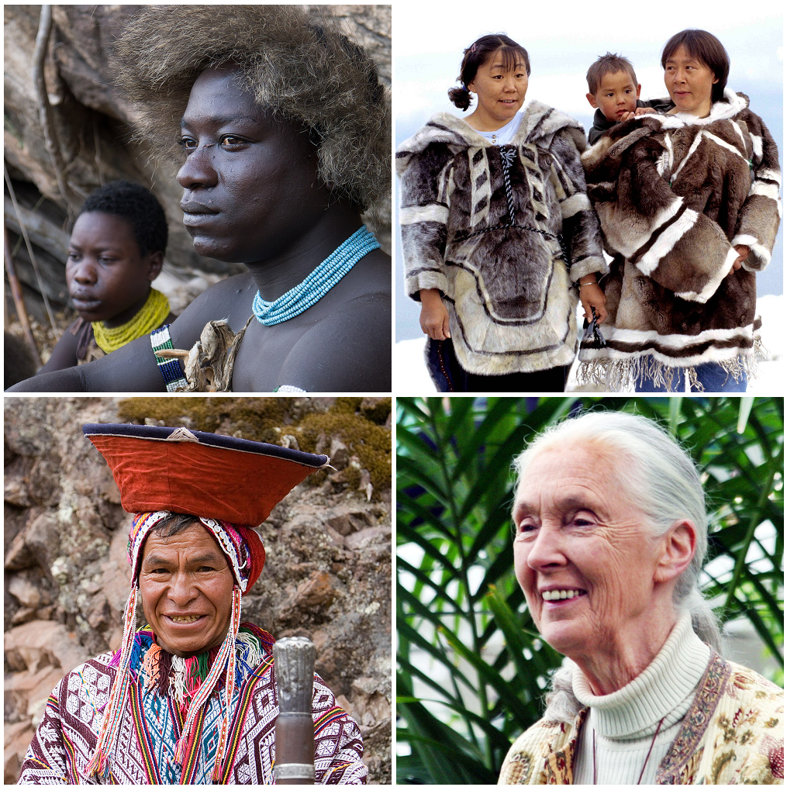
Themes in the Study of Race
Race is not useful in describing human diversity
Humans have much less genetic diversity than other primates and mammals

Slide 4
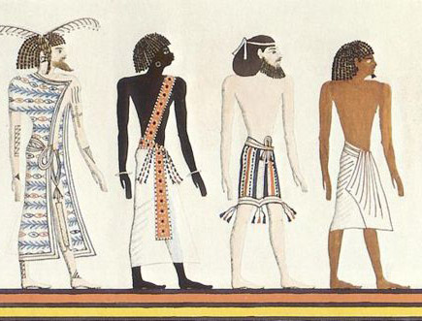
“Race” in the Classical Era
Many cultures have attempted to classify human diversity
Ancient Egypt
Romans
Greeks
Religious traditions (Christianity, Judaism, Islam)

Slide 5
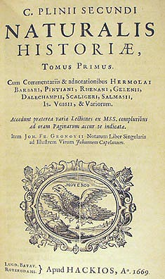
Naturalis Historia
Three categories
Civilized peoples
Barbarians
Monstrous individuals
Book of Gates
Limited exposure to other cultural groups

Slide 6
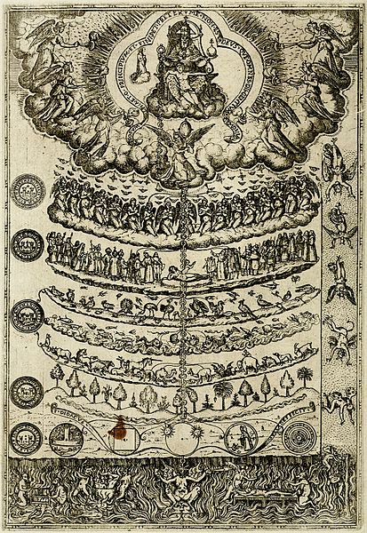
Great Chain of Being
Ladder: all objects, plants, animals, humans, and celestial bodies in a hierarchy
Order of existential importance
Humans near the top, beneath divine beings
Aristotle: certain people are inherently (or genetically) more instinctive rulers, others are more naturally fit to be workers or slaves

Slide 7
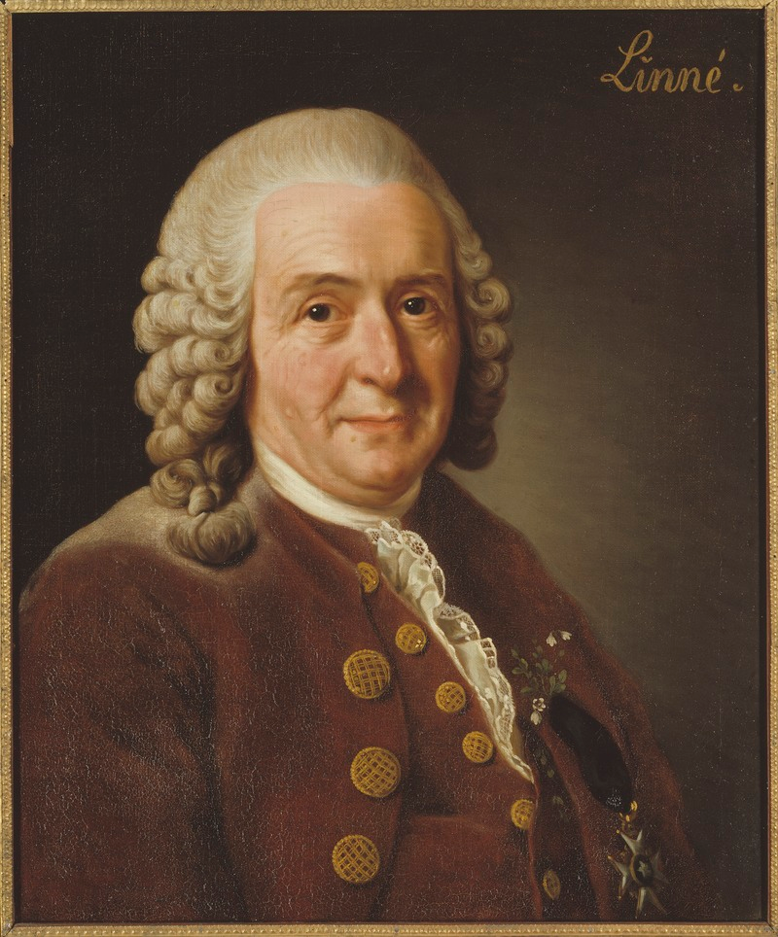
“Race” from the Scientific Revolution
Linnaeus: Systema Naturae (1758)
Classified all plants and animals under the first formalized naming system
Binomial nomenclature
First to group humans with apes and monkeys
Essentialism

Slide 8
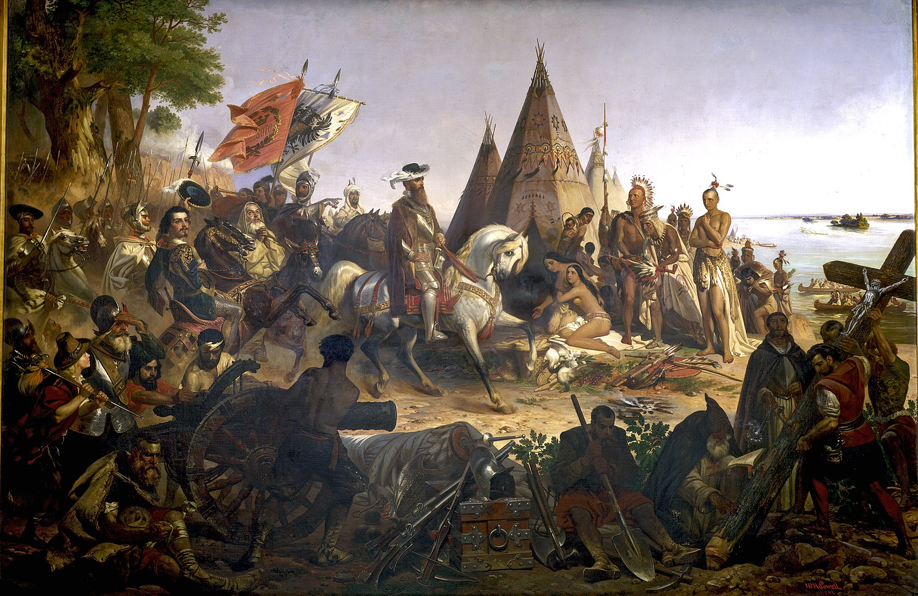
Age of Discovery
European colonialism
1400s and 1700s
Intentionally violent encounters overseas
Idea of species and “subspecies”
French “rasse”: “local strain”
Geography
Othering

Slide 9
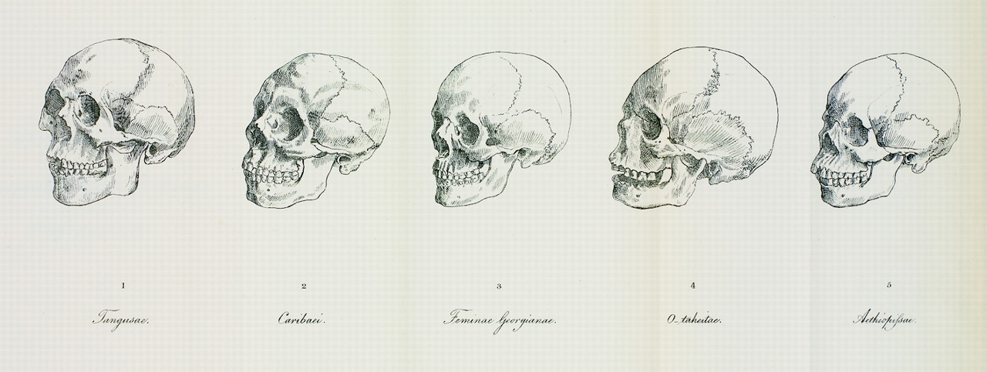
Emergence of “Race” Concept
Johann Friedrich Blumenbach (1752‒1840)
Five races based on
Cranial form variation
Skin color
“Original” form of the human cranium: “Caucasian”
Gradation idea

Slide 10
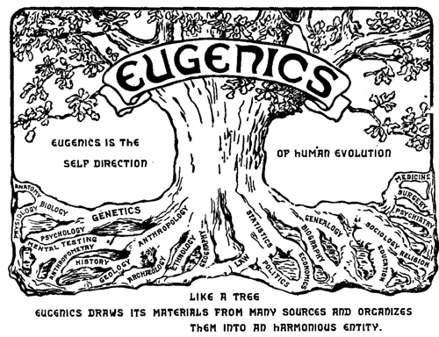
“Race” and the Dawn of Scientific Racism
Biological determinism
Morton
Cranial measurements
Paul Broca
Skin color and intelligence
Civilized and barbaric populations

Slide 11
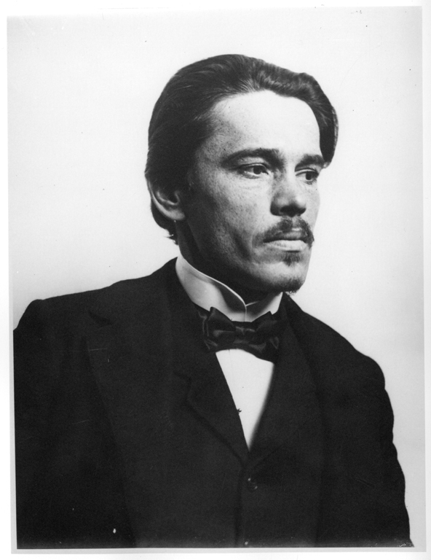
“Race” and Beginnings of Physical Anthropology
Aleš Hrdlička
Physical anthropology
American Journal of Physical Anthropology
Franz Boas
Four-field anthropology in the U.S.
Founded American Anthropological Association, 1902
Skull dimensions depend on cultural and environmental factors
Social learning influences human behaviors

Slide 12
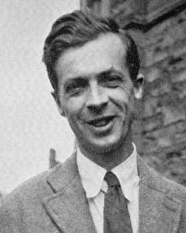
“Populations” instead of “Races”
Julian Huxley
Modern Synthesis reconciled two fundamental principles about evolution
Human populations are capable of exchanging genes at the microevolutionary level
Multiple alleles for one trait (polygenic exchanges) can cause gradual macroevolutionary changes

Slide 13
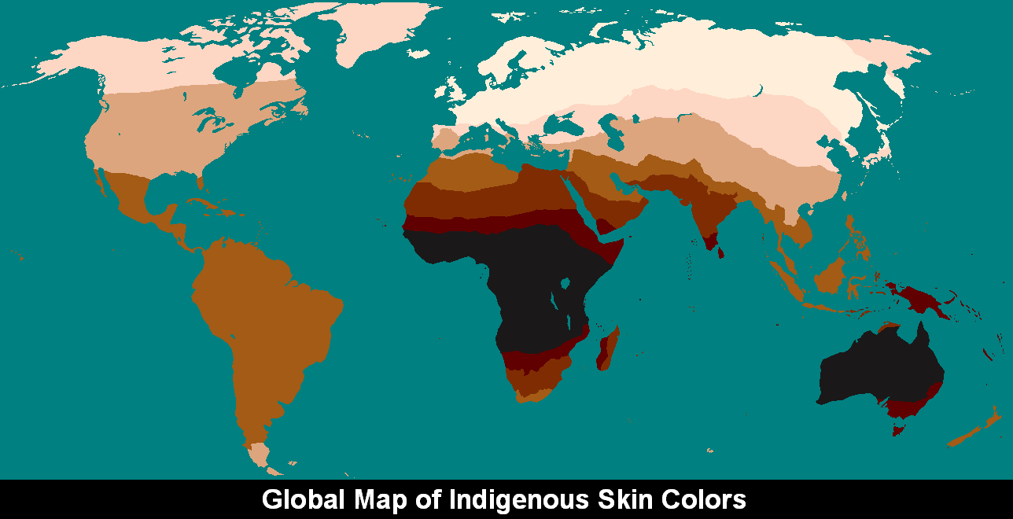
Human Variation is Clinal
Clines
Continuous variation
Frank B. Livingstone (1928‒2005): “There are no races, only clines” (1962)
Natural selection
Gene flow
Genetic drift

Slide 14
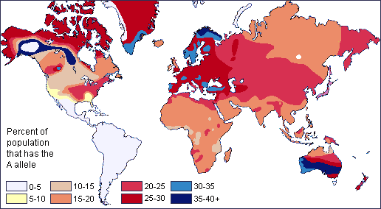
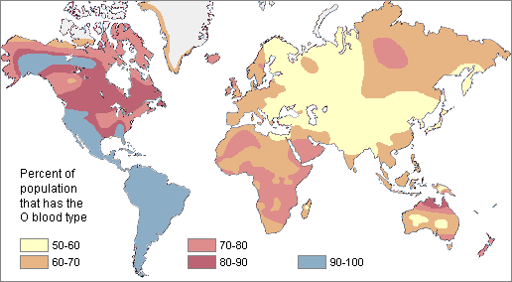
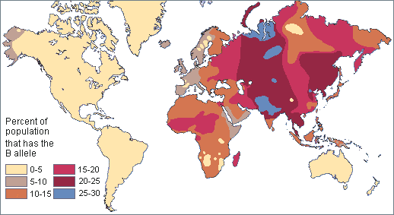
Global Distribution of Blood Types

Slide 15
Genetic Diversity is Greater Within-Group Than Between-Groups
Richard Lewontin (1929‒)
Most of human genetic differences (85.4%) were found within local subpopulations
8.3% were found between populations within continental human groups
6.3% were attributable to traditional “race” groups
Findings reject the existence of biological races
Noah Rosenberg and colleagues (2002)
Neutral genetic markers reflect combination of regional founder effects and population histories

Slide 16
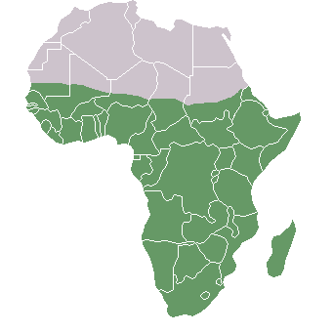
Biological Data Fit Out-of-Africa and Isolation-by-Distance Models
Worldwide human genetic variation
Most genetic variation: SubSaharan Africa
Least genetic variation: Northern Europe, southern tip of South America
Out-of-Africa model
Isolation-by distance model

Slide 17
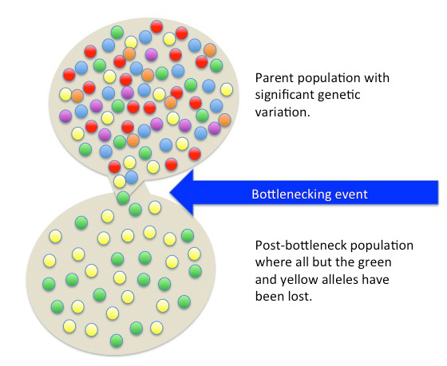
Humans Have Higher Homogeneity
Compared to most species
Humans have low average genome-wide heterogeneity
Founder effect
Ecological niches
Population bottleneck

Slide 18
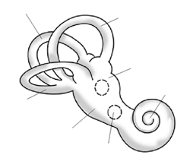
Phenotypic Traits That Reflect Neutral Evolution
Non-concordance
Pelvis, the teeth and the human bony labyrinth of the ear

Slide 19
Phenotypic Traits That Reflect Natural Selection
99.9% of DNA is the same between all humans worldwide
Many traits reflect neutral processes
0.1% of the human genome codes for individual and regional differences
Skin color
Disease resistance
Ancestry

Slide 20
Human Biological Variation: Going Forward
Local human groups are “populations”
Humans have less genetic diversity than other primates and mammals; share 99.9% of DNA
0.1% of human variation varies on a clinal basis
Many human biological characteristics are determined non-concordantly and/or polygenically

Slide 21
Human Biological Variation: Going Forward
Genetic distances are correlated with geographic distances among the global human population
Effects of gene flow, genetic drift, and population bottlenecking are reflected in some phenotypic traits, such as cranial shape
Other traits, like skin color and lactase persistence, are product of many millennia of natural selective pressures influencing human biology from the external environment

Slide 22
Attributions
Slide # | Figure # | Attribution
3 | 13.1 | a. Tanzania - Hadzabe hunter (14533536392) by A_Peach from Berlin, Germany, is used under a CC BY 2.0 License b. Inuit-Kleidung 1 by Ansgar Walk is used under a CC BY-SA 3.0 License c. Andean Man by Cacophony is used under a CC BY-SA 4.0 License d. Jane Goodall GM byFloatjon is used under a CC BY-SA 3.0 License
4 | 13.2 | Egyptian races Drawing (1772-1846) by an unknown artist after a mural of the tomb of Seti I, Copy by Heinrich von Minutoli (1820), is in the public domain.
5 | 13.3 | Naturalishistoria from the front page of Pliny the Elder’s Naturalis Historia is in the public domain.
6 | 13.4 | Great Chain of Being 2 by Didacus Valades (Diego Valades) is in the public domain.
7 | 13.5 | Carl von Linné by Alexander Roslin artist QS:P170,Q315102 is in the public domain.
8 | 13.6 | Discovery of the Mississippi by William Henry Powell artist QS:P170,Q3568696 (photograph courtesy Architect of the Capitol) is in the public domain.
9 | 13.7 | Blumenbach's five races by Johann Friedrich Blumenbach is in the public domain.
10 | 13.9 | Eugenics congress logo scanned from Harry H. Laughlin, The Second International Exhibition of Eugenics held September 22 to October 22, 1921, is in the public domain.

Slide 23
Attributions
Slide # | Figure # | Attribution
11 | 13.8 | (Ales Hrdlicka) SIA2009-4246 by Unknown photographer is in the public domain
12 | 13.11 | Julian Huxley 1-2 by Unknown photographer is in the public domain
13 | 13.12 | Skin color by S25454541 is used under a CC BY-SA 4.0 License
14 | 13.13 a, b, c | a. Map of blood group a by Muntuwandi at en.wikipedia is used under a CC BY-SA 3.0 License b. Map of blood group b by Muntuwandi at en.wikipedia is used under a CC BY-SA 3.0 License c. Map of blood group o Based on diagrams from http://anthro.palomar.edu/vary/vary_3.htm reproduced from A. E. Mourant et.al., The Distribution of the Human Blood Groups and Other Polymorphisms, 2nd ed. (1976) is used under a CC BY-SA 3.0 License
16 | 13.14 | Sub-Saharan-Africa by Ezeu has been designated to the public domain (CC0).
17 | 13.15 | Bottleneck effect by Tsaneda is used under a CC BY 3.0 License.
18 | 13.18 | Bony labyrinth by Selket (5 February 2007, UTC) has been designated to the public domain (CC0)

