Slide 1
WELCOME!

Slide 2
Notes:
-introduce WEAVE
-trauma-informed warning, give audience space to practice self-care if needed, some of the topics we discuss can be difficult or triggering "take time for yourself if you need to, this information can be heavy or triggering for those who have experiences or witnessed abuse, so be sure to always take care of yourself first“
-community agreements

Slide 3
COMMUNITY AGREEMENTS
1. RESPECT each other
2. SHARE THE SPACE, while centering Black, Indigenous, and Other People of Color (BIPOC), and LGBTQIA+ voices
3. CONFIDENTIALITY. What’s said here, stays here. What’s learned here, leaves here.
4. CONTENT WARNING. Some content that is being shared may be triggering. Please share a Content Warning if what you share might trigger others.
5. REMOVAL. Those not adhering to the community agreements, will be removed from the forum.
Notes:
Trajan will lead!
1. RESPECT each other
2. SHARE THE SPACE, while centering Black, Indigenous, and Other People of Color (BIPOC), and LGBTQIA+ voices
3. CONFIDENTIALITY. What’s said here, stays here. What’s learned here, leaves here.
4. CONTENT WARNING. Some content that is being shared may be triggering. Please share a Content Warning if what you share might trigger others.
5. REMOVAL. Those not adhering to the community agreements, will be removed from the forum.

Slide 4
LAND STATEMENT We honor and acknowledge Miwok, Nisenan, and Maidu lands, and the tribal nations whose lands Los Rios Community College District sits on.
We honor and acknowledge early migrant and laboring communities of color who built the foundations of these regional lands.
Notes:
Fenix will lead!
LAND STATEMENT We honor and acknowledge Miwok, Nisenan, and Maidu lands, and the tribal nations whose lands Los Rios Community College District sits on.
We honor and acknowledge early migrant and laboring communities of color who built the foundations of these regional lands.

Slide 5
BLACK SOLIDARITY STATEMENT
Together we stand in solidarity with our Black community, and our students, faculty, staff, and administrators, to fight against systemic inequity, injustice, and racism, which is resulting in untimely deaths and immense suffering in the Black community.
We understand that in addition to the disproportionate impact of COVID-19 on Black and POC communities, we must address racism and white supremacy within ourselves, our communities, and our colleges.
Notes:
Fenix will lead!
BLACK SOLIDARITY STATEMENT
Together we stand in solidarity with our Black community, and our students, faculty, staff, and administrators, to fight against systemic inequity, injustice, and racism, which is resulting in untimely deaths and immense suffering in the Black community.
We understand that in addition to the disproportionate impact of COVID-19 on Black and POC communities, we must address racism and white supremacy within ourselves, our communities, and our colleges.

Slide 6
ICE BREAKER
- Name + Pronouns
- What campus are you from?
- What’s something that is bringing you joy right now?
Notes:
Encourage students to speak, but if not, using the chat is fine.
- Name + Pronouns
- What campus are you from?
What’s something that is bringing you joy right now?

Slide 7
Mondays, 1:00 – 2:00pm: Drop-In Counseling, College Nurse
Monday, 2:00 - 2:30pm: Equity Lounge
Wednesdays, 3:00 - 4:00pm: Drop-In Counseling, Licensed Psychologist, Jobs & Internship Support
Thursdays, 4:30 – 5:30pm: Faculty Office Hours with Dr. Victoire Chochezi
Notes:
Equity Center will speak on their resources and drop-in hours!

Slide 8
WEAVE’s mission is to promote safe and healthy relationships and support survivors of sexual assault, domestic violence, and sex trafficking.
Established in 1978.
Opened first domestic violence shelter in California, and third in the nation in 1986.
Sacramento County’s sole rape crisis center since 1988.
Notes:
Sacramento County’s primary service provider
Sacramento County’s sole Rape Crisis Center
Sacramento County’s only contracted CSEC service provider
About WEAVE
WEAVE is the primary provider of crisis intervention services for survivors of domestic violence, sexual assault, and sex trafficking in Sacramento County.
WEAVE works to build a community that does not tolerate sexual assault, domestic violence and sex trafficking and provides survivors with the support they need to be safe and thrive.
WEAVE’s vision is a community free of violence and abuse.
At WEAVE we believe that crisis intervention services are only part of the solution. Prevention and Education are critical in improving how our community responds to violence. WEAVE is committed to breaking the cycle of violence by educating the community to better understand the issues of sexual violence.

Slide 9
Student Resources
Confidential Advocate: (916) 568-3011
Provide confidential emotional support
Discuss reporting options
Provide information regarding medical options and evidentiary exam
Provide accompaniment when reporting or for college proceedings
Provide advocacy for accommodations
Make referrals for on- or off-campus counseling and legal assistance
File confidential report to the Title IX Officer in compliance with the Clery Act
Notes:
Provide confidential emotional support
Discuss reporting options
Provide information regarding medical options and evidentiary exams
Provide accompaniment when reporting or for college proceedings
Provide advocacy for accommodations
Make referrals for on- or off-campus counseling and legal assistance
File confidential report to the Title IX Officer in compliance with the Clery Act

Slide 10
Confidential Advocate: (916) 568-3011
weave@losrios.edu
WEAVE Confidential Advocate provides support and resources for students at Los Rios Community Colleges.
Mon: SCC – Tues: FLC – Wed: ARC – Thurs: CRC

Slide 11
Friends
Parents
Classmates
Family
Peers
Neighbors
What is a relationship?
Teachers
Girlfriends
Counselors
Boyfriends
Coaches
Partners
Notes:
- Invite audience to give suggestions of different types or what one is
Important to point out that relationships doesn't always mean a girlfriend/boyfriend/partner, it could be all of the listed above and more
Also point out that with the different types of relationships there are different expectations and that’s okay

Slide 12
What is a healthy relationship?
Notes:
-Open up discussion for audience participation, "what are some characteristics of a healthy relationship?“

Slide 14
Healthy Relationships
have both
-respect & equality-

Slide 15
Respect
Communication
Support
Negotiation & Compromise
Honesty & Trust
Consent
Notes:
-Respect: honoring boundaries and privacy; valuing others and their feelings; understanding that just because something isn't important to you, it might be important to others, so you still value and respect that (i.e. if someone likes a certain show, game, sport, etc., don't make fun of them for it, respecting others to allow them to enjoy what they like)
-Communication: being able to express feelings and opinions openly without fear of making someone mad; understanding that it's okay to disagree on things and being able to communicate that in a productive manner; being able to say what's okay and what's not okay within your own boundaries
-Support: offering comfort and support when needed; encouraging someone's personal growth and goals (i.e. if your friend or partner is on a basketball team, but you don't really care for basketball, still being able to go to their games to show support)
-Negotiation & Compromise: having discussions rather than arguments (think of it like us vs the problem instead of you vs me); being willing to compromise at a middle ground, but it is important to understand this does not mean you compromise your own values and beliefs, do not make unhealthy compromises on things that are important to you (i.e. if it's your family member's birthday the same day as a friend/partner's basketball game, you shouldn't sacrifice your own needs, and your friend/partner should respect that by not getting upset or angry; finding a compromise that you will go to the next game instead)
-Honesty & Trust: how do you build trust? By being honest. Be honest about what your needs are, what you're doing, how you're feeling; making sure you don't keep things from your friend/partner because you think it'll hurt their feelings or make them mad; on the flip side, you can't build trust by invading someone's privacy and getting jealous/mad if they're spending time with others; ties back to respect and communication
-Consent: an important part of a healthy relationship is physical affection, but there must ALWAYS be consent before any physical activity; ALWAYS respect others' boundaries

Slide 16
No relationship should be abusive.
Notes:
-transition with "of the relationships we just went over, do you think that any of those should be abusive?"
-loving someone does not mean you abuse them

Slide 17
What is an abusive relationship?
Notes:
-open up discussion for audience participation, "what are some signs of an abusive relationship?"

Slide 18
Physical
Emotional
Sexual
Financial
Spiritual
Technological
Notes:
-Physical: the use or threat of physical force against another person in a way that injures a person (hitting, choking) or puts the person at risk of being injured, this means that any time a person feels unsafe or in danger of violence (i.e. throwing things even if not directly at a person, blocking someone from leaving, breaking things, choking)
-Emotional: constant negative criticism, name-calling, putting down, gas-lighting aka crazy-making (what you believe is not true/you're being crazy for believing something); making all the decisions for someone; an example could be someone saying "if you leave, I'll hurt myself" and acknowledge that this can be a very scary thing to hear, and if someone says that to you, you should talk to a trusted adult to get extra support for yourself and that person.
-Sexual: forcing ANY unwanted physical contact and/or sexual acts (sexual assault); any abuse based on gender identity or expression; sexual abuse can be linked to other types of abuse, including technological with the act or threat of sharing private photos or messages
-Financial: withholding resources, stealing from the victim, expecting to pay for everything, using someone's name to incur debt, demanding personal financial info (bank account information, passwords, cards, etc.), interfering with someone's source of income (i.e. constantly showing up or calling to get someone in trouble at their work)
-Spiritual: audience will often link spiritual abuse to religion, but it's important to acknowledge that there are also other ways spiritual abuse happens along with the religious aspect; essentially spiritual abuse is getting in the way of doing something that someone believes in or enjoys for their well-being (i.e.not allowing someone to practice their morals/values/religious beliefs, not allowing someone to spend time with their family or friends); ask: "do you feel like you've given up things that are important to you?"
-Technological: any use of technology (including social networking) to bully, harass, stalk, or intimidate someone; high frequency of calls/texts day and night, and getting angry if you fail to respond right away; controlling passwords to phone and social media accounts; using social media to stalk or impersonate someone; GPS tracking without permission; using private photos and messages as a threat; acknowledge the difference that there is a difference in power dynamic between parents and children, parents/caregivers are legally responsible for their child, which is very different from the equality in relationships
-IMPORTANT to acknowledge that there could be as little or as many overlapping types of abuse present, it's all about the power and control; these are ways to categorize so we can identify the red flags more easily

Slide 19
Cycle of Violence
Honeymoon
Tension Building
Explosion
False
Honeymoon or Calm Phase
Notes:
-Cycle of Violence is important so that we can identify what's going on and take steps to stop the cycle
-Honeymoon: everything is going really well and there are no issues (i.e.
-Tension Building:
-Explosion:
-False Honeymoon or Calm Phase:

Slide 20
Going home for the holidays?
Let’s talk about BOUNDARIES…
Notes:
-Acknowledge that while family and holidays can be a great, loving time—that is NOT the case for everyone
-Some students will face differing political views, judgements on their gender identity or sexual orientation
-Some students have toxic households

Slide 21
Why have boundaries?
A way to practice self care
Promotes good emotional health for both individuals
Lessen feelings of being responsible for other’s emotions
Taking responsibility of your own needs

Slide 22
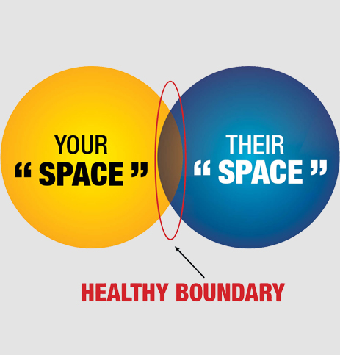
First steps in Creating Boundaries
Be simple and direct
Explain why this is important to you
You can start small
Prioritize your feelings
Remember these boundaries can be fluid, it’s up to you!
Get comfortable saying “no”
Notes:
Be simple and direct– ex: ”I don’t want to talk about politics today” or “I don’t want you to comment on my appearance”
Explain why this is important to you
You can start small
Prioritize your feelings
Remember these boundaries can be fluid, it’s up to you!
Open up for students to share

Slide 23
What if I can’t this time?
Remember that it’s okay to remove yourself from uncomfortable conversations
Have an external support system
Allow yourself to feel your feelings
Acknowledge your past and present
Know your school resources, such as the Equity Center
Notes:
-Remember that it’s okay to remove yourself from uncomfortable conversations, don’t pressure yourself to start this conversation with family if you don’t want to!
-Have an external support system
-Allow yourself to feel your feelings
-Acknowledge your past and present

Slide 25
Notes:
-Create space for students to share their thoughts or plans going into the holidays

Slide 26
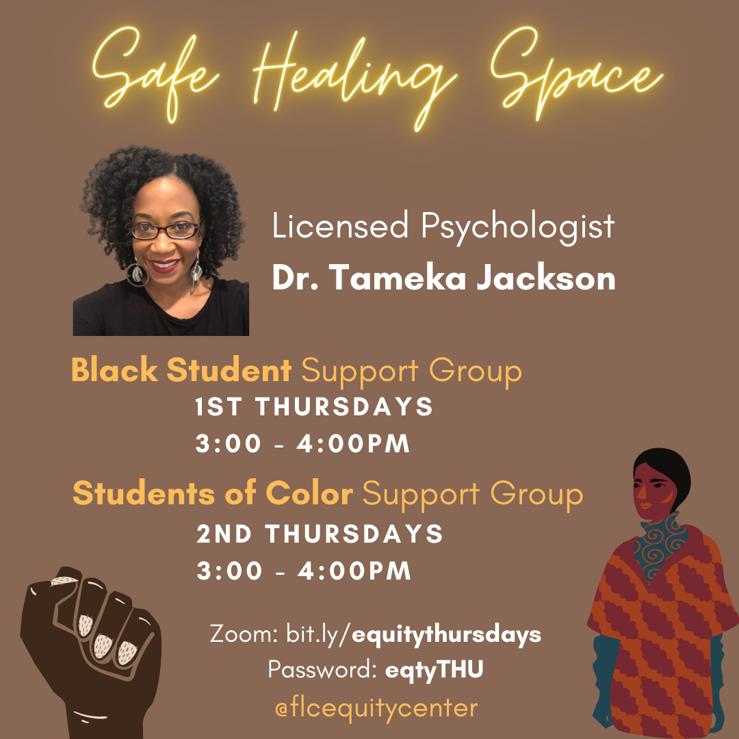
Upcoming Events

Slide 27
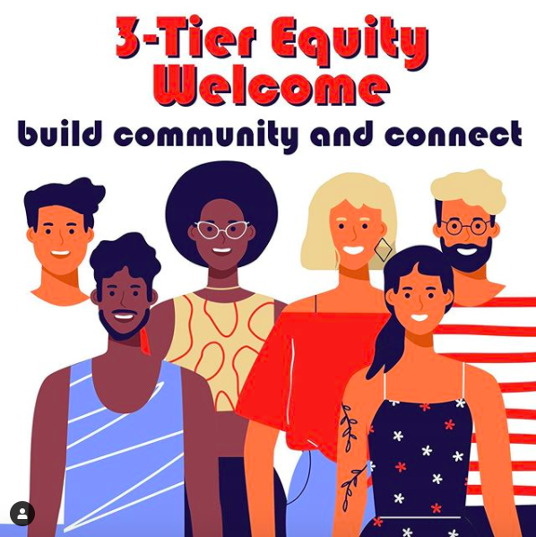
3-Tier Equity Connection: Black, People of Color, and LGBTQ+ communities in Los Rios Colleges
Monday, November 30, 2020
Zoom Link: bit.ly/equitymondays
Password: eqtyMON
Students, staff, faculty, administrators are encouraged to attend. Open to Los Rios Community College District.
2:00 – 2:50pm Black/African American/African Diaspora Connection
3:00 – 3:50pm Black, Indigenous, and other People of Color (BIPOC) Connection
4:00 – 4:50pm LGBTQ+ Connection
Notes:
2:00 – 2:50pm Black/African American/African Diaspora Connection
3:00 – 3:50pm Black, Indigenous, and other People of Color (BIPOC) Connection
4:00 – 4:50pm LGBTQ+ Connection

Slide 28
Student Resources
Confidential Advocate: (916) 568-3011
WEAVE Confidential Advocate is on each of the 4 campuses 1 day/week
Mon: SCC – Tues: FLC – Wed: ARC – Thurs: CRC
Office hours are currently held virtually through Zoom
weave@losrios.edu
(916) 568-3011

Slide 29
WEAVE Services
Response & Crisis Intervention
Emergency Shelter & Housing Assistance
Trauma Informed Counseling
Case Management
Legal Assistance
Training &
Presentations

Slide 30
Confidential Advocate: (916) 568-3011
weave@losrios.edu
24/7 Support & Information Line
916-920-2952
weaveinc.org

