Slide 1
Art shared with permission by @madame_marilou on instagram.
Notes:
Why we’re here…

Slide 2
API Legacy: Planning Committee
With Support From:
ARC: Jimina Afuola (she/her/hers), Rod Agbunag (he, him, his), Neue Leung (she/her/hers) CRC: Paolo Soriano (he/him/his) FLC: Valerie Chueh (they/she), Sharisse Estomo (she/her/hers) SCC: Jamil Malik (he/him/his)
FLC Equity Center Team, Dr. Molly Senecal (she/her/hers) ASL Interpreters Jesse Martinez (he/him/his) & Janina Witteborg (she/her/hers) ARC Pacific Islander Asian American Resilience Integrity & Self-Determination through Education (PRISE)
Notes:
Name, campus, pronouns

Slide 3
Land Acknowledgement & Asian Pacific Islander History
on these lands
We honor and acknowledge Miwok, Nisesan, and Maidu lands, and the tribal nations whose lands Los Rios Community College District sits on.
We honor and acknowledge early Asian and Pacific Islander migrant labor communities, and other communities of color who came to build the foundations of these regional lands long ago.
Notes:
Valerie

Slide 4
In Solidarity
Although today’s focus is on the experiences of Asian Americans, we would also like to express solidarity with all communities outside of Asian Americans that have been impacted. We understand that communities of color have been at the front line of negative repercussions since the pandemic.
Notes:
Jamil/Jimina
Solidarity is the concept of showing support to others who may be experiencing a struggle different to yours. In other words, it’s the practice of fighting for someone you don’t know.
We recognize that Black/African Am and Latinx communities dying at a higher rate, most people of color are part of the essential workers; we acknowledge hardships that muslim communities of not being able to gather for Ramadan; PI communities unable to practice traditional ceremonies of celebration and grief around death.

Slide 5
Poll 1: Who’s in the Room?
Please indicate how you self-identify (Check all that apply)
Notes:
Neue

Slide 6
Poll 2: Who’s in the Room?
Please indicate how you self-identify (Check all that apply)
Notes:
Neue

Slide 7
Community Agreements
RESPECT each other
SHARE THE SPACE, while centering API voices and experiences
CONFIDENTIALITY, “What’s said here, stays here. What’s learned here, leaves here.”
CONTENT WARNING, aware of content that is being shared may be triggering
Those not adhering to the community agreements, will be removed from the forum.
Notes:
Jimina/Jamil

Slide 8
Overview
Context
Share Personal Stories
Coping Strategies, Campus & Off-Campus Resources
What’s Next?
Optional Emotional Support Space 1:30 - 2:00pm (Stay on Zoom)
Notes:
Valerie/Paolo

Slide 9
Context
President Trump frames COVID-19 as “Chinese Virus”
“Kung Flu”
1500+ Anti-Asian Hate Incidents & Acts of Violence since mid-March
UC Berkeley, IG Post “Xenophobia is a ‘common’ reaction”
Damaging property of businesses / Avoiding API-owned
Violence toward children/babies and elders
Notes:
Valerie

Slide 10
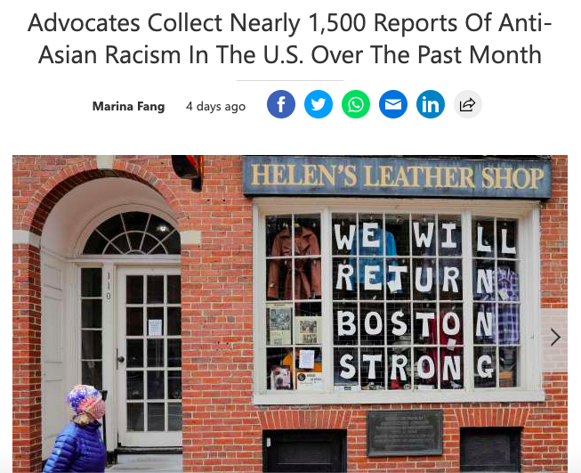
Context

Slide 11
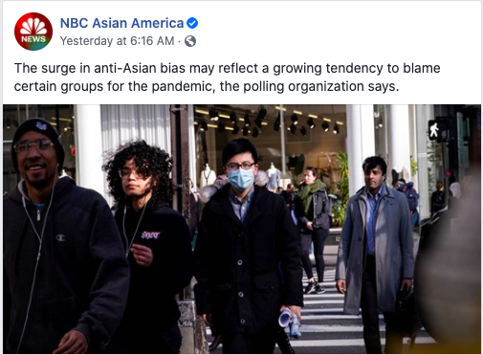
Context

Slide 12
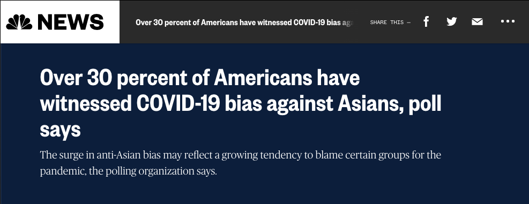
Context

Slide 13
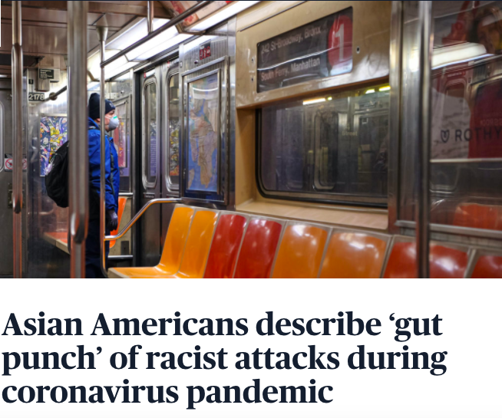
Context

Slide 14
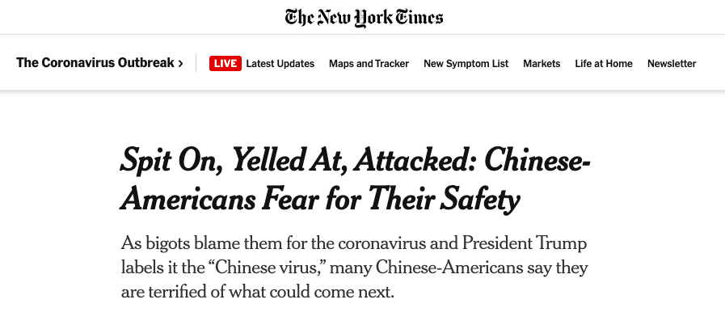
Context

Slide 15
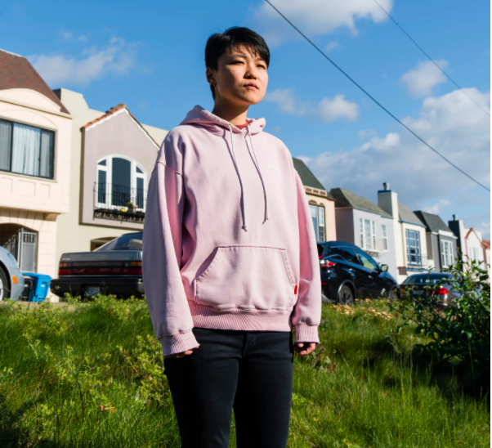
Context

Slide 16
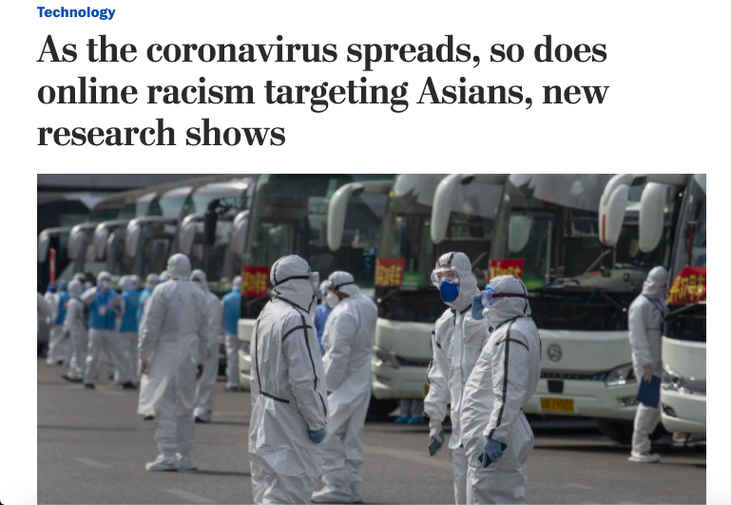
Context

Slide 17
INCIDENTS OF CORONAVIRUS-RELATED DISCRIMINATION REPORT
This report reviews 1,497 reports of coronavirus discrimination submitted on the CAA/A3PCON STOP AAPI HATE website from March 19 - April 15, 2020*.
The following patterns emerged over the course of one month**:
STOP AAPI HATE received 1,497 reports in its first four weeks.
Incidents from California and New York constituted over 58% of all reports.
Civil rights violations involving workplace discrimination and being barred from businesses and transportation or refused service made up almost ten percent of all incident reports.
* A Report for A3PCON and CAA Russell Jeung, PhD and Kai Nham1 San Francisco State University Asian American Studies April 23, 2020. **www.asianpacificpolicyandplanningcouncil.org/wp-content/uploads/STOP_AAPI_HATE_MONTHLY_REPORT_4_23_20.pdf
1 Research assistance provided by Sarah Gowing, Kara Takasaki, Kourtney Nham, Mai Xiong, Bianca Louie, Amelia Navins, and Keri Eason. 2 It was determined from our monthly tabulation of incident reports that a small number were reported to the site more than once. All duplicates were then removed.
Notes:
Paolo/Valerie
“These incidents are part of a long and growing list of anti-Asian xenophobia that has intensified since COVID-19 began to spread outside the borders of mainland China. This is a curve that needs to be flattened, too.”
We should also acknowledge that this isn’t unique to Asians, e.g. discriminating against blacks in china, and vice versa in africa.

Slide 18
INCIDENTS OF CORONAVIRUS-RELATED DISCRIMINATION REPORT
...continued:
44% of incidents took place at private businesses.
AAPI women were harassed 2.3 times more than AAPI men.
Nine percent of respondents were AAPI seniors (over the age of 60).
Reports came from 45 states across the nation and Washington DC.
Even as shelter-in-place policies were implemented across much of the country and AAPIs interacted less with others, the rate of acts of racism remains alarming.
* A Report for A3PCON and CAA Russell Jeung, PhD and Kai Nham1 San Francisco State University Asian American Studies April 23, 2020. **www.asianpacificpolicyandplanningcouncil.org/wp-content/uploads/STOP_AAPI_HATE_MONTHLY_REPORT_4_23_20.pdf
1 Research assistance provided by Sarah Gowing, Kara Takasaki, Kourtney Nham, Mai Xiong, Bianca Louie, Amelia Navins, and Keri Eason. 2 It was determined from our monthly tabulation of incident reports that a small number were reported to the site more than once. All duplicates were then removed.
Notes:
Paolo/Valerie
“These incidents are part of a long and growing list of anti-Asian xenophobia that has intensified since COVID-19 began to spread outside the borders of mainland China. This is a curve that needs to be flattened, too.”
We should also acknowledge that this isn’t unique to Asians, e.g. discriminating against blacks in china, and vice versa in africa.

Slide 19
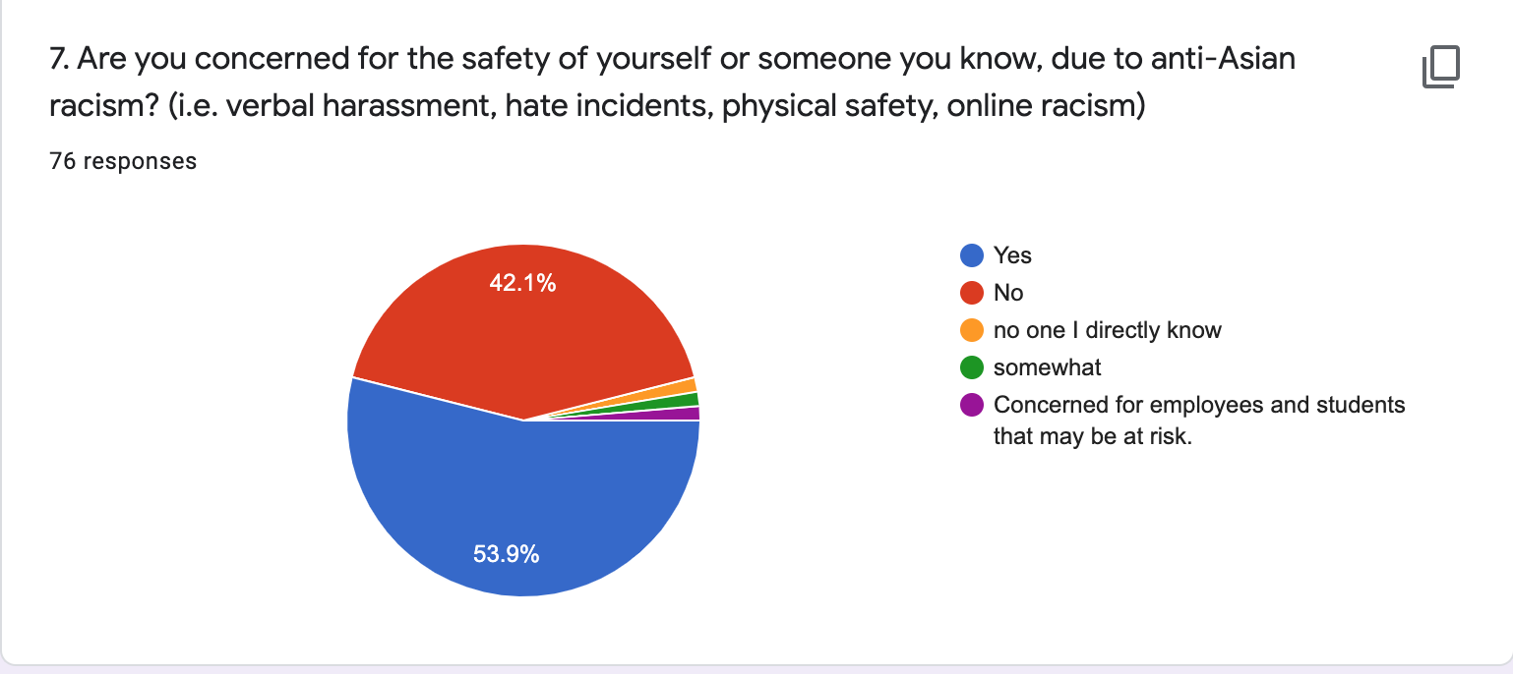
Los Rios API Survey (76 responses)
Notes:
Our aim is to build and share this space to have and engage in courageous and difficult conversations as a means of healing and learning.

Slide 20
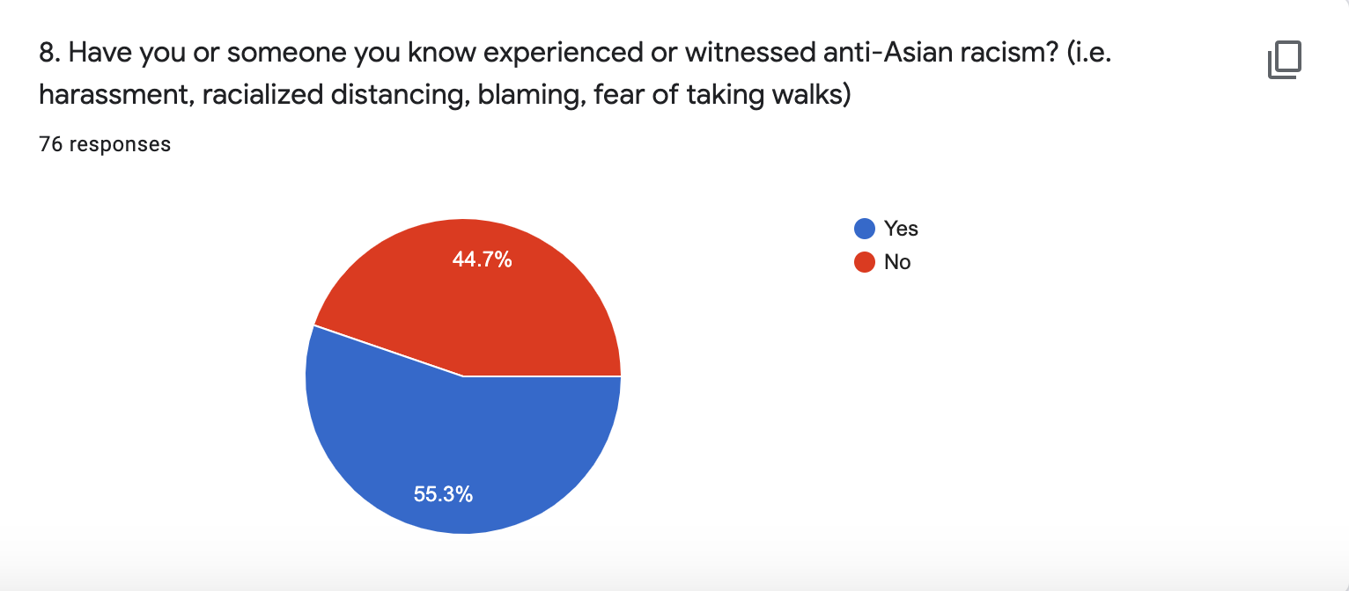
Los Rios API Survey (76 responses)
Notes:
Our aim is to build and share this space to have and engage in courageous and difficult conversations as a means of healing and learning.

Slide 21
Personal Stories
Truth-telling is a form of healing.
To be added to the list, please enter your name in the Zoom Chat to share your story
Notes:
*share survey results if too much silence

Slide 22
How to cope with and heal from Anti-Asian Racism
Self-care tips for Asian Americans
Reach out to friends/peers/colleagues who can validate your experiences too
Pull yourself away from TV and other headlines once in a while
If you have to go to out (e.g. grocery stores) steel yourself
If you’re being discriminated against, put your safety first
Lean into literature written for and by Asians
Remind yourself that this is part of a larger story, and you are not alone

Slide 23
How to support those who have experienced Anti-Asian Racism
Support API students and students of color inside and outside the classroom
Learn more by educating myself, attending webinars, and researching
Plan events or webinars for API Heritage Month (May)
Include curriculum that features API voices, history, and experiences
Intervene when I observe anti-Asian behavior or harassment, if I feel safe to
Report anti-Asian hate incidents or acts of violence, if comfortable
Other (share with group, or via Chat)

Slide 24
Resources
Where to report incidents for each campus:
ARC: Nicolas Daily, Interim Dean of Equity & Inclusion | dailyn@arc.losrios.edu | (916) 484-8163
CRC: Alexander Casareno, Equity Officer | casarea@crc.losrios.edu | (916) 691-7740
FLC: Brian Robinson, Equity Officer | equity@flc.losrios.edu | (916) 608-6752
SCC: Andre V. Coleman, Dean of Campus Interventions | colemaa@scc.losrios.edu | (916) 650-2929
DO: Peter Khang, DO Equal Opportunity Officer |KhangP@losrios.edu | (916) 568-3063
Report any incidents you experience or witness:
https://www.standagainsthatred.org/report
Notes:
(include graphic as part of slides?)
It’s important to keep in mind the most vulnerable and impacted by this.
Taking care of yourself, your friends, and your family can help you cope with stress. Helping others cope with their stress can also make your community stronger.
Everyone reacts differently to stressful situations
How you respond to the outbreak can depend on your background, the things that make you different from other people, and the community you live in.
(People who may respond more strongly to the stress of a crisis include
Older people and people with chronic diseases who are at higher risk for severe illness from COVID-19
Children and teens
People who are helping with the response to COVID-19, like doctors, other health care providers, and first responders
People who have mental health conditions including problems with substance use)

Slide 25
Resources
How to intervene as a bystander:
https://www.ihollaback.org/bystanderintervention/
https://www.ihollaback.org/app/uploads/2016/11/Show-Up_CUPxHollaback.pdf
Notes:
(include graphic as part of slides?)
It’s important to keep in mind the most vulnerable and impacted by this.
We cannot combat this as asian americans alone, which is why it’s important for us to build community together and to be aware of and respond, and challenge anti-Asian incidences of hate and discrimination, as well as those from other vulnerable communities.
Taking care of yourself, your friends, and your family can help you cope with stress. Helping others cope with their stress can also make your community stronger.
Everyone reacts differently to stressful situations
How you respond to the outbreak can depend on your background, the things that make you different from other people, and the community you live in.
(People who may respond more strongly to the stress of a crisis include
Older people and people with chronic diseases who are at higher risk for severe illness from COVID-19
Children and teens
People who are helping with the response to COVID-19, like doctors, other health care providers, and first responders
People who have mental health conditions including problems with substance use)

Slide 26
Questions, Comments, Concerns
Please share your questions, comments and concerns in the Zoom chat provided
Notes:
Jimina

Slide 27
Poll 3: What’s Next?
What actions are you committed to taking next?
Notes:
Rod
We get to shape the narrative of how we respond as a community.
There are varying levels of action we can take, from micro to macro, institutional that can contribute to systemic changes.
As asian american community, we cannot combat this alone, which is why it’s important for us to build community together and to be aware of, respond, and challenge anti-Asian incidences of hate and discrimination, along with those from other vulnerable communities.
In remembering that we are in Solidarity with all people who have been affected by injustices shown by this pandemic:
it is important to continue to show care and support to others who may be experiencing a struggle different than your own
and have the willingness to help others you do not know or is part of a different community other than your own.

Slide 28
Thank you for showing up!
1:30 - 2:00pm
Optional Emotional Support Space
Jimina Afuola - afuolaJ@arc.losrios.edu
Valerie Chueh - ChuehV@flc.losrios.edu
Neue Leung - leungn@arc.losrios.edu
Paolo Soriano - sorianp@crc.losrios.edu
Roderic Agbunag - agbunar@arc.losrios.edu

