Slide 1
Equity Center Presentation
Spring 2021
February 8, 2021
Presented by: Victoire Chochezi, Faculty Coordinator Equity Center
Andrea Fuertes, Student Support Specialist Equity Center
Fénix Lopez and Bindu Mukkamala, Student Assistants Equity Center
Kellie Butler, Dean of Student Services

Slide 2
Land Acknowledgement
& POC History on These Lands
We honor and acknowledge Miwok, Nisenan, and Maidu lands, and the tribal nations whose lands Los Rios Community College District sits on.
We honor and acknowledge early migrant and laboring communities of color who built the foundations of these regional lands.

Slide 3
Black Solidarity Statement
Together we stand in solidarity with our Black community, and our students, faculty, staff, and administrators, to fight against systemic inequity, injustice, and racism, which is resulting in untimely deaths and immense suffering in the Black community.
We understand that in addition to the disproportionate impact of COVID-19 on Black and POC communities, we must address racism and white supremacy within ourselves, our communities, and our colleges.

Slide 4
Community Agreements
1. RESPECT each other
2. SHARE THE SPACE, while centering Black, Indigenous, and Other People of Color (BIPOC), and LGBTQIA+ voices
3. CONFIDENTIALITY. What’s said here, stays here. What’s learned here, leaves here.
4. CONTENT WARNING. Some content that is being shared
may be triggering. Please share a Content Warning if what you share might trigger others.
5. REMOVAL. Those not adhering to the community agreements, will be removed from the forum.

Slide 5
Our Values
FLC champions equity, diversity, social justice, and environmental sustainability as foundational to academic, campus, and community life. We work with the communities we serve toward just and fair inclusion into society in which all people can participate, prosper, and reach their full potential. We commit to equity driven decision-making, planning, and reflective processes that are responsive to the diverse identities and experiences in our community.
Source: https://flc.losrios.edu/about-us/our-values

Slide 6
Equity Center Mission
To build a diverse campus that collectively fosters success through equitable educational opportunities, culturally affirming support, and intersectional inclusion.
Equity Center Proposal Document

Slide 7
Equity Center Priorities
Healing and Wellness, Support, and Education in Solidarity Work
Social Justice & Advocacy
Culturally- Affirming/Responsive Education focused on Student Success
Student Ready Environments
DEI Professional Development
Notes:
Dr. Chochezi
The Equity Center’s work revolves around four priorities based on Zaretta Hammond’s distinctions of Equity featured in a May 20, 2020 KQED article by Armielle Major.
1. Social Justice and Advocacy: The Equity Center addresses the social and political contexts that students experience, to provide and train others in using a critical lens to recognize and eliminate systemic, racist structures in the interest of social justice education.
Culturally-Affirming/Responsive Education focused on Student Success: Using a Culturally Responsive approach, the Equity Center works to eradicate the negative dominant narratives about people of color that often perpetuate negative perceptions and treatment of students of color.
With a focus on student success and accountability of faculty and staff, the Equity Center works with campus partners to acknowledge and combat implicit bias and microagressions that may hinder student success by creating safe spaces for student services targeted to serve our most disproportionately impacted student groups.
Diversity, Equity and Inclusion Education, Training and Professional Development: The Equity Center works to celebrate diversity, creating culturally safe spaces and positive interactions across differences to expose privileged students to multicultural experiences and to reflect the diverse backgrounds of students of color in the curriculum especially to combat anti-Blackness and to effect anti-racist practices.
4.
Student Ready Environment: The Equity Center strives to serve as a student hub on-ground and virtually for disproportionately impacted student groups, and to hold FLC accountable to adapting to a student ready environment instead of expecting students to arrive college ready, since that era has passed and those practices are not aligned with our goals of closing equity gaps. (Adapted from the Town Hall presentation by Dr. Lasana Hotep and Dr. Tia Brown McNair Becoming a Student- Ready College: A New Culture of Leadership for Student Success).
5. Healing and Wellness, Support, and Education in Solidarity Work: Black and other People of Color in predominantly white institutions (PWI’s) are over-taxed to lead and engage in equity work to increase representation and shift culture to close equity gaps. The Equity Center creates spaces and a campus culture that models and promotes self-care, prevents burnout, and encourages Black and People of Color Healing and Wellness as part of racial justice work.

Slide 8
Equity Center Testimonials
I followed your advice and applied for the student emergency fund. And I was approved! I was also approved for Calfresh food stamps (thank god). I also wanted to follow up with you that I was able to contact my Astronomy 300 Professor and we worked out an alternative assignment to help with my lack of access to his program. Thank you for your advice! --FLC Student who self-identified as homeless
This Resource Guide is really great. I received grocery cards today. GREAT TIMING because I didn't get my FAFSA nor unemployment yet. I like the continuity you’re creating. Keep up the good work! --FLC Student
Deep appreciation for all of your work! It is not easy to do this work, but it is important work. Some of the most critical conversations that we need to have as a college started because of you, because this amazing team created the space for these dialogues - something that might not have been possible a few years ago. I hope you continue to be relentless in the pursuit of human dignity. --Molly Senecal, Ed.D

Slide 9
Equity Center Resources
Join our Canvas Course at tinyurl.com/flcequityonline
On Mondays and Wednesdays we have Drop-Ins for Counseling, Clinical Therapy, the WEAVE Advocate and Jobs & Internship Support
Mondays 1:00 - 2:00pm
Wednesdays 3:00 - 4:00pm
Faculty Office Hours with Dr. Victoire Chochezi
Wednesdays 1:00 - 2:00pm
FLC Racial Justice Resources Grid - tinyurl.com/flcracialjusticeresources
Equity Center Basic Needs Resource Grid - tinyurl.com/flcequityresources
The Equity Center is also available by appointment this Spring, Mondays through Thursdays. Email Andrea Fuertes at FuerteA@flc.losrios.edu

Slide 10
PEAC²E Program
Peer Engagement for Achievement, Culture, Connection, and Excellence
New PEAC²E Program
FLC’s new program designed to provide an enhanced educational experience for the college’s Black, Indigenous, and People of Color (BIPOC) communities
Learn More at the PEAC²E Website:
https://flc.losrios.edu/student-resources/support-services/peer-engagement-for-achievement-culture-connection-and-excellence-(peac2e)

Slide 11
PEAC²E Program
Peer Engagement for Achievement, Culture, Connection, and Excellence
New PEAC²E Program
Initial implementation will focus on first year Black/African American students then we’ll expand to LatinX, Native American, Asian Pacific Islanders, etc.
Purpose of the program is to: Foster community, Student engagement and Connection and Provide resources and support services to ensure student success and completion
The PEAC²E Program will live in the Equity Center as part of Soar to Success Case Management

Slide 12
FALCONCARES
Basic Needs Program
Information about FALCONCARES and Basic Needs Resources
Falcon Cares Website
https://flc.losrios.edu/student-resources/remote-campus-information-for-students/basic-needs-resources
Welcome Student Success Center: FLC Basic Needs Survey
Technology Needs
Emergency Housing
Food Distribution
Remote Campus Information (Technology, Support Services and Basic Needs)
https://flc.losrios.edu/student-resources/remote-campus-information-for-students
Emergency Funding
CARES Emergency Funding: https://foundation.losrios.edu/students-and-alumni/students-get-support/apply-for-cares-emergency-fund
Los Rios Foundation Funding: https://foundation.losrios.edu/students-and-alumni/apply-for-student-emergency-fund

Slide 13
FALCONCARES
Basic Needs Program
Resources to Share with Students
Welcome & Student Success Center
Contact by phone (916) 608-6702 or email FLC-WelcomeCenter@flc.losrios.edu
Hours of Operation: Monday-Thursday: 8:00 am to 8:00 pm and Friday: 8:00 am to 5:00 pm
Basic Needs Survey
Student Services at a Glance: What You Need to Know for Spring 2021
https://tinyurl.com/Student-Services-Spring21
Falcon Cares Basic Needs Canvas Resource Page
Login to Canvas: https://lrccd.instructure.com/
https://lor.instructure.com/resources/0cb53598cb7941c387f2b405cd4252fd?shared

Slide 14
FALCONCARES
Basic Needs Program
Health and Wellness Resources
https://flc.losrios.edu/campus-life/health-and-safety/health-and-wellness-services and also https://docs.google.com/document/d/14IT279A_EWQDhrBhXtGdP8WB5S5Yh87TzVfOLv3v8NU/edit
Campus.Health by TimelyMD (free online medical and mental health services for Los Rios students) https://flc.losrios.edu/campus-life/health-and-safety/health-and-wellness-services/campushealth-by-timelymd
Mental Health: Make an appointment with our licensed therapist, Dr. Jackson, call Counseling at (916) 608-6510
More Mental Health Resources Available
https://flc.losrios.edu/campus-life/health-and-safety/health-and-wellness-services/mental-health-support
WEAVE Confidential Advocate (Support and Information for those who’ve experienced sexual harassment or violence)
https://flc.losrios.edu/campus-life/health-and-safety/sexual-violence-and-title-ix/weave-confidential-advocate

Slide 15
Spring 2021 Equity Center
Events Collaboration
How can we help/support your equity related events?
In the past we have provided the following:
think tank/brainstorm
support with marketing/spreading the word
student perspective or feedback through EC student assistants
logistical support (potential funding, processing of funding etc.)
Complete our Equity Center Collaboration Request Form: bit.ly/ECEventForm

Slide 16
Equity Center Contact Information
flc-equitycenter@flc.losrios.edu
(916) 608-6869
Equity Center Facebook
Equity Center Twitter
Equity Center Instagram

Slide 18
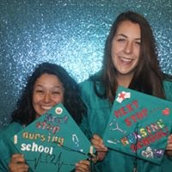
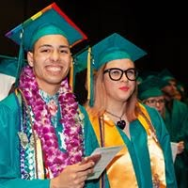
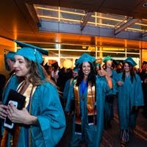
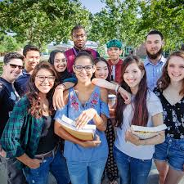
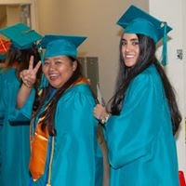
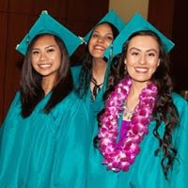
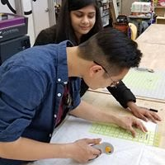
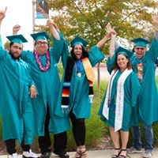
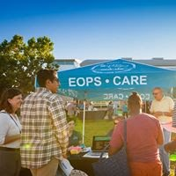
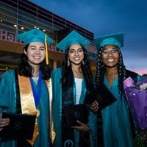
THANK YOU

