Slide 1
Welcome to the
Equity Center
Presented by Fénix, Trajan and Bindu
Notes:
hi

Slide 2
Introductions

Slide 3
Land Acknowledgement
We honor and acknowledge Miwok, Nisenan, and Maidu lands, and the tribal nations whose lands Los Rios Community College District sits on.
We honor and acknowledge early migrant and laboring communities of color who built the foundations of these regional lands.
Notes:
https://native-land.ca/

Slide 4
Black Solidarity Statement
Together we stand in solidarity with our Black community, and our students, faculty, staff, and administrators, to fight against systemic inequity, injustice, and racism, which is resulting in untimely deaths and immense suffering in the Black community.
We understand that in addition to the disproportionate impact of COVID-19 on Black and POC communities, we must address racism and white supremacy within ourselves, our communities, and our colleges.

Slide 5
Community Agreements
RESPECT each other
SHARE THE SPACE
CONFIDENTIALITY. What’s said here, stays here. What’s learned here, leaves here.
CONTENT WARNING. Some content that is being shared may be triggering. Please share a Content Warning if what you share might trigger others.
REMOVAL. Those not adhering to the community agreements, will be removed from the forum.

Slide 6
EQUITY CENTER
Notes:
Can briefly show EC website here

Slide 7
Our Mission Statement
To build a diverse campus
that fosters success through
equitable educational opportunities, culturally relevant support,
and intersectional inclusion.

Slide 8
Why Equity Center?
Build community, get engaged, collaborate with equity-minded students, staff, faculty, admin
Attend events, workshops, and trainings
Provide confidential spaces and refer students who need support
Drop-In Counseling with Lishia Rahman and Kou Yang
Health and Wellness with Mary Hansen, College Nurse
Licensed Psychologist, Dr. Tameka Jackson
Jobs and Internship Support
Faculty Office Hours with Dr. Victoire Chochezi
Help improve campus climate and reach equity-related goals

Slide 9
We invite you to our Canvas Course!
To join the Canvas course and receive weekly announcements that include Zoom links and passwords to access upcoming events, workshops, Drop-In Partners, and potential changes to our weekly schedule, email your full name and w ID number to lopeza@flc.losrios.edu with the subject "Join Canvas". Be sure to "accept" the course invitation!
Notes:
Screenshare Canvas Page, show this week’s announcement

Slide 10
Equity 101

Slide 11
Equality
What is your definition of equality?

Slide 12
Equity
What is your definition of equity?

Slide 13
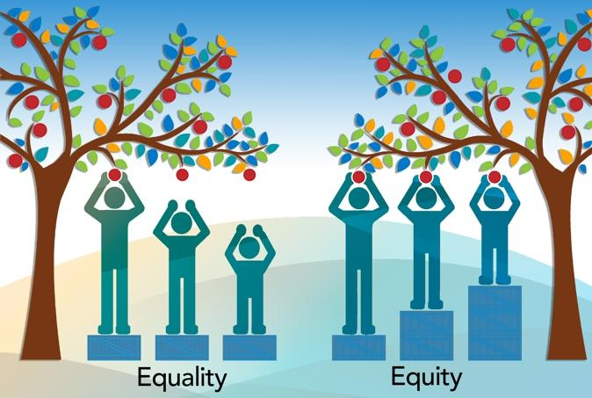
Why Equity?

Slide 14
Why Equity?
Notes:
Equity is the Pathway to Equality

Slide 15
Equity Mindset
Evidence Based: Routinely examine disaggregated data; resist the urge to lean on assumptions
Race Conscious: Be aware of historical and social contexts affecting different racial groups; resist the urge to be “color-blind” or focus only on separate circumstances (e.g. “low income”)
Institutionally Focused: Understand the power you and your college have to make change; resist “deficit” thinking (e.g., “some students just don’t care” or “students just aren’t prepared”)
Systemically Aware: Understand how current inequities are related to larger structural inequities, past and present; resist the urge to assume our students are immune
Equity Advancing: Be action-oriented and feel empowered to take action towards closing equity gaps; resist the urge to assume someone else is responsible
As students, you can make a difference in the experience of your fellow classmates!
Notes:
Switch to Emelia’s slides

Slide 16
What is Cultural Competence?
The combination of knowledge, understanding, and skills pertaining to cultural differences and diversity.
Identities include: race, language, gender identity and expression, sexual orientation, socioeconomic class, disability, citizenship status, military status. And many more.

Slide 17
Benefits of Cultural Competence
Improves student recruitment, experience, retention, and completion rates
Expedited enrollment, Improved reputation in the community
Adherence to the FLC Equity Statement/Mission/Vision

Slide 18
Cultural Competency Dos & Don’ts
Situation | Dos | Don’ts
Restroom | Share location of men’s, women’s and gender neutral restrooms when asked. | Assume which gendered restroom they use.
Pronouns/Name | Ask for pronouns/preferred names. When in doubt, just ask! Introduce self with pronouns. | Guess pronouns based off appearance.
Accents/Language Barriers | Be patient. It is okay to ask them to repeat or clarify. Ask them to write down if you can't understand in either English or native language. Use Google translate. Seek someone to assist in translation if possible (refer to translator list). Walk them to the location they need instead of giving directions. | Speak louder or slower. Assume they don’t know what they are asking for. Show frustration.

Slide 19
Cultural Competency Dos & Don’ts
Situation | Dos | Don’ts
Citizenship Status/ Undocumented Students | Keep confidentiality. Respect their privacy. Speak in private or quietly. Keep information amongst those who need to know. | Speak loudly. Assume they are out about their status (non-resident, AB 540, Dream Act).
Socioeconomic Class | Keep information regarding Food Pantry visible in your office. Refer students to available resources. | Assume all our student’s have class privilege.

Slide 20
Call Out v. Call In
How to address problematic behavior and language in the moment?
Promote hard to have discussions “I know you might feel uncomfortable --I need to communicate something with you about the language you just used”
Can model allyship by saying ““Hi I just overheard what you were saying. I might not identify as LGBTQ+ but I do find that language offensive. I know you might not have meant it that way, but it doesn’t align with our college values.”

Slide 21
R.A.V.E.N.
https://diverseeducation.com/article/176397/

Slide 22
Scenarios

Slide 23
Scenario 1
You hear someone referring to a classmate with the wrong pronoun. How do you respond? What resources and support would be helpful?

Slide 24
Scenario 2
In an online discussion forum, a student is using ableist language (i.e. using dumb/lame/deaf/blind as insults). How do you respond? What resources and support would be helpful?

Slide 25
Scenario 3
Your friend experienced a hate incident and was called a freak and the f-word. How do you respond? What resources and support would be helpful?

Slide 26
Scenario 4
A student wearing a Black Lives Matter t-shirt is
confronted with another student who said “All Lives Matter.” How do you respond? What resources and support would be helpful?

Slide 27
Upcoming Events

Slide 28
Post Election Campus Forum
Black Student Support Group
Facilitated by Professor Deanne Repetto
Thursday, November 5
12:00-1:00pm
With Dr. Tameka Jackson, Licensed Psychologist
Thursday, November 5
12:00-1:00pm

Slide 29
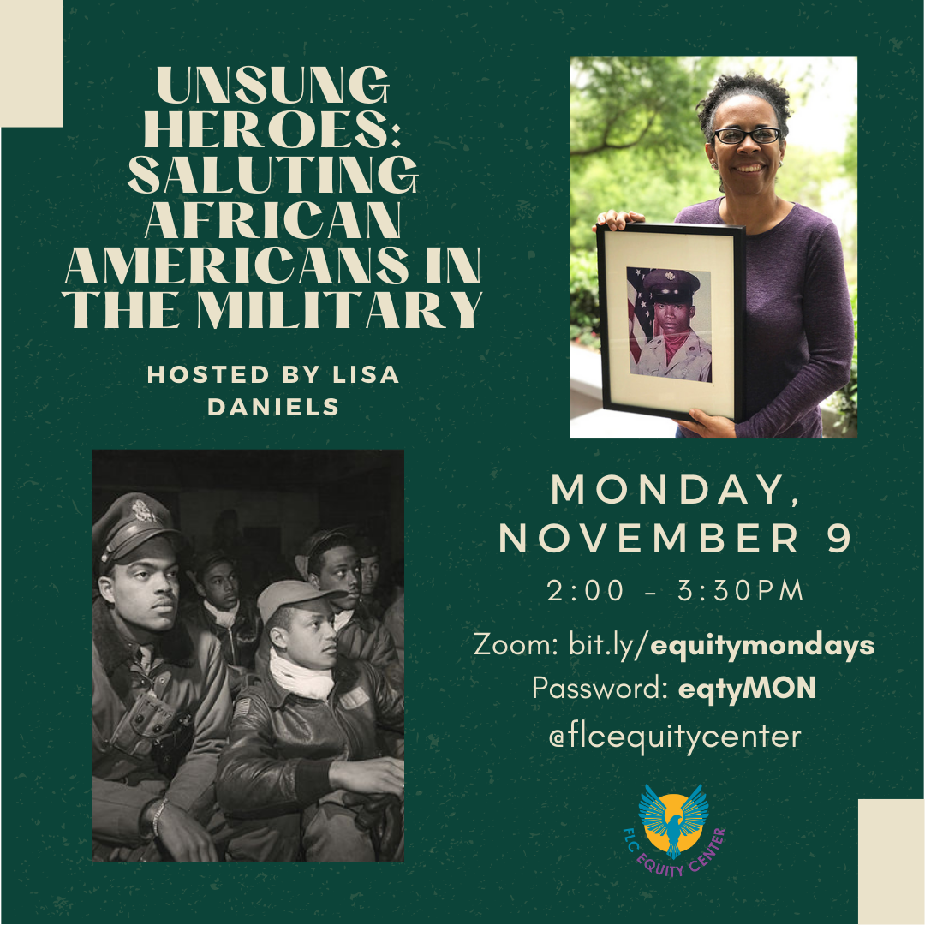

Slide 30
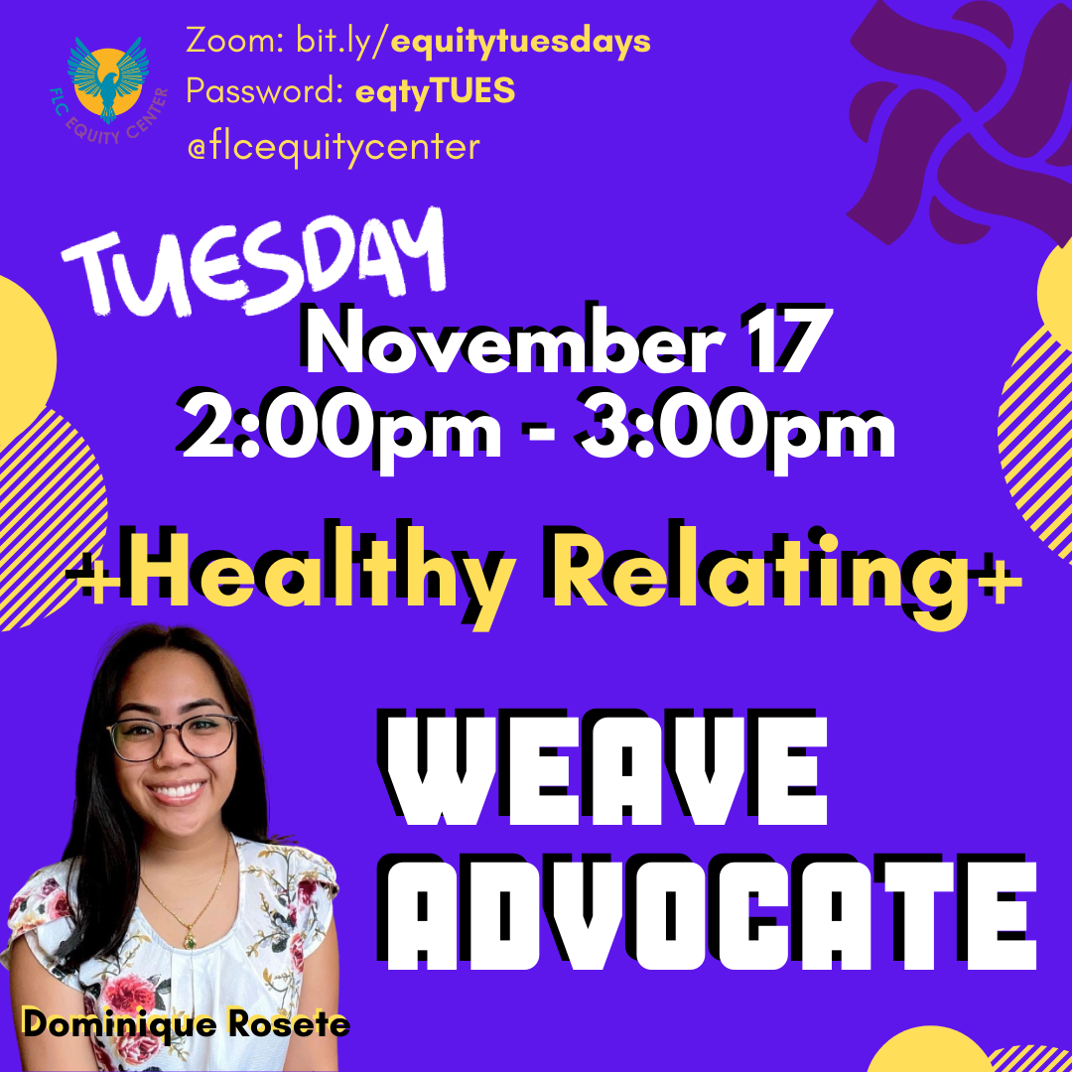

Slide 31
Thank you!
Questions?

