Slide 1
How To Prevent Burnout
Hosted by the Equity Center

Slide 2
What is Burnout?
Burnout is a state of emotional, physical, and mental exhaustion caused by excessive and prolonged stress. It occurs when you feel overwhelmed, emotionally drained, and unable to meet constant demands. As the stress continues, you begin to lose the interest and motivation that led you to take on a certain role in the first place.
Burnout reduces productivity and saps your energy, leaving you feeling increasingly helpless, hopeless, cynical, and resentful. Eventually, you may feel like you have nothing more to give.

Slide 3
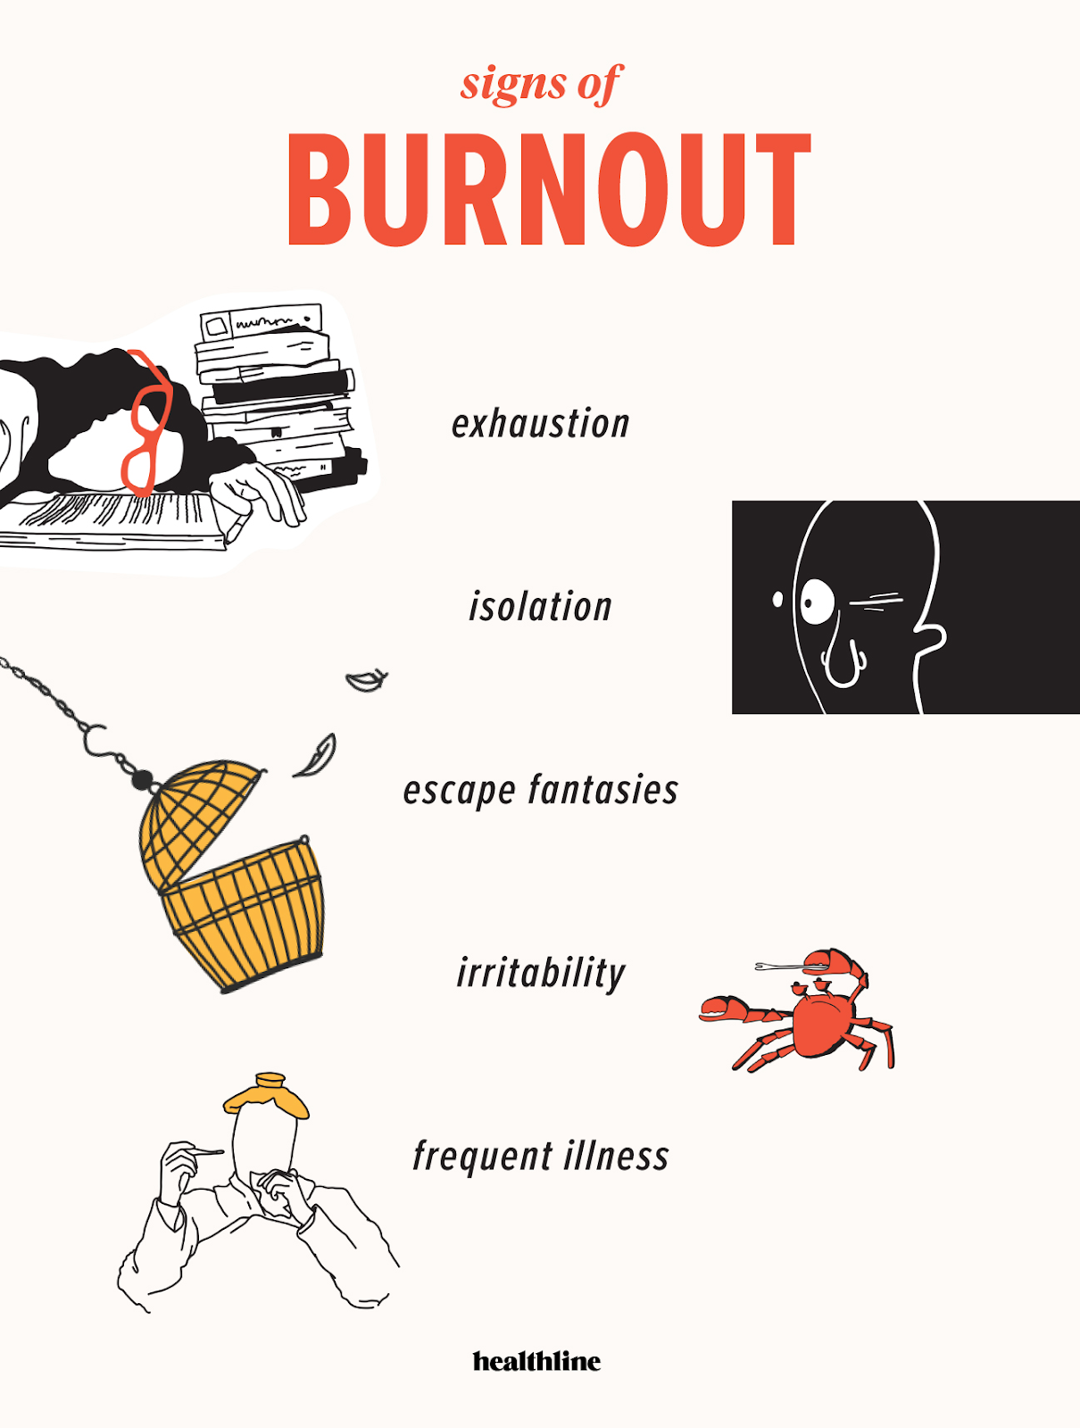
Recognizing Signs of Burnout
Having a negative and critical attitude at work.
Having low energy, and little interest at work.
Having trouble sleeping.
Being absent from work a lot.
Having feelings of emptiness.
Experiencing physical complaints such as headaches, illness, or backache.
Being irritated easily by team members or clients.
Having thoughts that your work doesn't have meaning or make a difference.
Pulling away emotionally from your colleagues or clients.
Feeling that your work and contribution goes unrecognized.
Blaming others for your mistakes.
You're thinking of quitting work, or changing roles.
Notes:
Exhaustion. Feeling physically and emotionally depleted. Physical symptoms may include headaches, stomachaches, and appetite or sleeping changes.
Isolation. People with burnout tend to feel overwhelmed. As a result, they may stop socializing and confiding in friends, family members, and co-workers.
Escape fantasies. Dissatisfied with the never-ending demands of their jobs, people with burnout may fantasize about running away or going on a solo-vacation. In extreme cases, they may turn to drugs, alcohol, or food as a way to numb their emotional pain.
Irritability. Burnout can cause people to lose their cool with friends, co-workers, and family members more easily. Coping with normal stressors like preparing for a work meeting, driving kids to school, and tending to household tasks also may start to feel insurmountable, especially when things don’t go as planned.
Frequent illnesses. Burnout, like other long-term stress, can lower your immune system, making you more susceptible to colds, the flu, and insomnia. Burnout can also lead to mental health concerns like depression and anxiety.

Slide 4
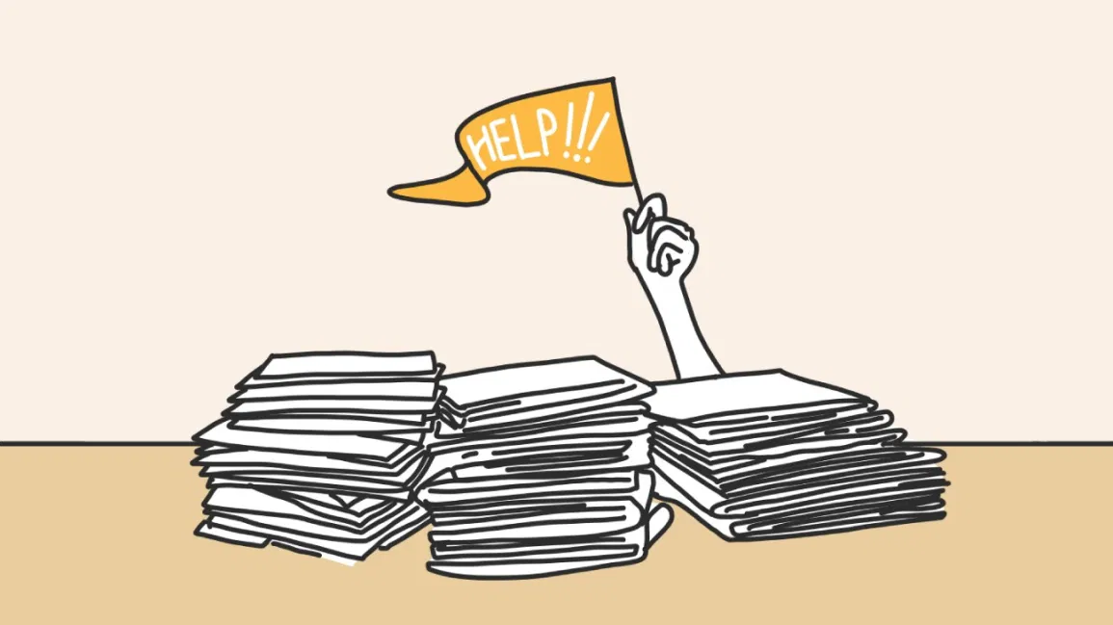
Dealing with Burnout
Dealing with burnout requires the “Three R” approach:
Recognize. Watch for the warning signs of burnout.
Reverse. Undo the damage by seeking support and managing stress.
Resilience. Build your resilience to stress by taking care of your physical and emotional health.

Slide 5
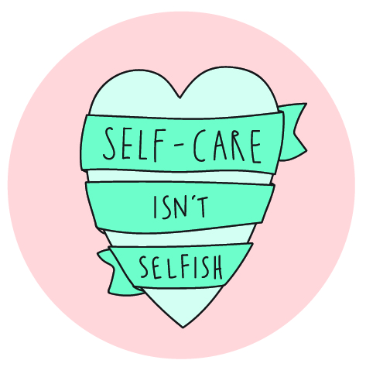
Dealing with Burnout Continued...
Normalize saying “no”
Make time for yourself
Allow yourself to heal
Remember that you are one person
Notes:
Take a vacation and Unplug
Forget Balance, and find harmony
Reevaluate your priorities
Know your breaking point
Fill your day with joy, do something for yourself
Schedule free time
Change your environment
Meditate

Slide 6
Positive Affirmations

Slide 7
Thank you.

