Slide 1
Welcome to the
Equity Center
Presented by Andrea Fuertes, Bindu, Fénix, Jaskirat
Notes:
Andrea

Slide 2
INTRODUCTIONS
Notes:
All

Slide 3
Land Acknowledgement
We respectfully acknowledge the land currently occupied by Folsom Lake College as the traditional home of the sovereign Nisenan, Maidu and Miwok peoples who have a unique and enduring relationship stewarding this land since time immemorial. Despite colonization, occupation and genocide, the Nisenan, Maidu and Miwok people continue and thrive in their resilience and self-determination. We celebrate and recognize our Nisenan, Maidu and Miwok tribal neighbors and honor their sustained existence.
We honor and acknowledge early migrant and laboring communities of color who built the foundations of these regional lands.
Notes:
https://native-land.ca/
Andrea

Slide 4
Black Solidarity Statement
Together we stand in solidarity with our Black community, and our students, faculty, staff, and administrators, to fight against systemic inequity, injustice, and racism, which is resulting in untimely deaths and immense suffering in the Black community.
We understand that in addition to the disproportionate impact of COVID-19 on Black and POC communities, we must address racism and white supremacy within ourselves, our communities, and our colleges.
Notes:
Andrea

Slide 5
Asian Pacific Islander Solidarity Statement
Recent events have sadly once again highlighted the pervasiveness of white supremacist ideology, racism and xenophobia in California and nationwide. Americans of Asian or Pacific Islander (AAPI) ancestry share a tragic history of discrimination, racelighting, and violence with our Black, Indigenous, and other people of color allies. The recent murders in Atlanta are a heartbreaking reminder.
We stand in solidarity with our AAPI community, and call to end the hate that produces violence, division, and destruction. FLC Equity Center will continue to work as it says in our mission, to create a welcoming, non-judgmental environment where our campus community can learn together on how to better support our disproportionately impacted (DI) groups.
Notes:
Andrea

Slide 6
EQUITY CENTER
Notes:
Can briefly show EC website here

Slide 7
Our Mission Statement
To build a diverse campus
that fosters success through
equitable educational opportunities, culturally relevant support,
and intersectional inclusion.
Notes:
Andrea

Slide 8
Equity Center: Services
Build community, get engaged, collaborate with equity-minded students, staff, faculty, admin
Facilitate events, workshops, and trainings
Provide confidential spaces and refer students who need support
Help improve campus climate and reach equity-related goals
Weekly Drop-In Support
Academic Counseling: rotation of FLC Academic Counselors
Mental Health Support: Licensed Psychologist, Dr. Tameka Jackson
Jobs and Internship Support: Julie Collier and Ashley Slovak
Faculty Coordinator/Office Hours: Dr. Victoire Chochezi
Notes:
Andrea

Slide 9
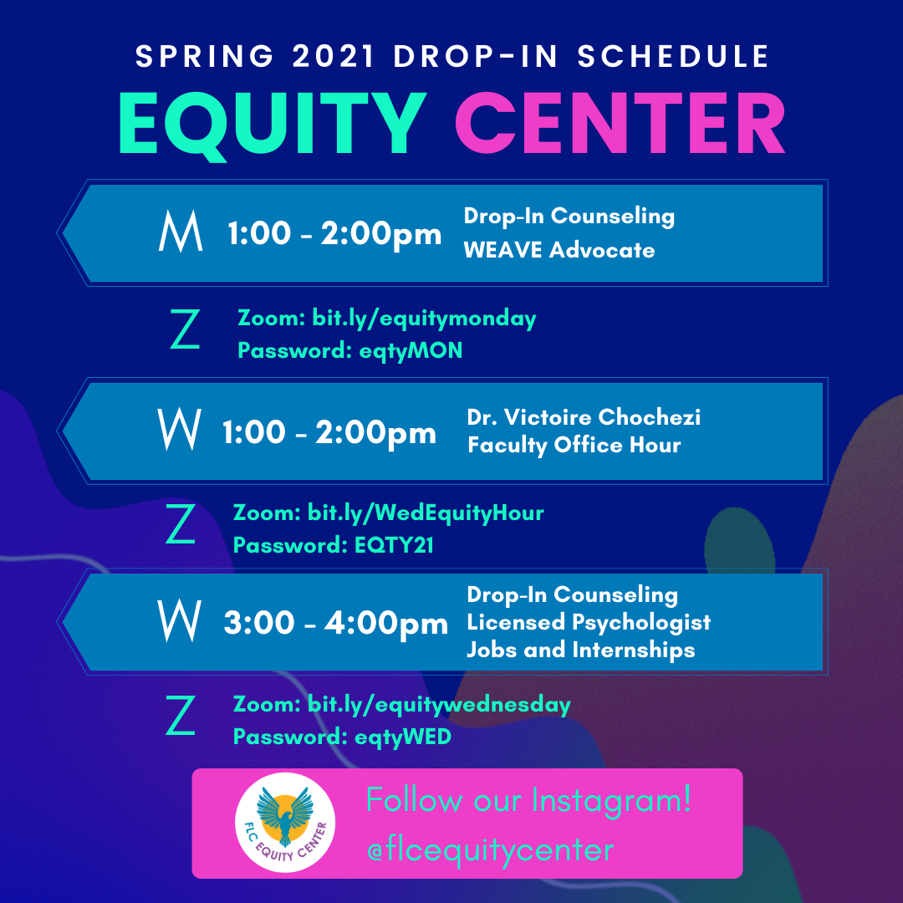
Notes:
Andrea

Slide 10
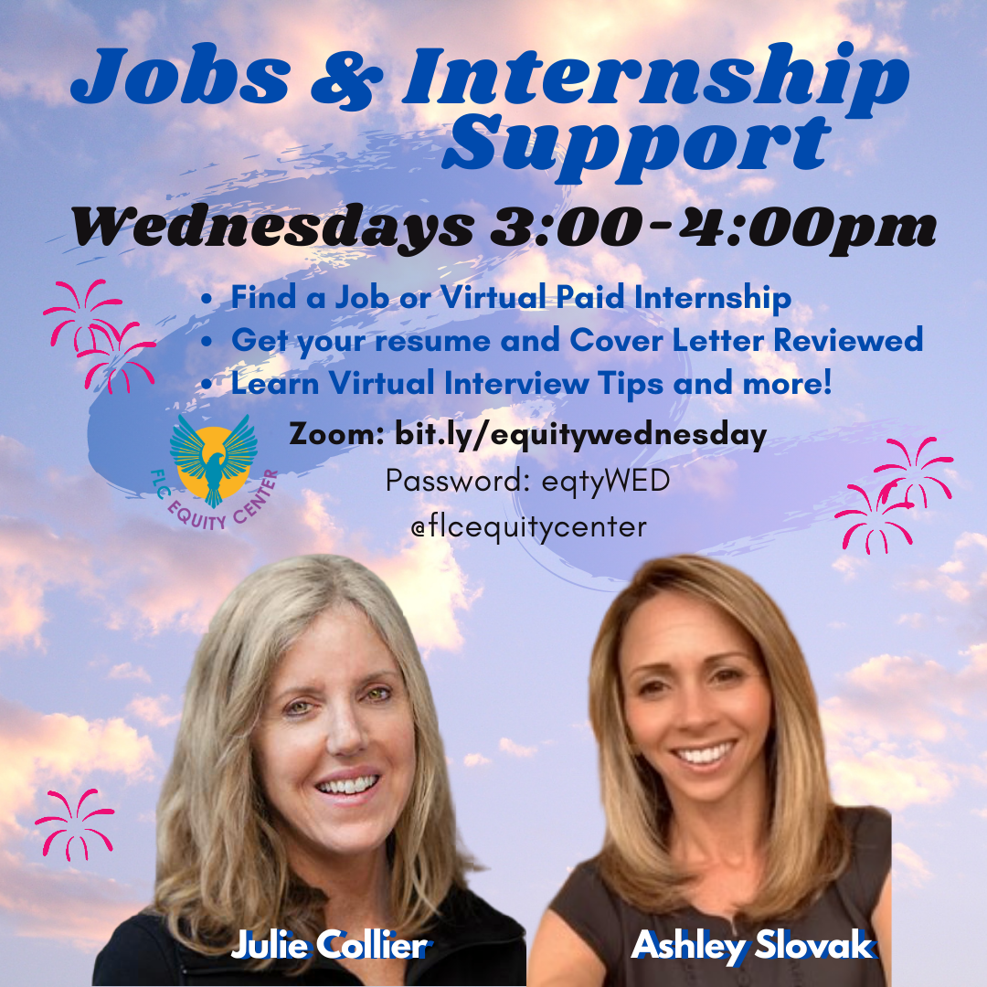

Slide 11
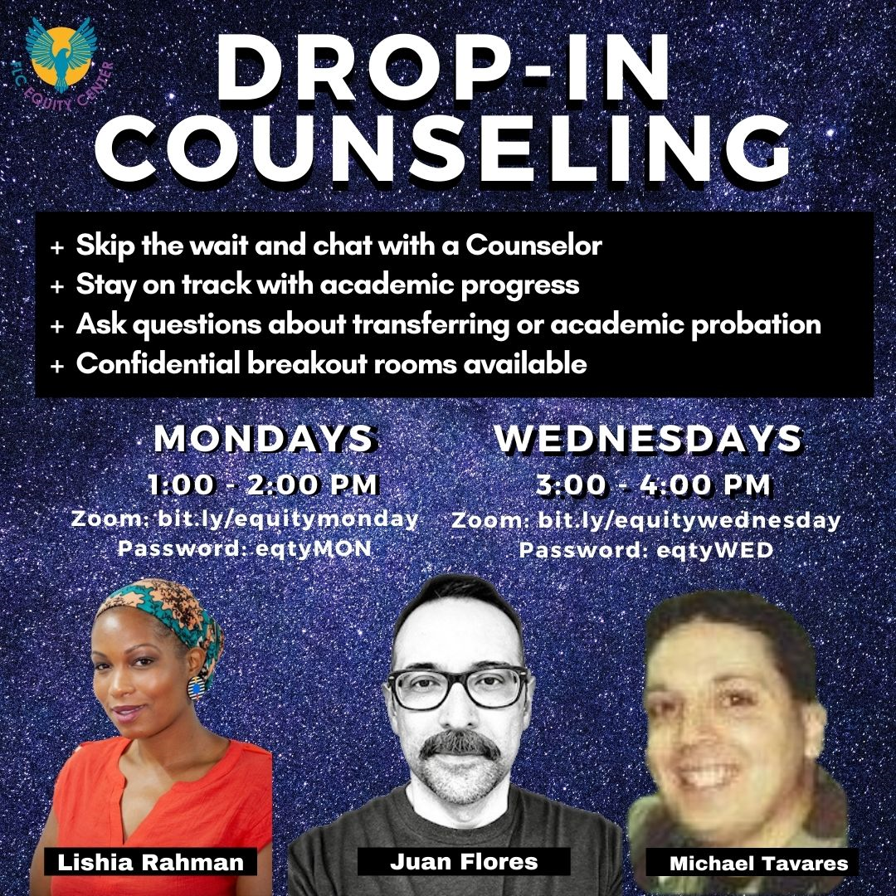

Slide 13
We invite you to our Canvas Course!
To join the Canvas course and receive weekly announcements that include Zoom links and passwords to access upcoming events, workshops, Drop-In Partners, and potential changes to our weekly schedule, email your full name and w ID number to lopezf@flc.losrios.edu with the subject "Join Canvas". Be sure to "accept" the course invitation!
Notes:
Fenix

Slide 14
TRANGENDER RIGHTS AND ADVOCACY
Notes:
Andrea

Slide 15
Community Agreements
RESPECT each other
SHARE THE SPACE
CONFIDENTIALITY. What’s said here, stays here. What’s learned here, leaves here.
CONTENT WARNING. Some content that is being shared may be triggering. Please share a Content Warning if what you share might trigger others.
BROKEN AGREEMENTS. Those not adhering to the community agreements, will be removed from the forum.
Notes:
Andrea

Slide 16
Anti-transgender legislation
Texas SB 1311
Provision of professional liability insurance coverage for gender transition or gender reassignment medical procedures and treatments for certain children
South Carolina HB 407
An anti- transgender medical care ban that prohibits the performance of a medical procedure or the prescription or issuance of medication, to a minor that is intended to alter the appearance of the minor’s gender or delay puberty.
Notes:
Jas
Helpful ways to be educated and be aware of these filed legislations
@translawcenter on Instagram
https://freedomforallamericans.org/legislative-tracker/anti-transgender-legislation/
@pinkmantaray, @thejeffreymarsh, @thechrismosier, #transgenderrights

Slide 17
Anti-transgender legislation continued..
Michigan SB 218
An anti- transgender sports ban, if a school designates a team in a interscholastic athletic activity offered to kids enrolled at the school as a girls’, women’s’ or female team, a requirement is that each person who is selected to compete on that team must be female based on biological sex. The same applies for males.
Arkansa HB 1570
The most extreme anti-trans law yet; bans doctors from providing any form of gender-affirming healthcare to transgender people under the age of 18. This bill makes Arkansas the first state to make such treatment illegal
Introduced in February this year. House passed the bill on March 10th which then went to the Arkansas Senate. The Senate passed the bill on March 29th. Governor Asa Hutchinson vetoed the bill on April 5th, saying that it would “set new standards of legislative interference”. The next day, the state legislature overrode the governor's veto allowing the bill to pass.
Notes:
Jas
Helpful ways to be educated and be aware of these filed legislations
@translawcenter on Instagram
https://freedomforallamericans.org/legislative-tracker/anti-transgender-legislation/
@pinkmantaray, @thejeffreymarsh, @thechrismosier, #transgenderrights

Slide 18
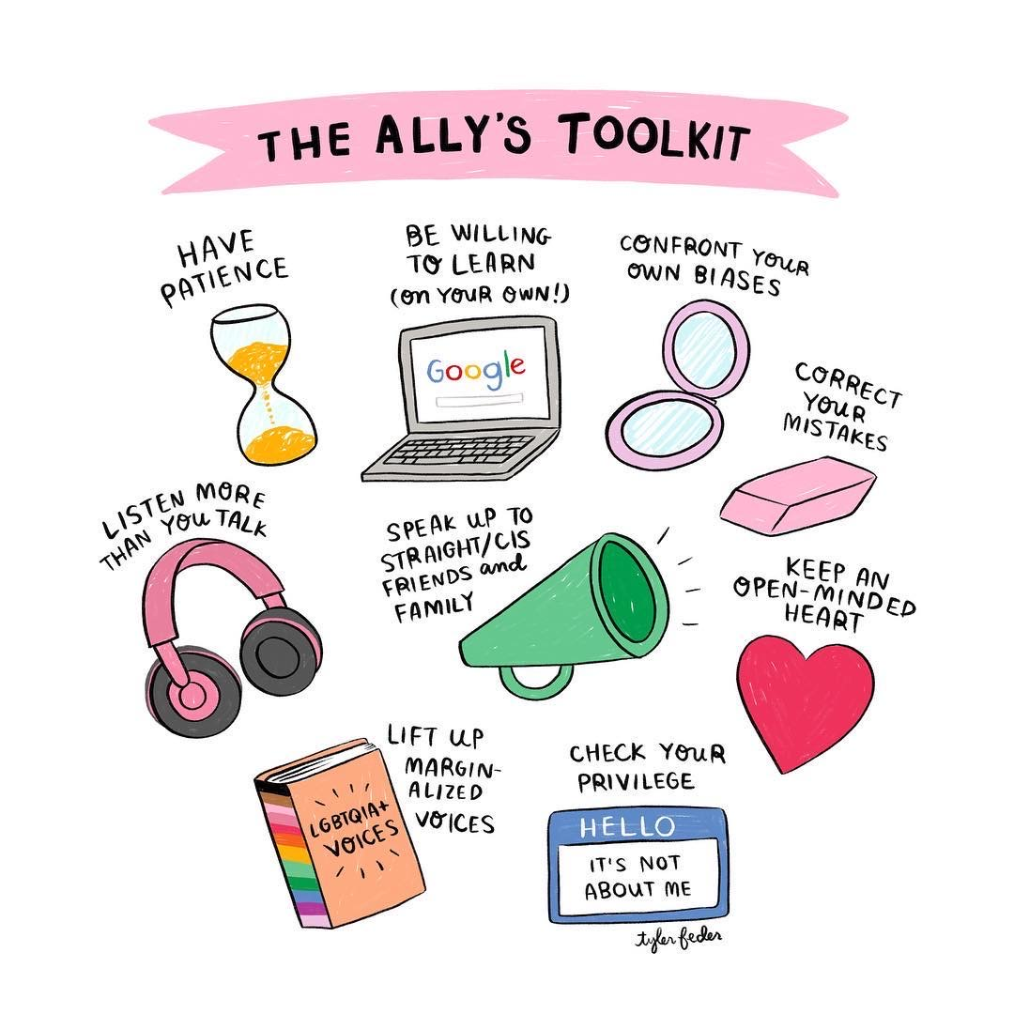
Tool Kits and Educational Resources
Notes:
Bindu
Learn about policies that affect trans athletes: https://www.transathlete.com/
Schuyler Bailar, trans rights activist: http://pinkmantaray.com/links

Slide 19
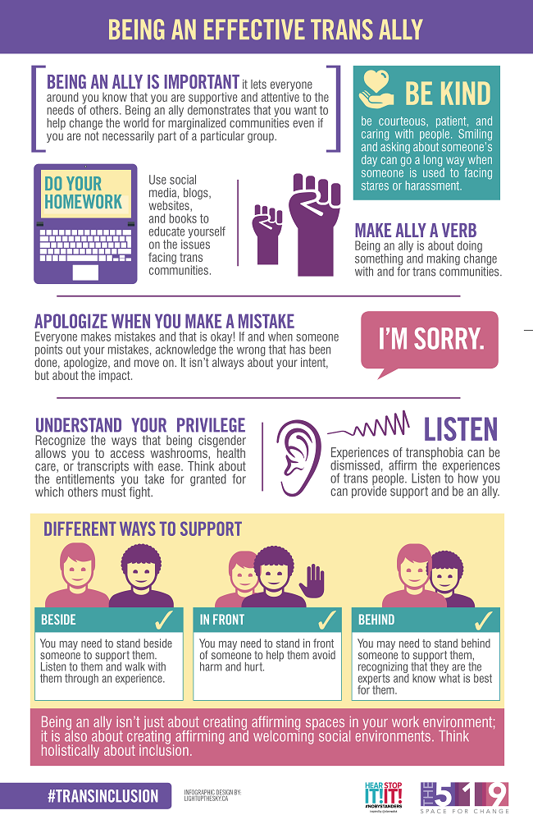
Tool Kits and Educational Resources
Notes:
Bindu
Learn about policies that affect trans athletes: https://www.transathlete.com/
Schuyler Bailar, trans rights activist: http://pinkmantaray.com/links

Slide 20
Tool Kits and Educational Resources
Website & Articles to Learn How To Be An Effective Trans Ally:
The 519 Guide To Be An Effective Trans Ally
Human Rights Campaign & Transgender Advocacy
Trans Rights Activist - Schuyler Bailar’s Website
How To Be A Trans Ally
National Center For Transgender Equality
Resources For Trans Inclusion in Athletics
Action Tips for Allies of Trans People
FAQ About Trans & Nonbinary People
General LGBTQ+ Ally Toolkit
Notes:
Bindu
Learn about policies that affect trans athletes: https://www.transathlete.com/
Schuyler Bailar, trans rights activist: http://pinkmantaray.com/links

Slide 21
Social Media Pages To Follow
Instagram Pages:
@pinkmantaray
@chnge
@impact
@translawcenter
Notes:
Bindu

Slide 22
Actions You Can Take
The most common ways to take action when it comes to legislation is to
Sign petitions that organizations have started
Contact (via phone/email) the lawmakers (representatives, governor, senators, etc.) of that state and voice your concerns.
As this option, though extremely helpful, is intimidating for many people, leading advocates and organizations typically have pre-filled emails and messages you can send if you’d like to help but are not sure where to start.
Important: When using these pre-written options, you should read what you are sending and make slight edits to personalize your email so it is not filtered out as spam when sent.
Donate to organizations and people who are already actively advocating
Notes:
Fenix

Slide 23
Petitions/Phone Calling/Emails
Support the Equality Act with HRC
Calling/emailing congress members, signing petition to support Equality act
Actions to Support Trans Athletes
Lists all current anti-trans athlete bills and possible actions
Scripts for Contacting Senators
Provides numbers and scripts for contacting senators
Actions to Support Trans Youth
Equality Act, email templates, educational resources
Notes:
Fenix

Slide 24
Donating to Advocates
The Trevor Project
Leading national organization providing crisis intervention and suicide prevention services to LGBTQ
Human Rights Campaign
Strives to end discrimination against LGBTQ people and realize a world that achieves fundamental fairness and equality for all
Trans Justice Project
A community-led funding initiative founded in 2012 to support grassroots, trans justice groups run by and for trans people.
Notes:
Fenix

Slide 25
Upcoming Events
How to Ground Yourself: Even When Things are Falling Apart
Wednesday, April 21st from 3:30-5:00pm
Zoom link: bit.ly/ECmentalhealth
Open Mic: Change the Narrative - Joy and Gratitude in Trying Times
Friday, April 30th from 12:00-1:30pm
Zoom link: bit.ly/losriosopenmic
Upstander Training
Tuesday, May 4th from 3:00-4:00pm
Zoom link: bit.ly/FLCUpstander
Notes:
Jas

Slide 26
Thank you!
Questions?
Notes:
Andrea

Slide 27
Equity Center Contact Information
flc-equitycenter@flc.losrios.edu
(916) 608-6589
Equity Center Facebook
Equity Center Twitter
Equity Center Instagram
Notes:
Andrea

